Slide 1

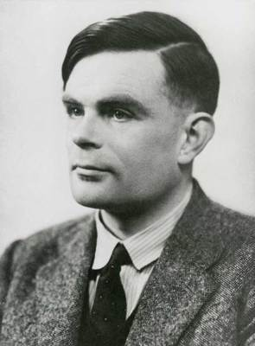
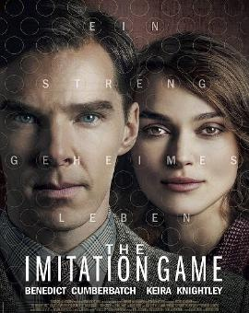
Alan Turing
—— Mystery Solver of riddles
The Imitation Game
Mathematician
Logician
The father of computer science and artificial intelligence

Slide 2
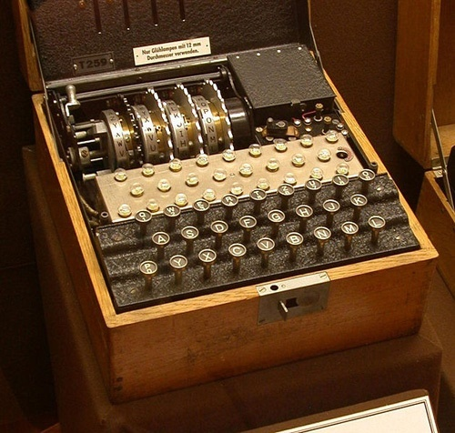
A powerful message encryption（加密方式）——Enigma
Create a machine
Broke the Enigma
Mastered（掌握） the Germans
Battle of Midway Island Normandy Landing
Homosexual
Broke the law
Enforced the government-mandated hormonal therapy （强制执行政府的激素疗法）

Slide 3
Video

Slide 4

After a year of government-mandated hormonal therapy , Alan Turing suicided（自杀）on June 7th 1954. He was only 41 years old.
Turing was being persecuted（迫害）just because he was homosexual, which ruined his career.
Historians estimate （估计） that breaking Enigma shortened the war by more than two years , saving over 14 million lives.
In 2013 , queen Elizabeth Ⅱ granted（授予） Turing a posthumous royal（皇家的） pardon （赦免）, honoring his unprecedented（空前的）achievements.
Turing’s work inspired （启发）generations of research into what scientists called “Turing Machines”.
Today , we call the COMPUTERS.

Slide 5
Turing , the decryption master, eventually lose to his inner mystery . Was he a criminal? Was he a hero? We can't judge . But his life is really unspeakable.
Pay tribute to Alan

Slide 6
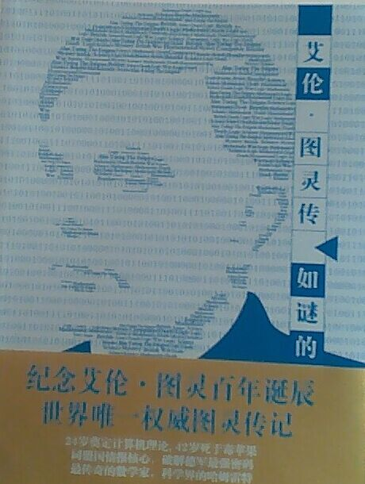
One more thing......

