Slide 1
Unit 3 Under the sea

Slide 2
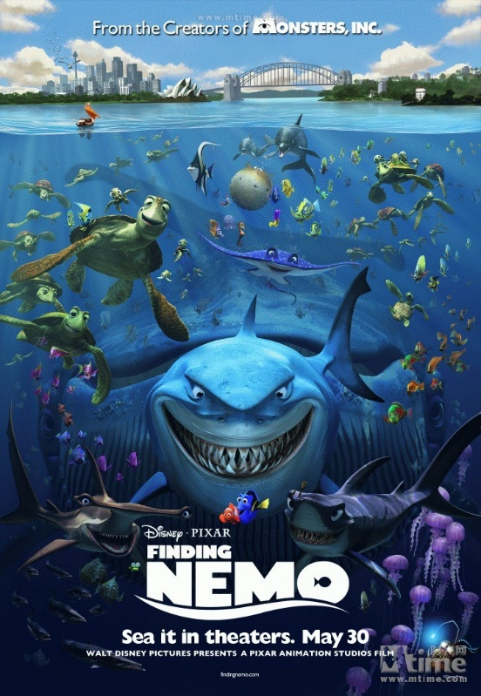
海底总动员 (2003) Finding Nemo

Slide 3
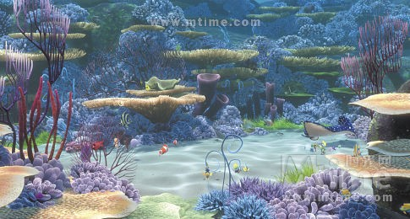
A clown fish lives in the Great Barrier Reef loses his son, Nemo. He ventures into the open sea, despite his father's constant warnings about the ocean's dangers.
Nemo is caught by a boat and netted up and sent to a dentist's office in Sydney.
While Marlin ventures off to try to retrieve Nemo, Marlin meets a fish named Dory. The companions travel a great distance, encountering various dangerous sea creatures such as sharks, anglerfish and jellyfish.
While the two are doing this, Nemo and the other sea animals in the dentist's fish tank plot a way to return to Harbor to live their lives free again.

Slide 4
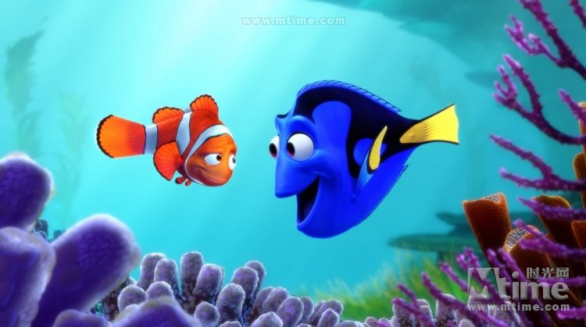
http://video.mtime.com/38905/?mid=10745
After his son is captured in the Great Barrier Reef and taken to Sydney, a timid clownfish sets out on a journey to bring him home.

Slide 5
Pre-reading
According to the picture on P19,
can you predict what is going to happen?
Who, where, what, when, how

Slide 6
Words and phrases
whaler ['weɪlə]
n. 捕鲸船；捕鲸者
pause [pɔːz]
n. 暂停；间歇
vi. 暂停，停顿，中止；踌躇
telescope ['telɪskəʊp]
n. 望远镜；缩叠式旅行袋
vi. 套叠；变短
vt. 压缩；使套叠
flee [fliː]
vt. 逃跑，逃走；逃避
vi. 逃走；消失，消散
baleen whale须鲸
anecdote ['ænɪkdəʊt]
n. 轶事；奇闻；秘史
Killer whale
n. 虎鲸
Accommodation
n. 住处，膳宿
harpoon [hɑː'puːn]
vt. 用鱼叉叉；用鱼叉捕获
n. 鱼叉

Slide 7
1. How many names appear in the text? Who are they?
Clancy --- the narrator of this story
Old Tom --- the killer whale
George --- one of the whalers
Jack --- the man in the bow with a harpoon of the boat
Red --- whale hunter
James ---whale hunter

Slide 8
2. Why did old Tom throw itself out of the water and then crash down again?
To tell the hunters there’s a whale our there.

Slide 9
3. Why did the men start turning the boat around to go home after the whale died?
They would return tomorrow to bring in the body. It won’t float up to the surface for around 24 hours.

Slide 10
4. Why do you think the killer whales behaved like this?
They want to have a good feed on the dead whale’s lips and tongue.

Slide 11
5. Why did George think that the killer whales worked as a team?
A pack of about six other killers attack one whale.
The killers over there threw themselves on top of the whale’s blow-hole to stop it breathing, and those others stopped it diving or fleeing out to sea.
Then the killers started racing between whalers and the harpoon was aimed at the whale.

Slide 12
Fill out the blanks in exercise 1.
1. Clancy arrived at the whaling station.
2. He heard a noise coming from the bay.
3. He saw a huge animal in the water, which was old Tom, the killer whale.
4. The men went to the boat and headed out for a whale hunt.
5. The killer whale guided the team to the hunt.
6. Clancy and his men killed the baleen whale with the help of the killers.
7. The killers ate the lips and tongue of the baleen whale.
8. The men returned for the baleen whale the next day.

