Slide 2
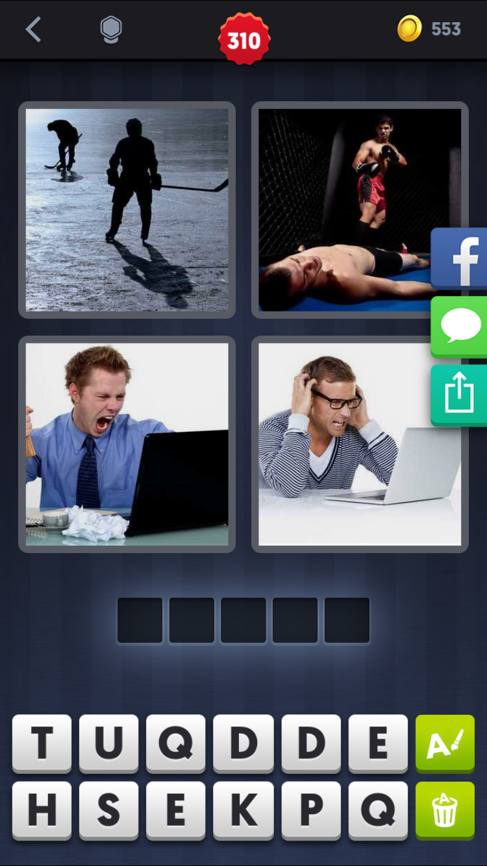
upset
adj. 心烦意乱的
v. 弄翻，打败，使难过

Slide 3
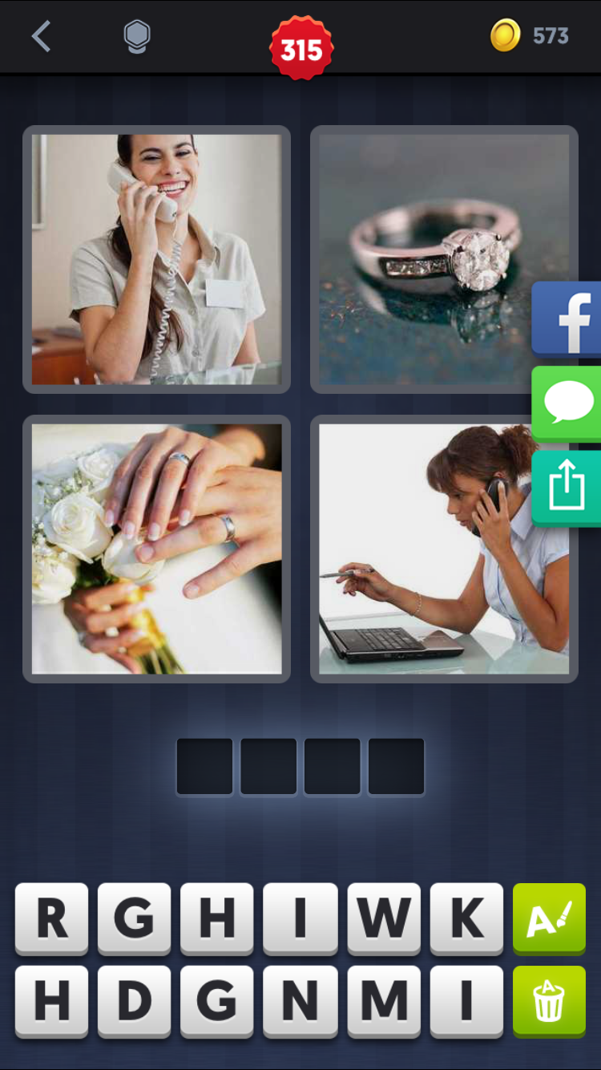
ring n. 环，戒指，拳击场
v. 打电话，敲钟

Slide 4
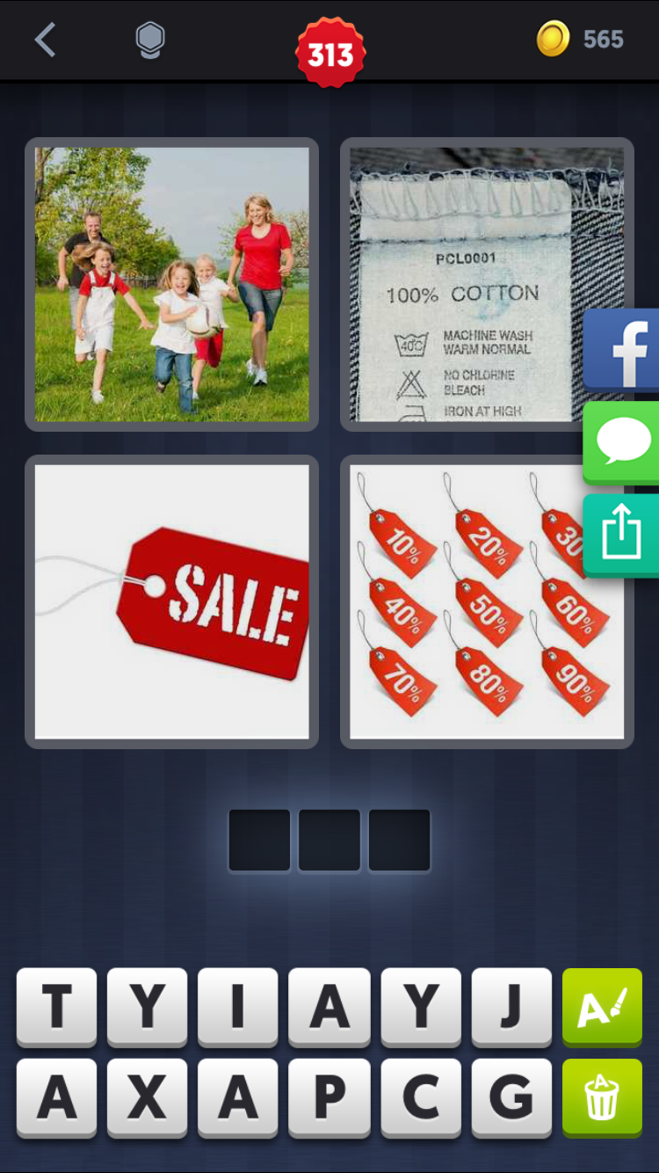
tag n. 标签
v. 贴标签，尾随

Slide 5
1. Today’s lesson focuses on how to write a summary of a news article.
2. We must skim the report to find the main idea.
3. The teacher told us to underline the difficult words and look them up in the dictionary.
4. He said that details like statistics should/need not be included.
5. I think I will use a report about how farmers are keeping their fields free of chemical fertilizers.
6. It took the farmer twenty years to build up his business.
7. Using too much/overusing chemical fertilizer will lead to serious problems.

Slide 6
The double life of Alfred Bloggs
Why did Alf want a white-collar job?
Why are people who work in offices called “white collar workers”?

Slide 7
English and I
English used to be a headache to me. I always found it difficult to memorize new vocabulary. Grammar was also a closed book to me because there were many exceptions to the rules I had learned, which almost drove me crazy. Needless to say, my English was poor, but I persevered.
Fortunately, I had a patient teacher. Rather than scold me, he kept on encouraging me. With his help and my diligence, my English improved step by step. After some time, I didn't seem to be struggling in English anymore. In fact, English is now my strongest subject. It only goes to show that there's no substitute for hard work.

Slide 8
非谓语动词
non-finite verb

Slide 9
谓语动词 VS 非谓语动词
She got off the bus but left her handbag on the seat.
She got off the bus, leaving her handbag on the seat.
She got on a plane and went to Paris.
She got on a plane to go to Paris.
I love this book and it is written by my favorite writer.
I love this book written by my favorite writer.

Slide 10
非谓语动词
形式：doing(现在分词和动名词)
done(过去分词)
to do(不定式)
除了谓语，可充当其他句子成分
主宾定状补表

Slide 11
现在分词&过去分词

Slide 12
分词
现在分词-ing与逻辑主语是主动关系，过去分词-ed与逻辑主语是被动关系。
The professor entered the hall, following his assistant.
The professor entered the hall, followed by his assistant.
现在分词表现在，进行
过去分词表过去，完成
The boy sleeping in the room is her son.
She found her necklace gone.

Slide 13
分词的语法功能
talking
The lady _______(talk) with your teacher is a nurse.
The girl ______(sit) next to me is my sister.
All the people _______(stand) by cried out loudly.
Mr. Smith once hired a young worker ______(call) John.
The book ______(write) by a farmer is very popular.
The window _______(break) by that naughty boy yesterday is being repaired
作定语，相当于一个定语从句
sitting
standing
called
written
broken

Slide 14
分词的语法功能
________(leave) Germany, Einstein went first to France.
His wife died in 1962, _______(leave) him with three children.
_______(hold) his head high, he walked past the hole.
______(bear) into a poor family, he had only two years of schooling.
______(give) more time, we are sure to finish it.
On _______(hear) the news, he jumped with great joy.
做状语
时间/地点/原因/条件/目的/让步/比较/方式/结果/伴随
Leaving
leaving
Holding
Born
Given
hearing

Slide 15
垂悬结构
当现在分词或者过去分词在从句中作定语或者状语时，其逻辑主语通常需要和主句的主语保持一致。
The professor entered the hall, following his assistant.
The professor entered the hall, followed by his assistant.
垂悬结构中，逻辑主语和句子的主语不一致
Taking the weather into consideration/Considering the weather, the picnic may be canceled.
Judging from his accent, he can’t be Chinese.
frankly/generally/strictly speaking …
supposing …

Slide 16
分词的语法功能
telling
We caught the visitor _______(tell) a lie.
I felt myself __________(lift).
The leader tried to make himself ___________(understand).
I had my bike _______(repair) yesterday.
Do you hear someone ________(knock) at the door?
I heard someone ______(knock) three times.
做宾语补足语，补充说明宾语
现在分词：see, hear, notice, watch, catch, smell, keep, feel …
过去分词：have, get, keep, make, see, find, think, wish, order …
being lifted
understood
repaired
knocking
knock

Slide 17
现在分词的时态和语态
Arriving
_______(arrive) at the station, they found the train had already gone.
一般时：现在分词动作与谓语动词动作同时发生
_____________(realize) his mistake, he made an apology.
_____________(finish) their homework, the boys went to bed.
完成时：现在分词动作，发生在谓语动词动作之前
_____________(protect) by the police, these women felt they were safe.
being done的动作与逻辑主语是被动且与谓语动词同时发生
_______________(give) so much money, the man began to work.
having been done动作与逻辑主语是被动且发生在谓语动词之前
Having realized
Having finished
Being protected
Having been given

Slide 18
现在分词的时态和语态
Having made
___________(make) up his mind, he went out in a hurry.
______________(promise) his mom, Stanley now studies hard.
___________(force) to finish the research, he is worried a lot.
The building _________(build) now will be used as a library.
________________(tell) that the train had gone, we were very upset.
________________(teach) several times, he still didn't know how to do it .
having been done 只作状语，且能被done所代替
Having promised
Being forced
being built
Having been told
Having been taught

