Slide 2
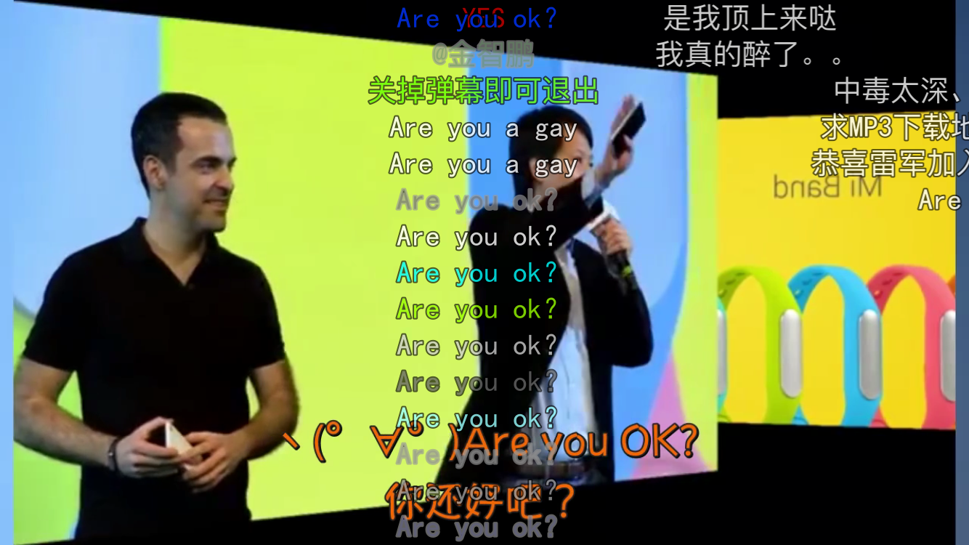
Before the presentation…

Slide 3
So it is about…
Xiaomi(?)

Slide 4
About its history
Founded in April 2010Its founder, chairman and CEO is Lei Jun
Their first mobile phone was officially released in August 16, 2011
And now it has lots of products…

Slide 5
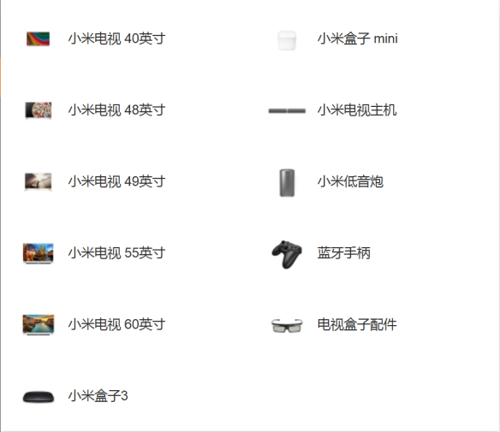
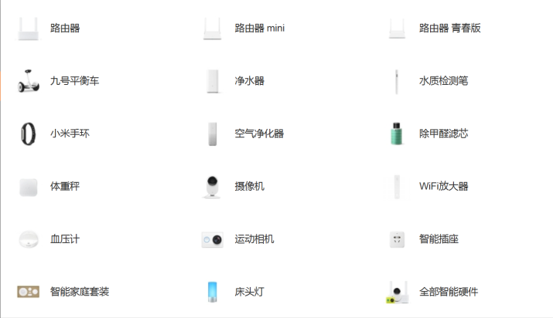
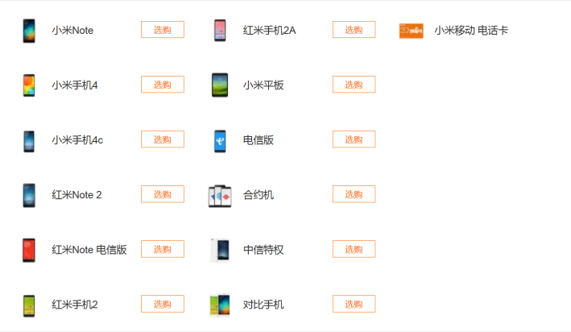
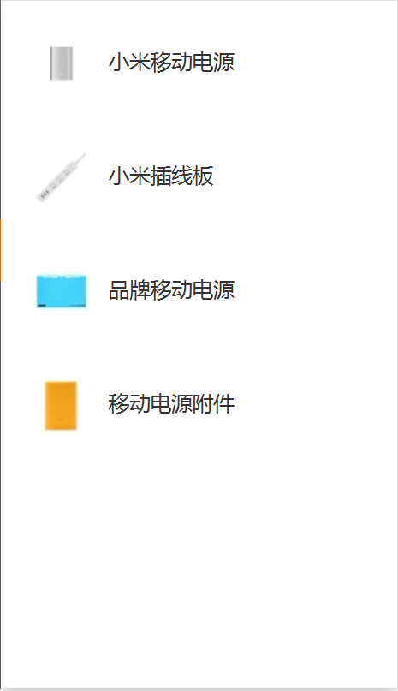
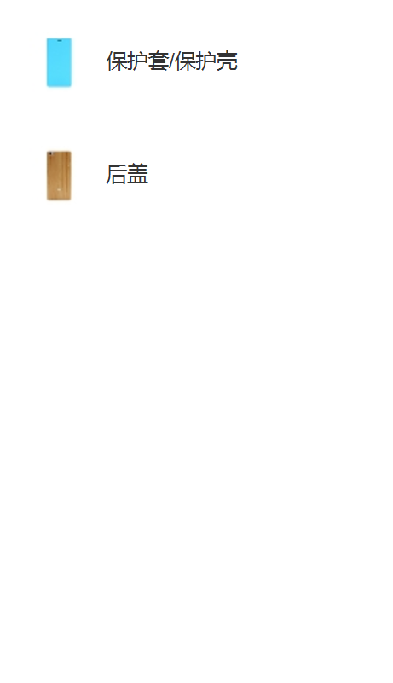
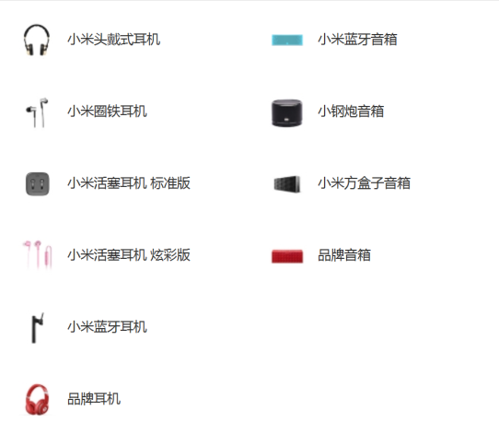
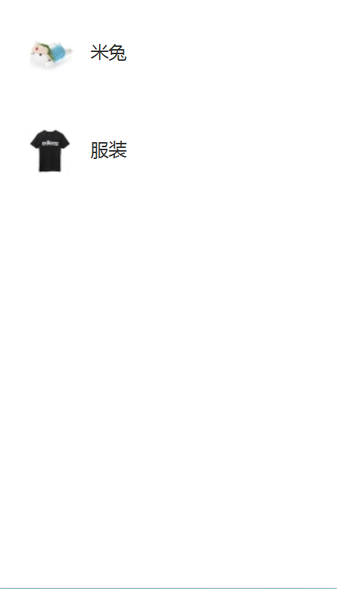
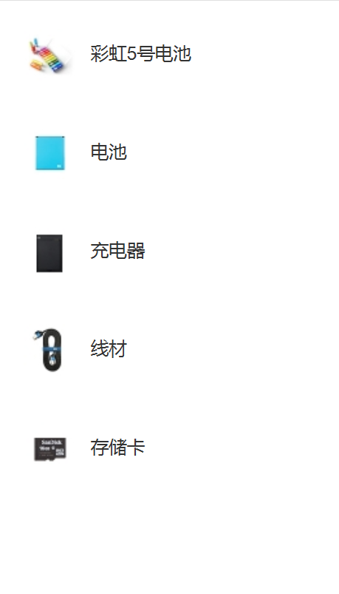
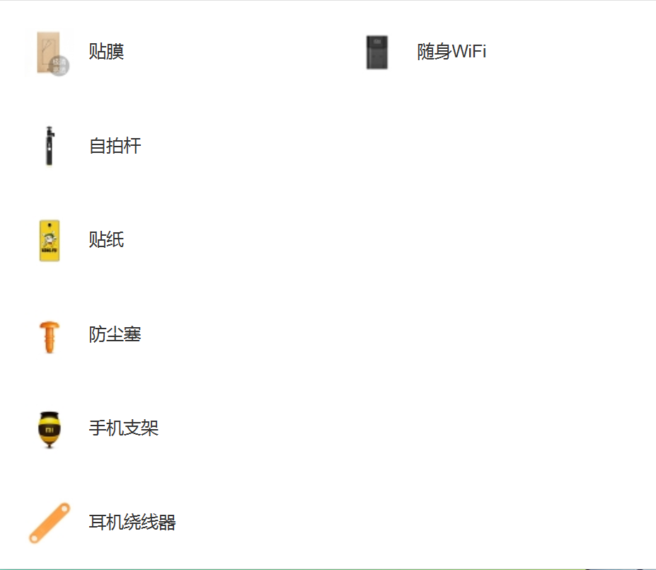
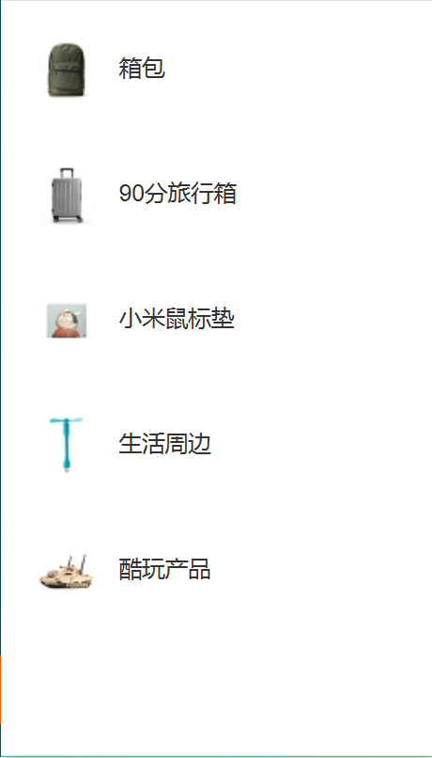

Slide 6

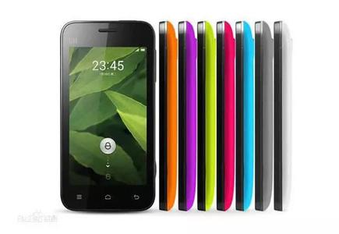
Three big products
MI (Phones)
MiTalk (Mobile communication software)
MIUI (Operating system)

Slide 7
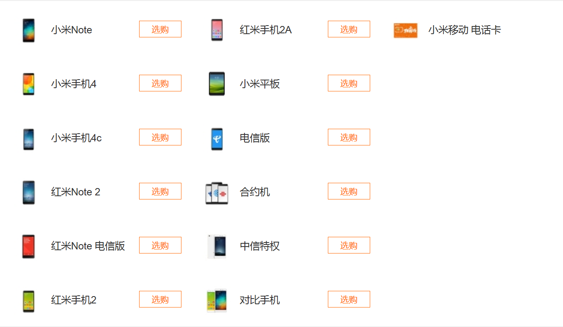
The lead character

Slide 8
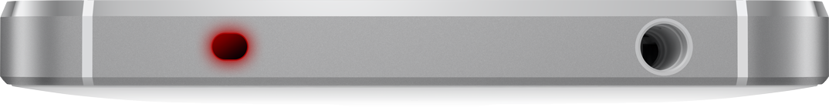
Key points
Cheap!!!(499)
Cloud platform
Humanized hardware
【Like Infrared emitter in MI 4】
(红外传感器)

Slide 9
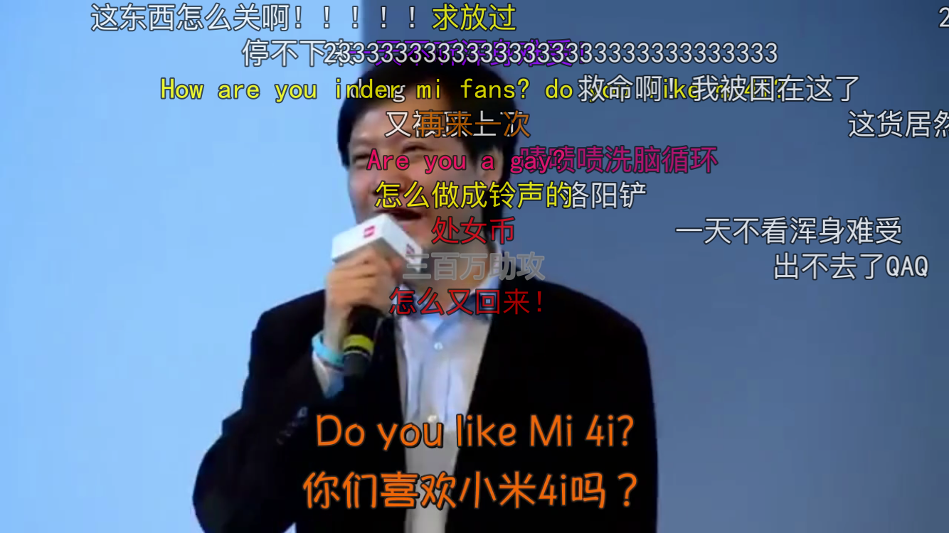
A Special Part

Slide 10
But…
Where is MI 4i?!

Slide 11
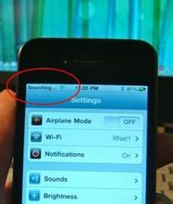
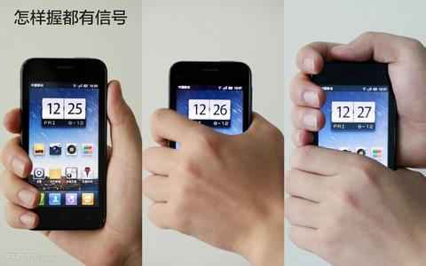
Compare
Single style
High quality
Easily damaged
Expensive(5288)
iOS, easy to use
Many styles
Lower than iPhone
Durable
Cheap(3099)
Android+MIUI (?)
iPhone
MI
Searching…

Slide 12
Conclusion
There are many good mobile phone brand in China now, like Xiaomi and Huawei
Some of them are also sell well in foreign countries
So we can give them more support
【Although I’m using iPhone6 now】
But don’t learn English from Lei Jun

Slide 13
That’s All ,Thank you!

