Slide 2


Slide 3

ORIGIN

Slide 4
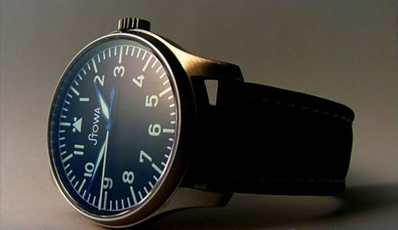
ACTUALITY

Slide 5


