Slide 1
sports
Sports play a big role in our daily lives. It helps us to build up a healthy body. It can also help us to enlarge our social circles. I have met many friends by basketball and football. We can also relieve the pressure.

Slide 2
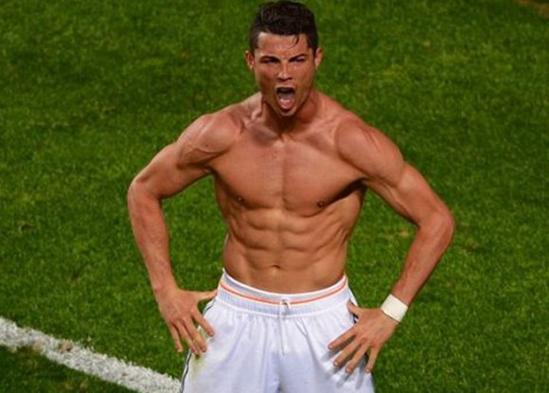
Cristiano Ronaldo
He is from Portugal
Ballon d'Or 3 times
Play for the Real Madrid Club

Slide 3
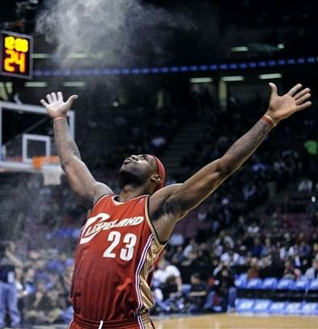
Lebron james
King
4 times National Basketball Association Most Valuable Player
2 times final mvp

Slide 4
http://v.17173.com/v_102_603/MjMyNzAyNzA.html

Slide 5
