Slide 1
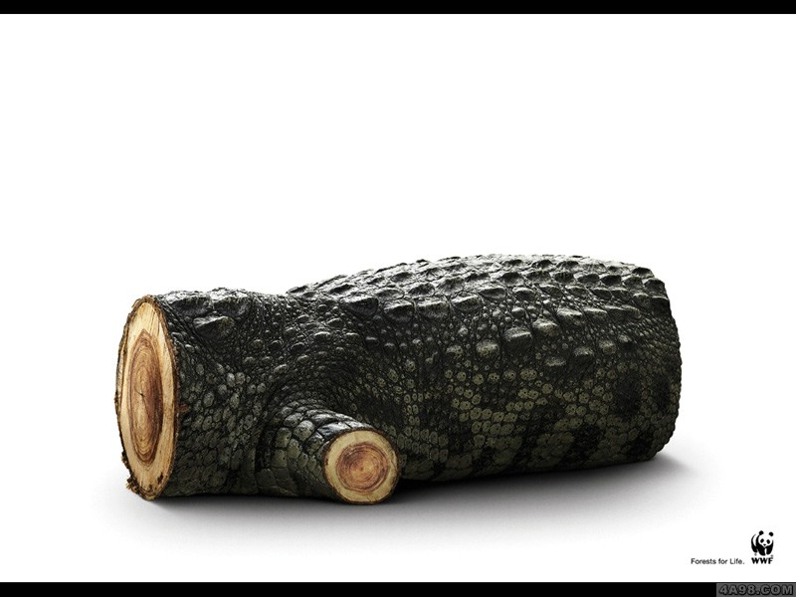
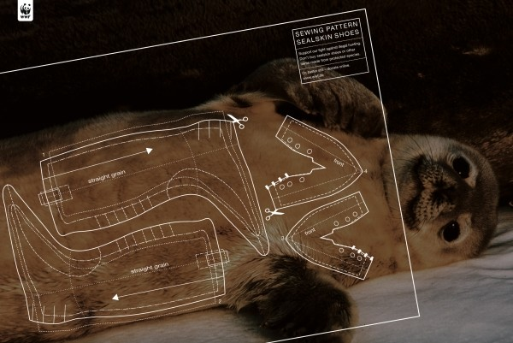
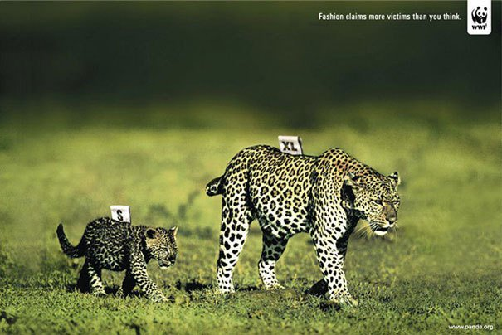
PROTECT THE ANIMALS

Slide 2
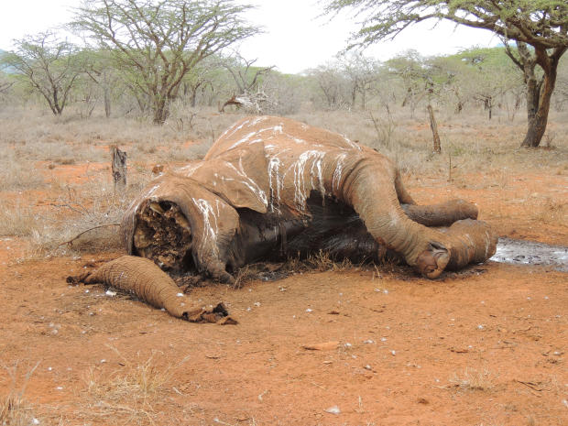

Slide 3
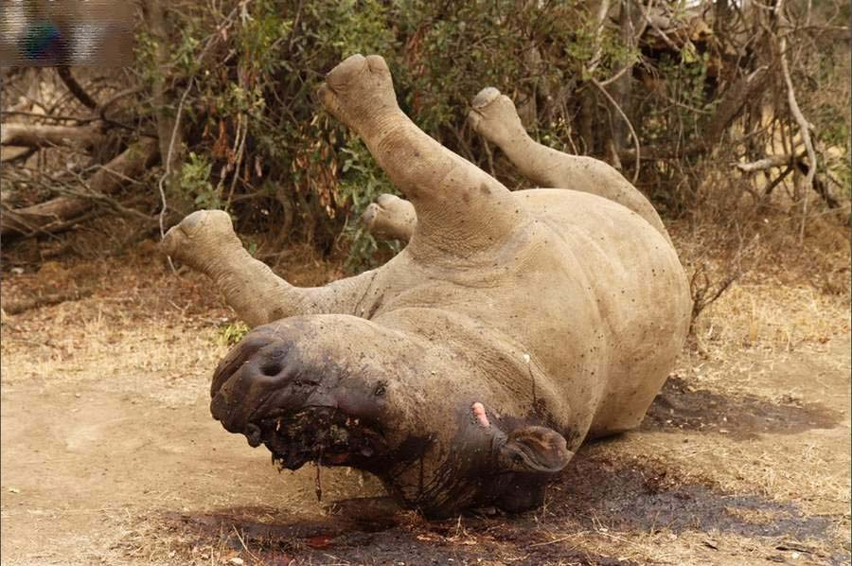

Slide 4
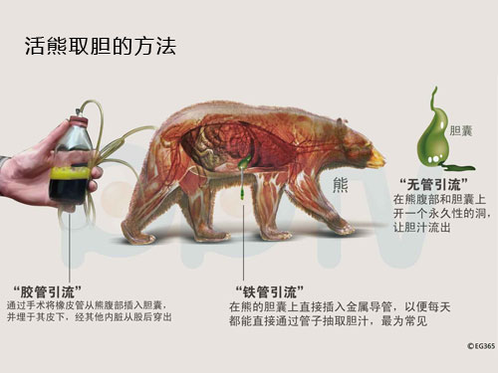

Slide 5
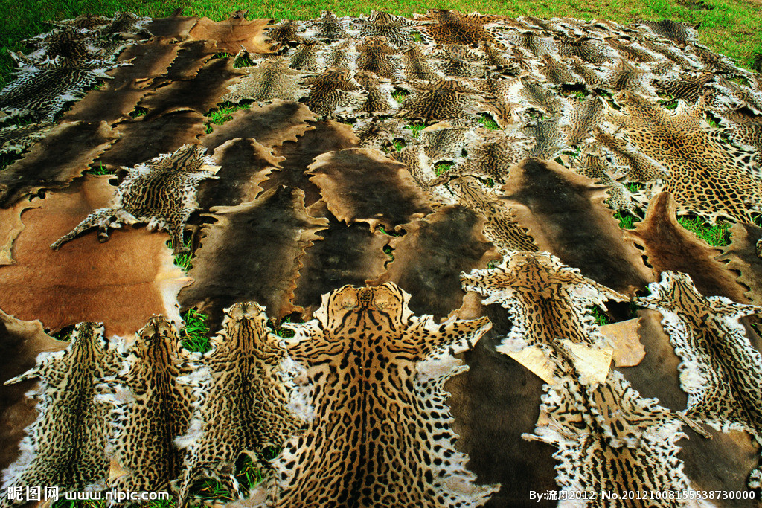

Slide 6
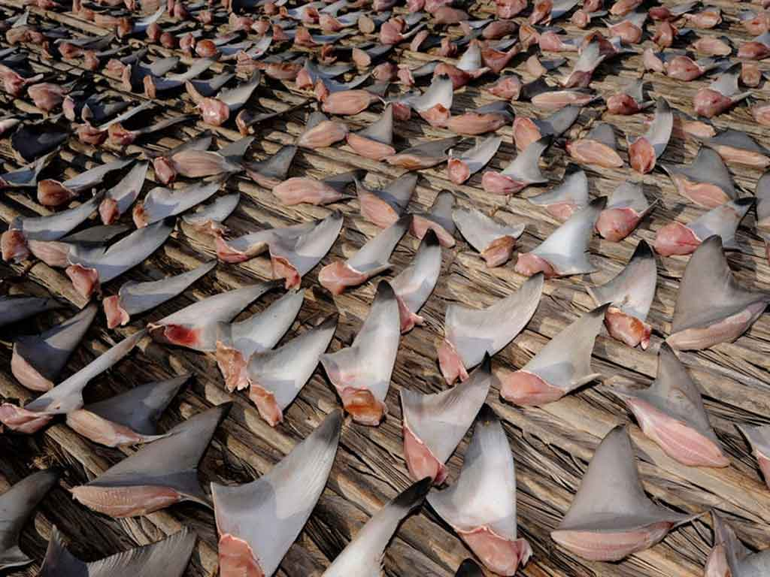

Slide 7
IF you still can’t feel the pain
that we’ve bought to the
animals ,
let’s watch a video:
http://v.qq.com/page/l/k/h/l01573vw0kh.html

Slide 8
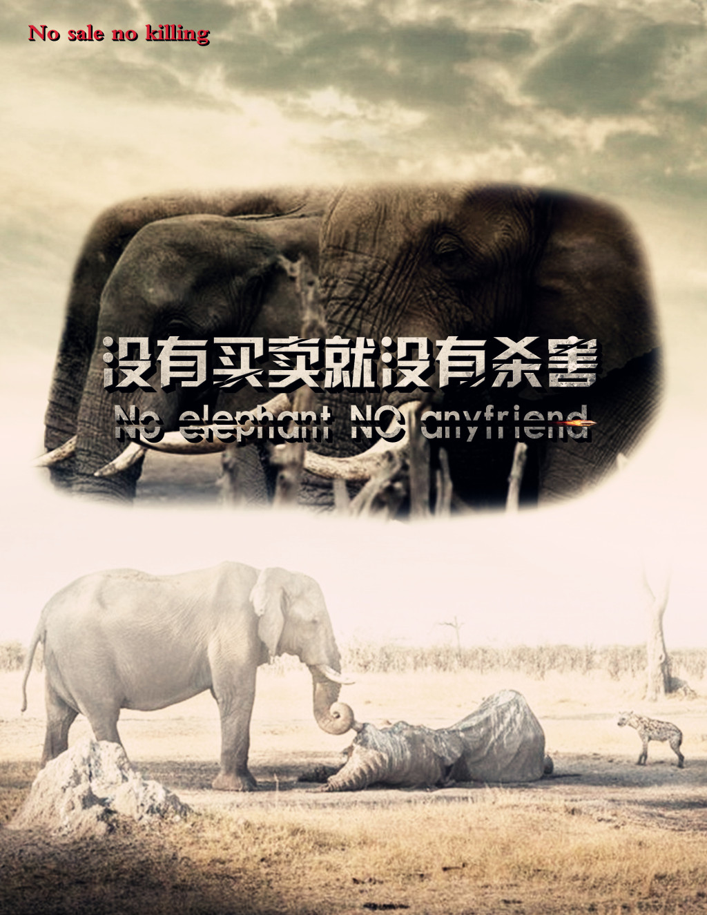
How can we protect them?
Actually, all that we need to do Is simple:

Slide 9
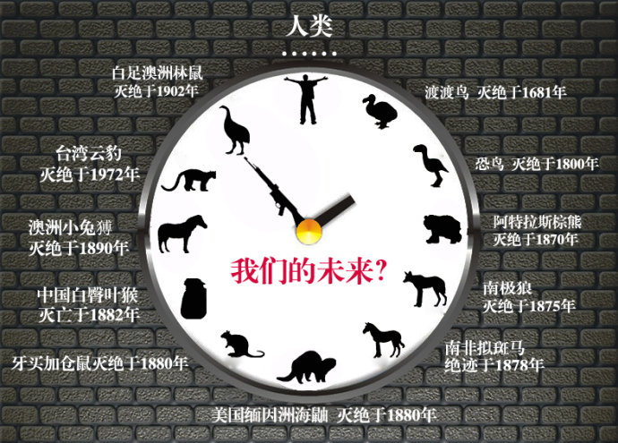
Please
STOP THE KILL!

