Slide 1
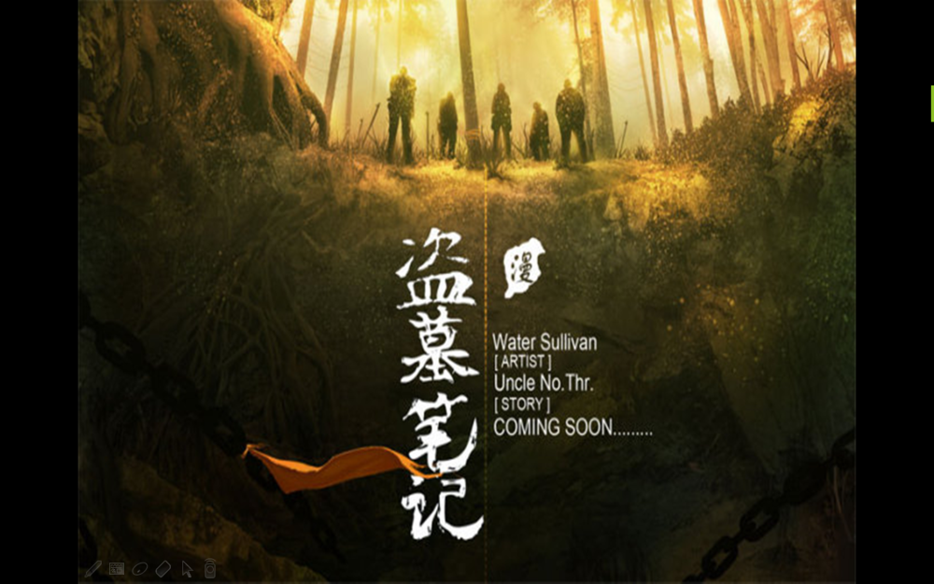
The Grave Robbers' Chronicles
--written by NANPAISANSHU (南派三叔)

Slide 2
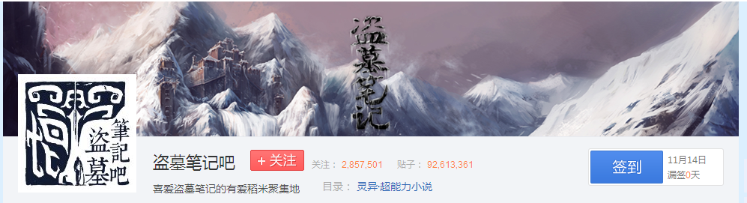
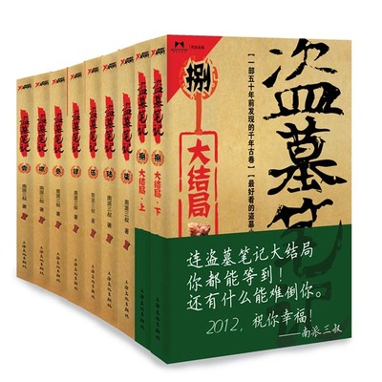
"The Grave Robbers' Chronicles" is the creation of a writer Nanpai Sanshu tomb novels, starting from the starting point Chinese net.

Slide 3
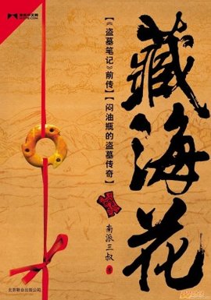
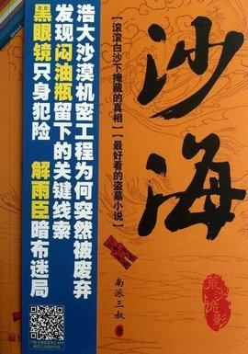
These are the continuations of the book, which are in the serial.

Slide 4
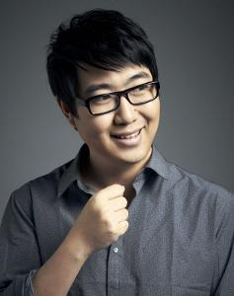
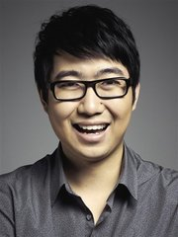
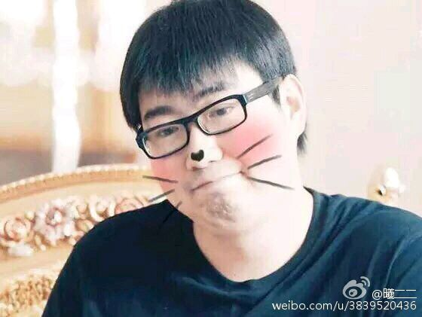
Author introduction
This is the author of the book. His true name is xulei.He is a very famous writer who start the hot tide of novel about tomb with tianxiabachang. XuLei,he is not a professional writer .He has said ,writing is not his day job,but it is where his heart lies.

Slide 5
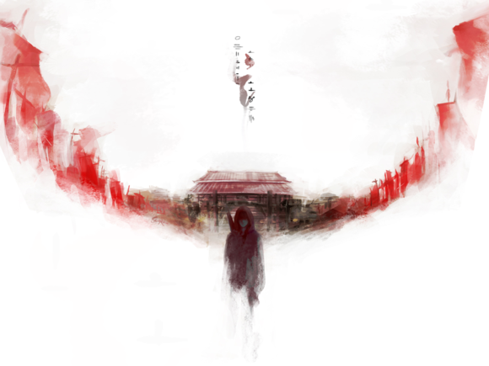
Main story
The content of this book is a story about some grave robbers . In their explorations，they met with a lot of strange things . There are many puzzle is full of mystery . They experienced a lot of risk which you can never think of. Such as monsters，traps ,poison and so on.

Slide 6
Main story
50 years ago, a group of Changsha grave robbers dug out manuscripts of the location of treasures from Warring states,but an encounter with an undead rendered almost the whole group dead.
After 50 years, one of the tufuzi’s grandson find the secret in his notes , gathered a group of experienced grave robbers to treasure hunt.

Slide 7
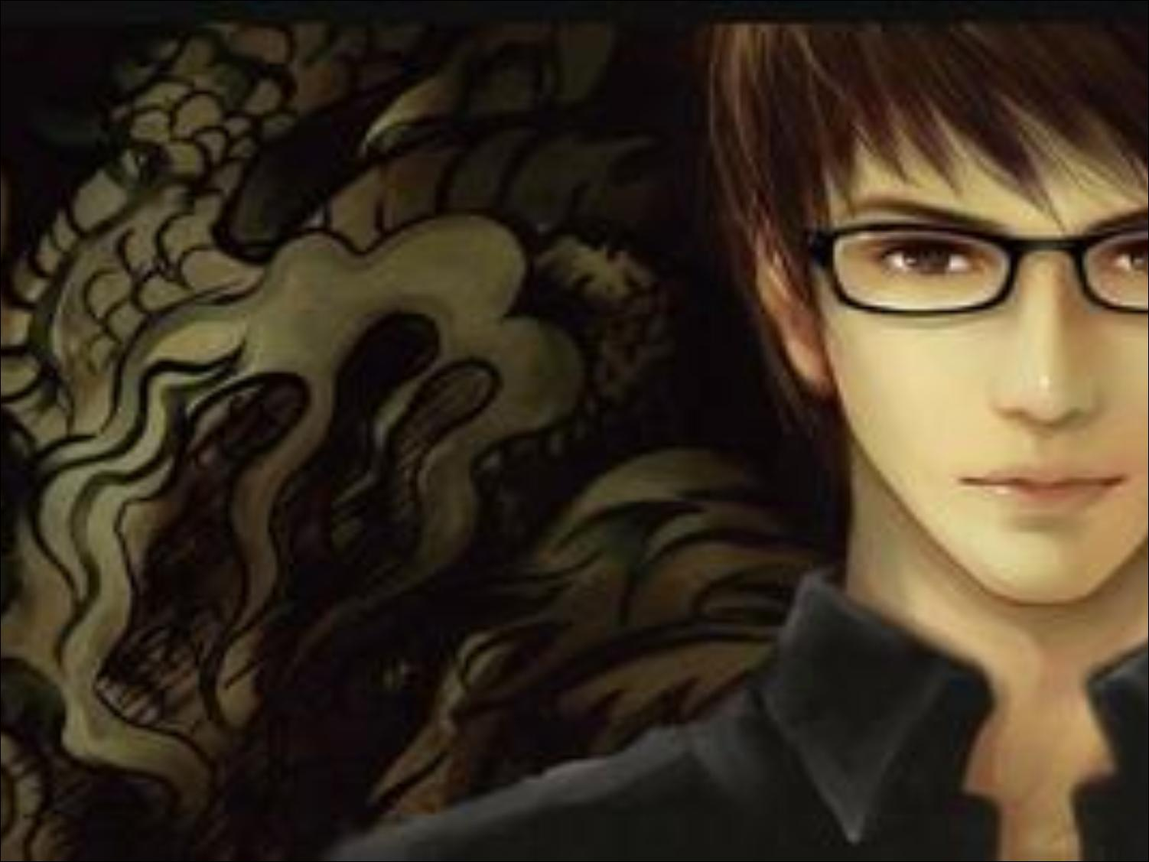
吴邪 wuxie
The point-of-view character and primary protagonist. He is from the Hangzhou Wu family, one of the Changsha Old Nine, a group of families who have been grave-robbing for centuries.
Someone think he is weak and innocent,but I still like him because he is kind and tough.

Slide 8
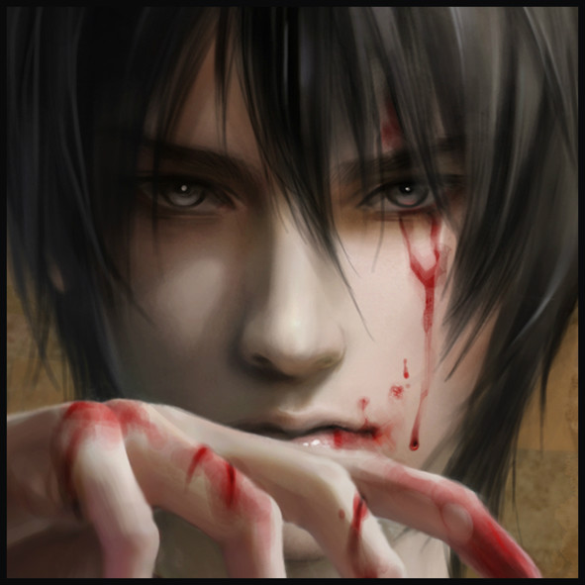
张起灵 Kylin Zhang
A man with a mysterious past whose story leads the last few volumes of the chronicles. He is often hired as an assistant to many grave-robbing endeavors and is highly competent at it; very little is known about him, even his real name.

Slide 9
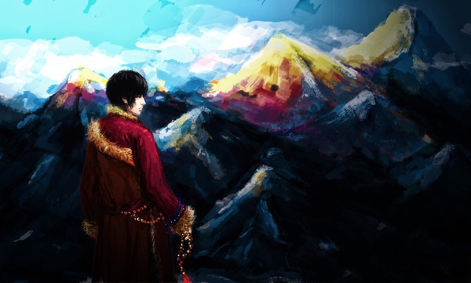
At the end of the book, he got into the door made from brazen in the Changbai Mountains. No one knows that what he will be faced with. He was willing to take ten years like this to protect Wu Xie.
Man can be absolutely powerful if he has no trammels and belongs to nothing.

Slide 10
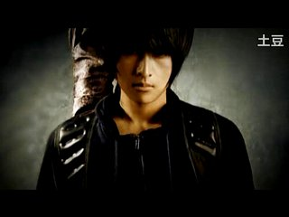
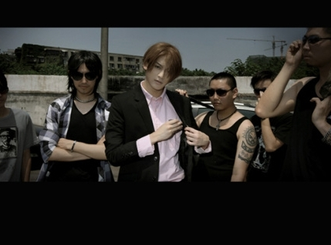
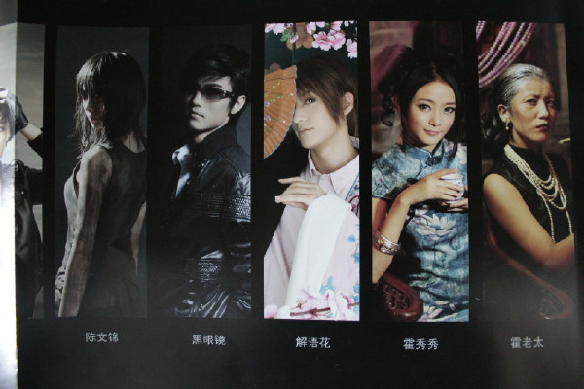
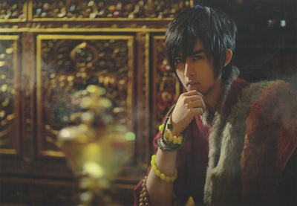
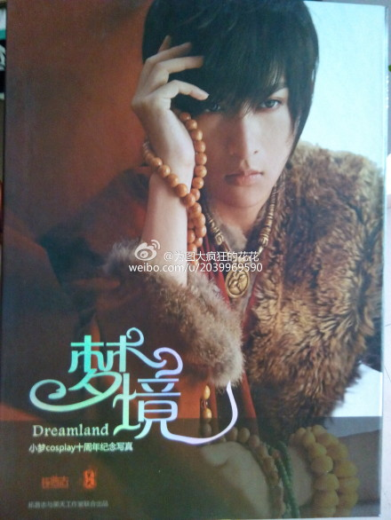
cosplay
There are also a lot of outstanding cosplay on the book.

Slide 11
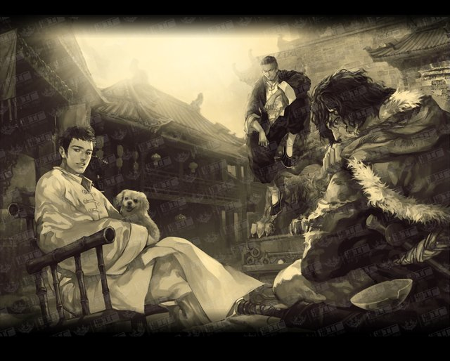
Conclusion
In the end, I want to send you a paragraph by the author :
We all ordinary people who have to experience life we didn’t want to. We may can’t stand up to it, but there must be some people we are willing to pay for. We can find our 1% courage in our weakness and keep going for these people. Just like you raise a needle to hold back a tank. This is the only courage you have, it is tiny but sharp.

Slide 12
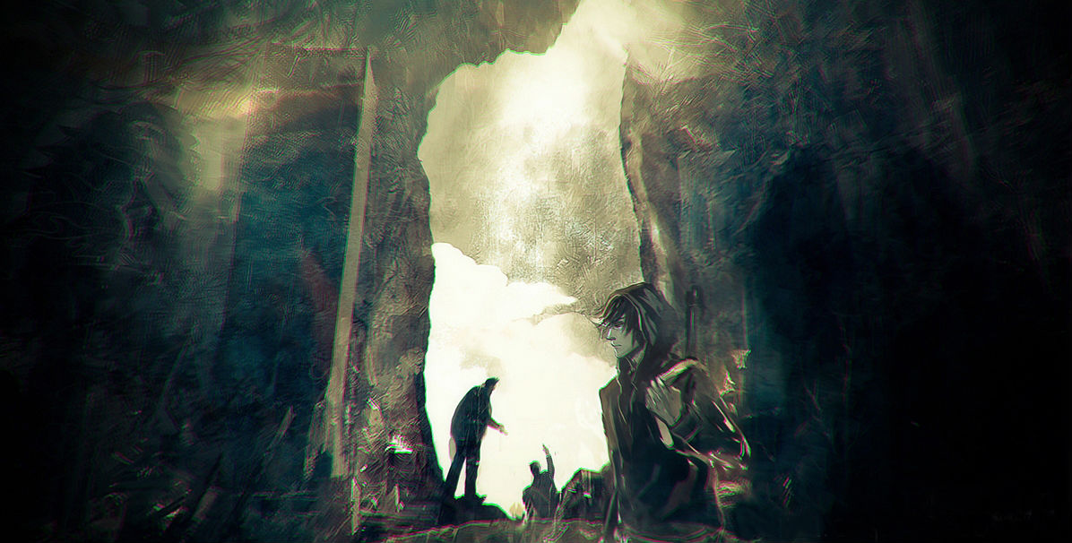
In fact,I first read this book when I was ten.And it has stayed with me for 6 years.It is like my good friend that always brings me courage and power .It is not only about adventure,but also about humanity and choice.In my mind ,although the book is over, the story is continuing......

Slide 13
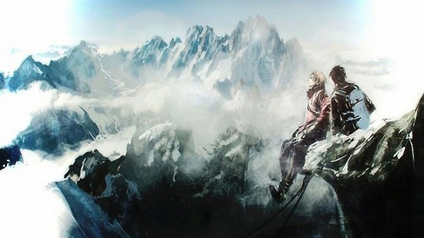
THANK YOU!

