Slide 1
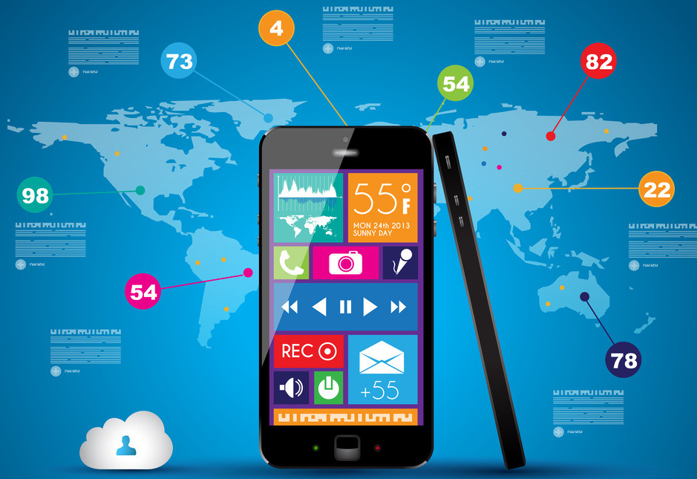
Is the smartphone just full of advantages?

Slide 2
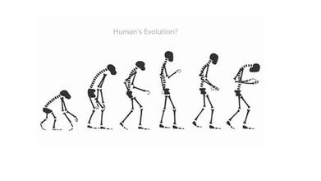
PHUBBER
A kind of people who are addicted to play phone.

Slide 3
Disadvantages of phubbing ——Are you playing your phone or playing your lives?

Slide 4
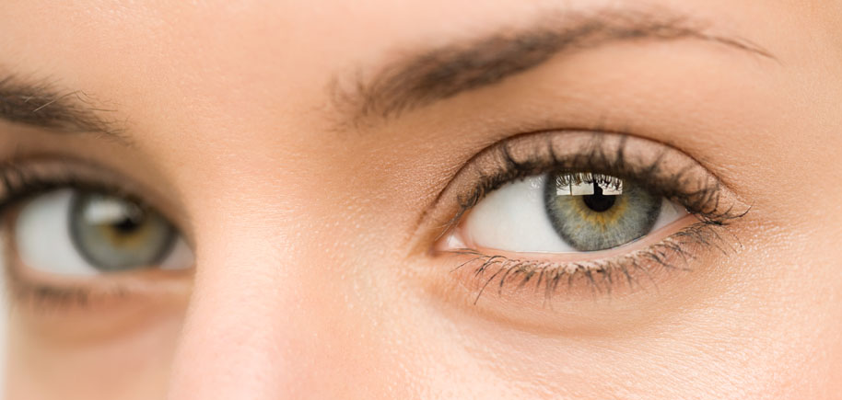
1.Watching the phone for a long time:
Short sight; Cataract(白内障);
Dry eye;

Slide 5

2.Bow your heads for a long time:
Cervical spondylopathy(颈椎病)

Slide 6
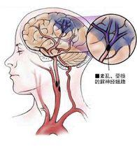
3.Stay up late to play phone:
Brain disease; Nerve is sometime out of controlled

Slide 7

4.Play games for a long time:
Finger disease; Thumb will not bend

Slide 8
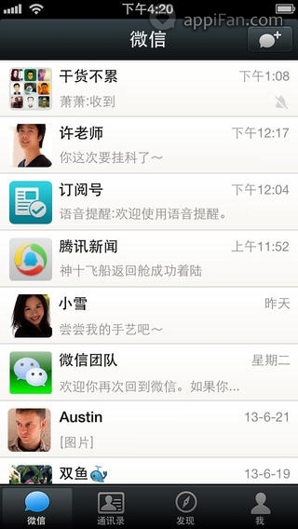
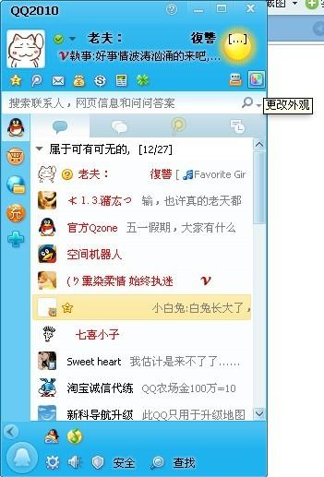

Slide 9

Huge Strong

Slide 10
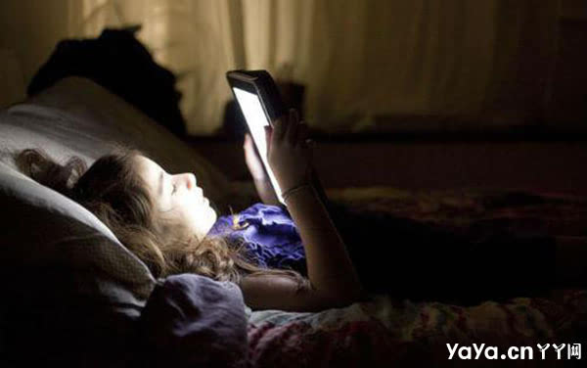
Technology: illusion(虚幻)
Companionship(友谊)：inclusion
Device（设备） of delusion（错觉）
Confusion（困惑）

Slide 11
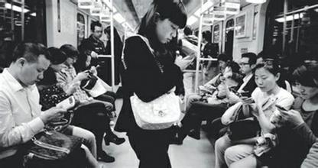
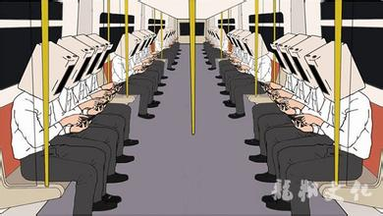
Master
Slave

Slide 12


Self interest(私欲) ;
Self image(自吹);
Self promotion（自擂）;
Share our best
Leave out our emotion

Slide 13
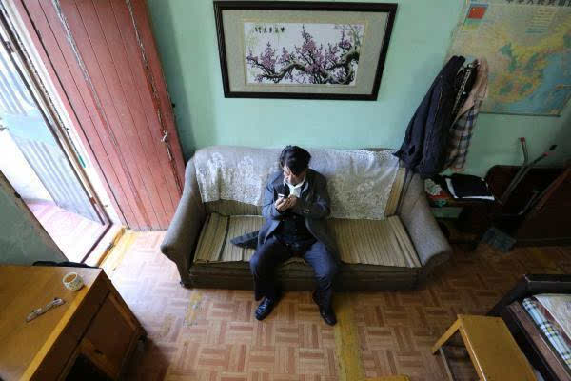



Edit
（编写）
Exaggerate（夸大）
Adulation（奉承）
Appreciation
A group message will do.
Is It the same ?

Slide 14
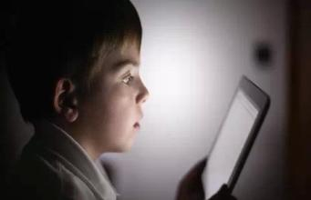
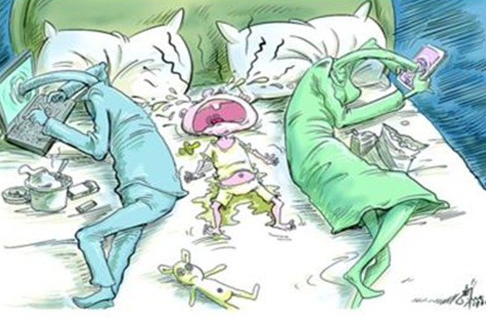
robot
Ignore

Slide 15
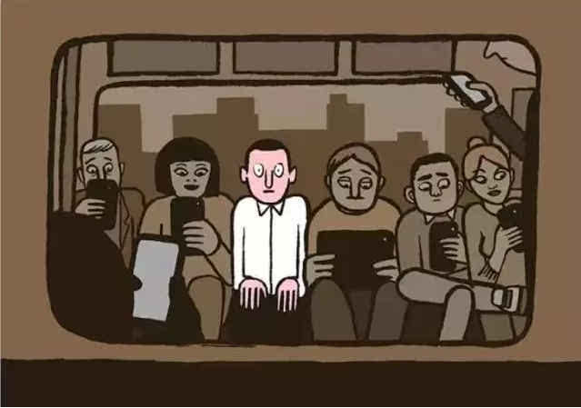

“Smart ”phone &“Dumb”people

Slide 16
TO: Smartphone addicts
"The further distance in the world is not between life and death. But when I stand in front of you, your eyes turn to your smartphone.”

Slide 17
We type as we talk, and we read as we chat
We spend hours together without making
eye contact
Give people your love, don‘t give them your ’like‘ (赞)
Disconnect from the need to be heard and defined
Go out into the world, leave distractions（分心） behind.

Slide 18

Thank you

