Slide 1
Beautiful towns in the world
by Grace

Slide 2
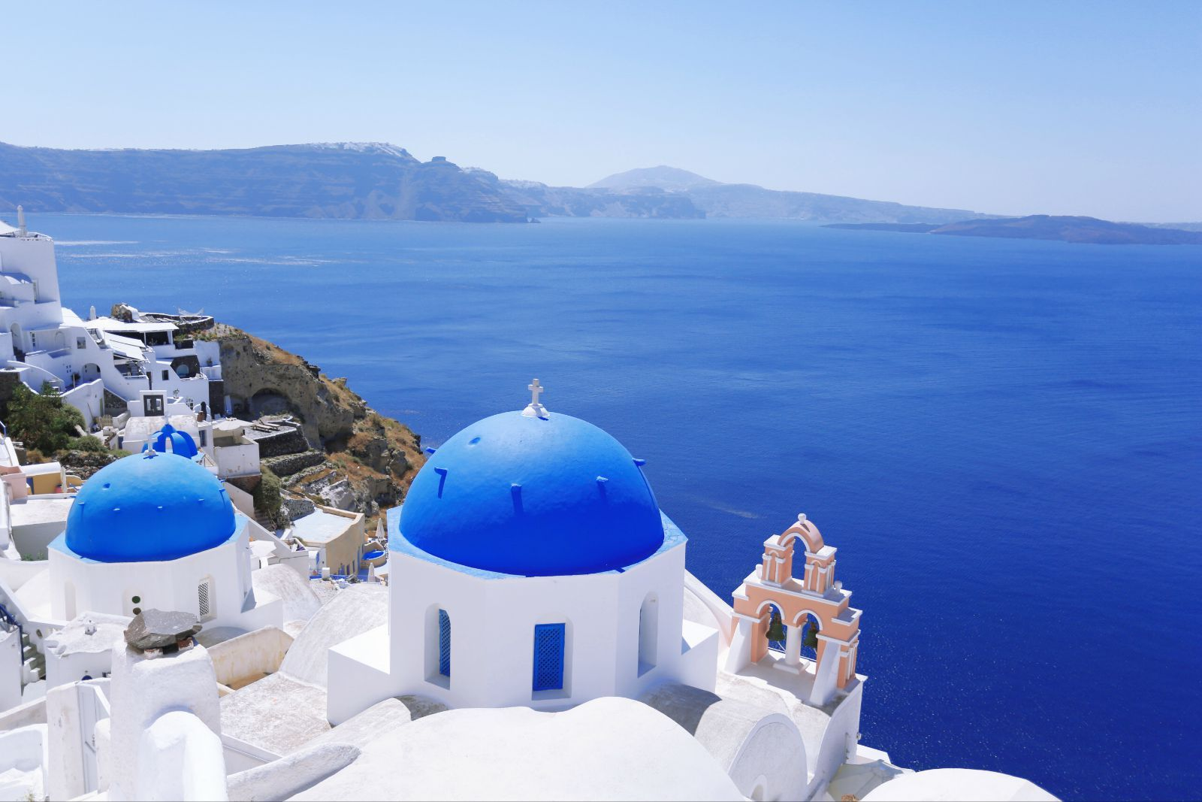
The town of Oia in Santorini Island
the town is built on the edge of the cliff
the place is consider to be the best place to see the sunset

Slide 3
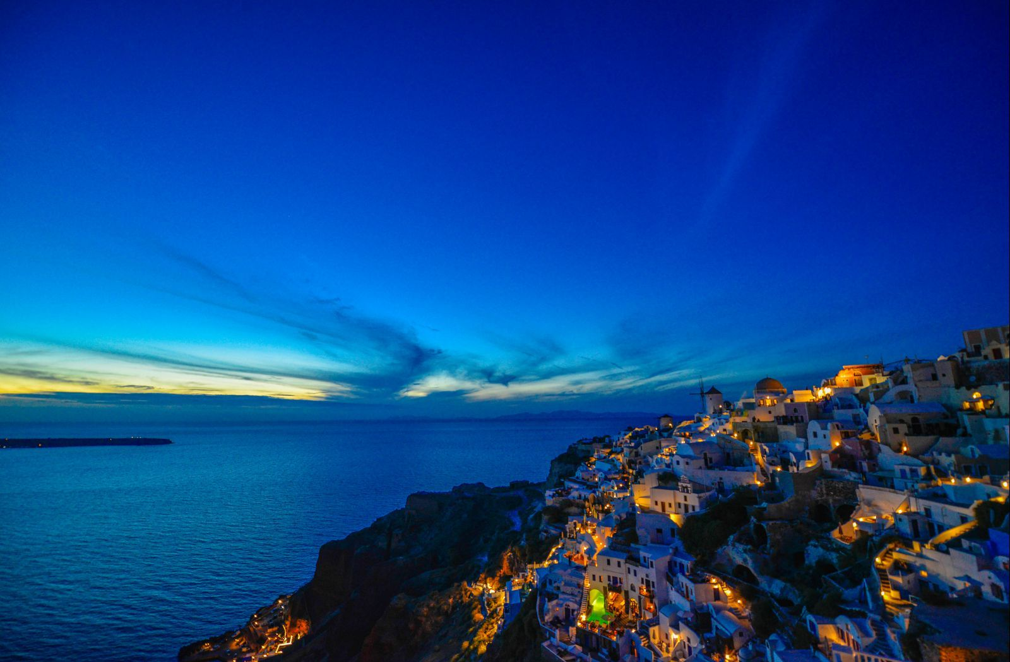

Slide 4
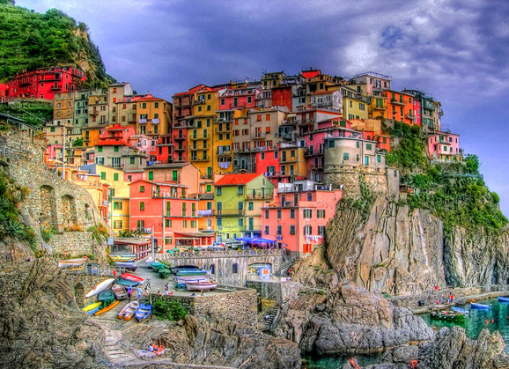
The town of Manarola in Italy
It is a town which was
Built by the sea and on the edge of the cliff
The buildings are
Colorful
There is a road called
“Via dell‘Amore”
where a lot of couples want to visit

Slide 5
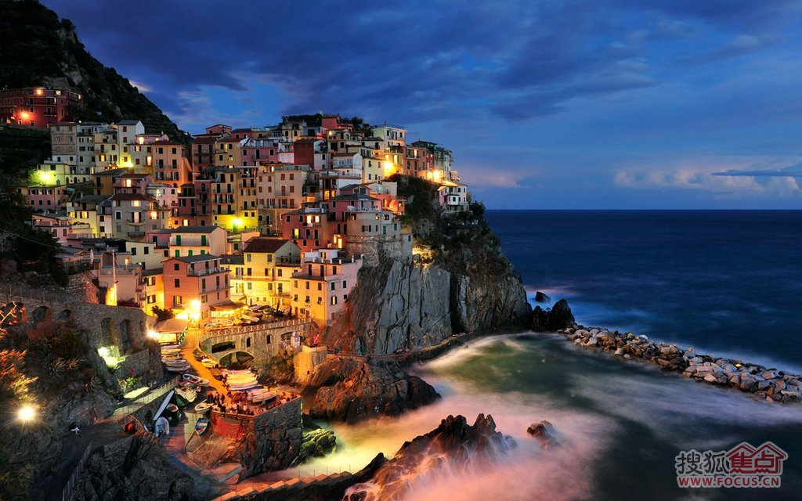

Slide 6
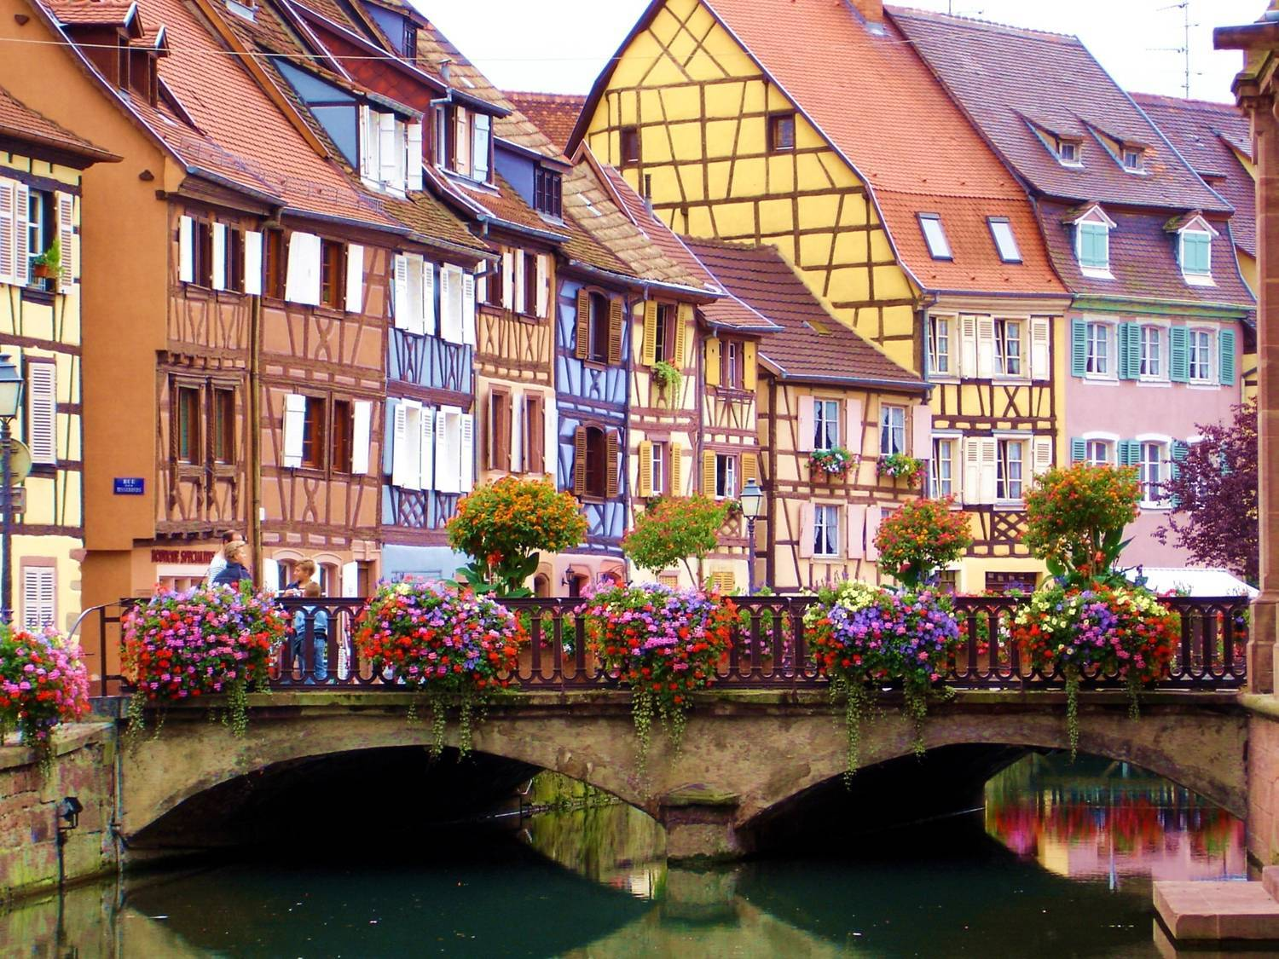
The Colmar town in France
It is a town in France
There are a lot of
museums and
some places of interest
The Eel River
goes through the
Town

Slide 7
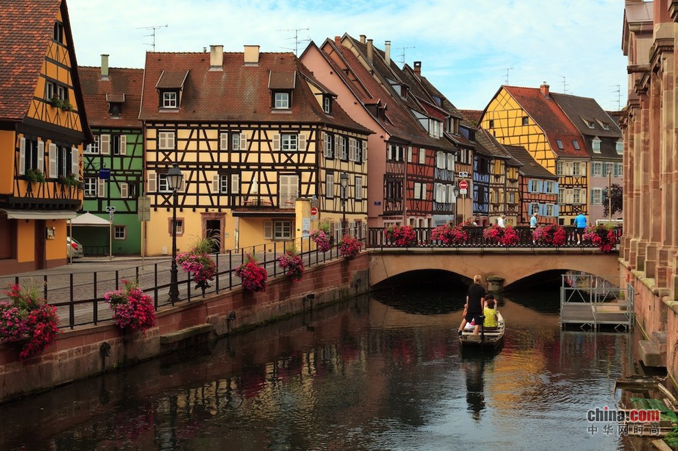

Slide 8
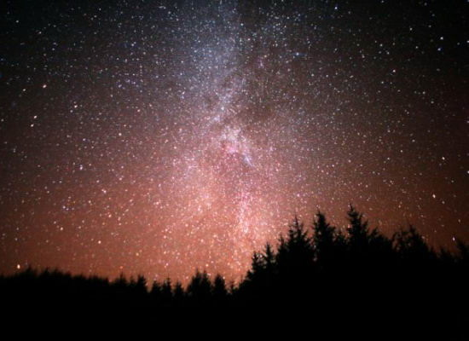
The town of Tekapo in New Zealand
The town is the
Best place to look
At the star
The people there
Are few and they
All use light
As little as
they can
You can do
Aquatic Sports
And go fishing in
The town in summer
And go skiing
in winter

Slide 9
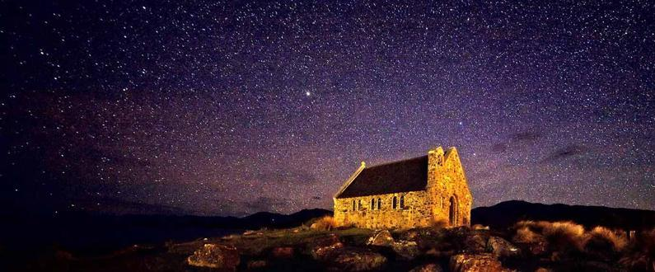

Slide 10
conclusion
There are a lot of beautiful places in the world
,and every place can give us different feelings and we will learn different philosophy of life
A trip always tell us a lot, so why not learn something on the way .Go out and have different gnosis of life.

