Slide 1
Celebrity Dinners
Room 401

Slide 2
1
Tiger, 17
2
3
4

Slide 3
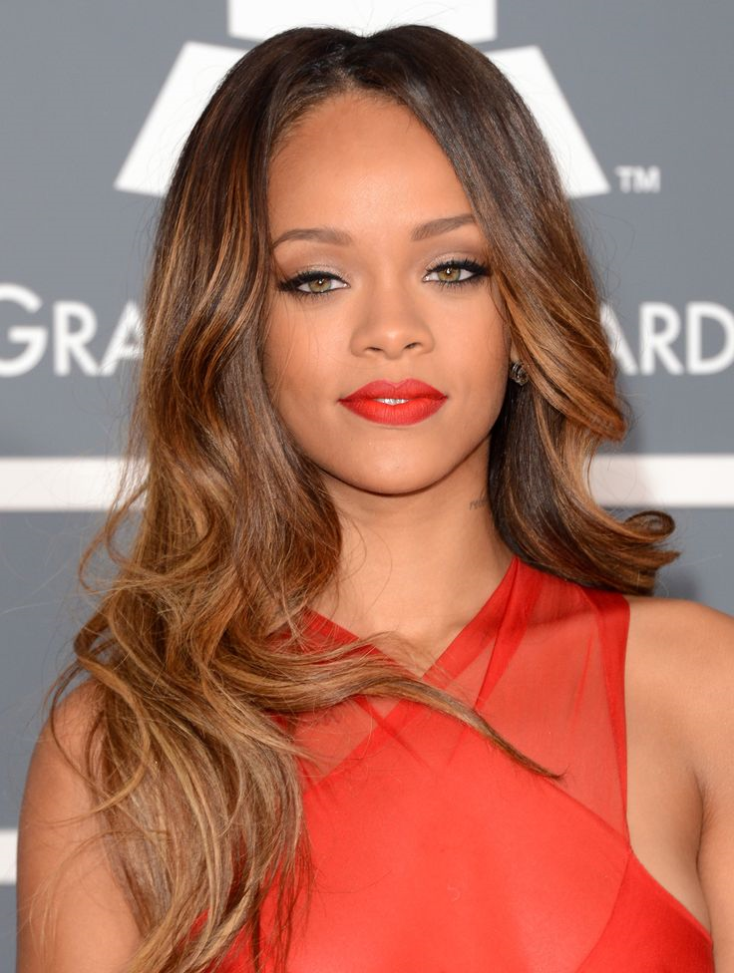
Who is she?

Slide 4
I’d appreciate a chance to have dinner with Robyn Fenty, a.k.a. Rihanna. As an eight-time Grammy（格莱美） winner, this Barbadian（巴巴多斯的） girl is a talented singer selling out millions of copies of music, with as many #1 singles on Billboard Hot 100 as Michael Jackson. Involved in many fields, she is not only an artist but also an entrepreneur collaborating with brands such as Puma and Dior. Being a fan listening to her songs for about five years, I would really like to learn about how this 27-year-old girl succeeds.
Rihanna

Slide 5
Diamonds
Shine bright like a diamond Shine bright like a diamond Find light in the _________ sea I choose to be _____ You and I, you and I We’re like diamonds in the sky You’re a ________ star I see A vision of ecstasy When you hold me, I’m _____ We’re like diamonds in the sky
I knew that we’d ______ one right away Oh, right away At first sight I felt the ______ of sun rays I saw the life inside your eyes So shine bright, ______, you and I We’re beautiful like diamonds in the sky Eye to eye, so alive We’re beautiful like diamonds in the sky

Slide 6
Diamonds
Palms rise to the ________ As we moonshine and molly Feel the ______, we’ll never die We’re like diamonds in the sky

Slide 7
Diamonds
Shine bright like a diamond Shine bright like a diamond Find light in the beautiful sea I choose to be happy You and I, you and I We’re like diamonds in the sky You’re a shooting star I see A vision of ecstasy When you hold me, I’m alive We’re like diamonds in the sky
I knew that we’d become one right away Oh, right away At first sight I felt the energy of sun rays I saw the life inside your eyes So shine bright, tonight , you and I We’re beautiful like diamonds in the sky Eye to eye, so alive We’re beautiful like diamonds in the sky

Slide 8
Diamonds
Palms rise to the universe As we moonshine and molly Feel the warmth, we’ll never die We’re like diamonds in the sky

Slide 9
1
Reddington, 17
3
4
2

Slide 10
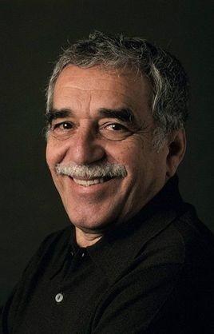
Gabriel
García Márquez
I would like to have dinner with Gabriel García Márquez, the author of One Hundred Years of Solitude. Gabriel was born into a extremely poor family in Columbia but with his hard work, he was awarded the Nobel prize in literature in 1982.

Slide 11
1
2
3
Starring , 16
4

Slide 12

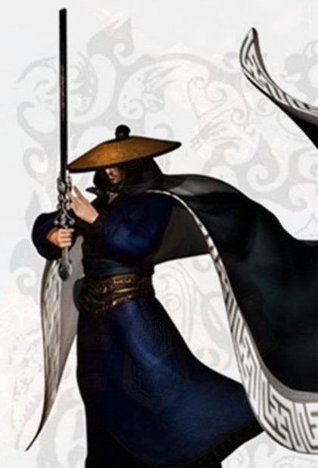
Who is his
Master’s
Master’s
Master’s
Master’s
Master?

Slide 13
I have a strong will to have dinner with Mozi, the pioneer of Mohism (墨家). It is universally acknowledged that Mohism is a theory with advanced idea ,which is promoted by the Chinese government today. As a result of the historical condition limitation , his ideal harmonious society has not been able to appear , but his thoughts of “The universal love ”,“ Against Aggression ”,“ Thrifty ” have provided rich cultural resources to the 21st century China′s harmonious society‘s construction . I’d like to have a debate of the realization of his points of view with him over dinner.
Mozi

Slide 14
Which period did Mozi live in?
α .The spring and Autumn Period
β .The Warring States
(Multiple choice)
What is his central ideas?
α . The Universal Love β .Individual
γ . Rule By Law δ. Against Aggression

Slide 15
1
2
3
4
Richard , 15

Slide 16
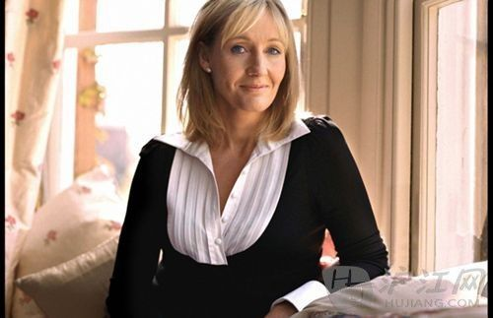
Who is she?
J . K . Rowling

Slide 17
GUESS!
Which book is this video based on?
http://www.iqiyi.com/pianhua/20110706/22412010b8b7fd6e.html

Slide 18
I have always been dreaming to have dinner with J. K. Rowling, the writer of the famous book series “Harry Potter”. It was in 1989 when she developed the idea of creating the magical little boy “Harry Potter”. Lasting for 18 years, the Harry Potter series finally comes to an end with the seventh book “Harry Potter and the deathly hallows”. Being made into films, Harry Potter series, which is translated into 67 languages, is fashionable world wide. Not only does it attract many children, but some adults also regard it as their favorite book. I’m one of the fans as well and I have dreamt to make an appointment with J. K. Rowling when I was just a little boy. I also admire her unique imagination and hope to have a further communication with her.
J.K. Rowling

