Slide 1
Unit 4 Book 1 Words & Expressions
right away= right ___ = in ___ time = immediately = at ___
smell n. & v. – adj.___ (looks/sounds/behaves) as if = as though___
nation n. – adj. ___ suffer v. – n. ___ extreme adj. – adv. ___
ruin the fun___; destroy the car___; damage the car___ ; harm your eyes___
injure v. – n. injury; deaths and injuries – adj. injured ; the injured
v. survive – n. ___ & ___
use n. & v. – adj. ___ VS ___ shock v. & n. – adj. ___ & ___
natural disasters___ mine n. – n. miner___ sincere adj. – adv. ___
frighten v. – adj. ___ & ____ judge n. & v. – n. ___ express v. – n. ___
v. congratulate sb. on sth.___ n. Congratulations!
electricity n. – adj. electric fan___ electric shock___
pt. & pp. burst___ ___ destroy___ ___ trap___ ___ dig___ ___ bury___ ___

Slide 2
Unit 4
Earthquakes

Slide 3
Natural disasters
Earthquake
tsunami
volcanic eruption
typhoon
hurricane
tornado
fire
flood
drought
...

Slide 4
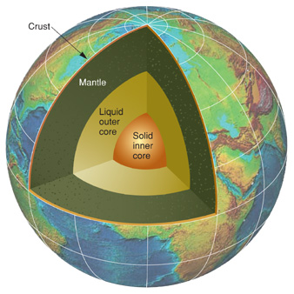
How does an earthquake occur?
crust
mantle
core

Slide 5
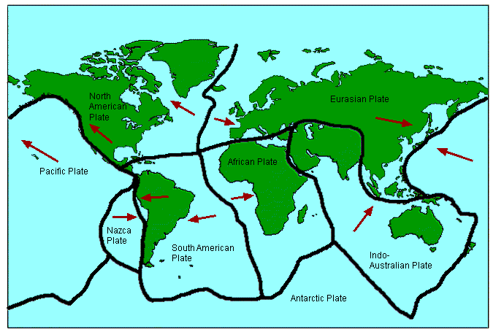
How does an earthquake occur?

Slide 6
Recent big earthquakes in China
●Tangshan
July 28, 1976
7.8 on the Richter scale
Deaths: 242, 419
Injuries: 164, 581

Slide 7
Recent big earthquakes in China
●Wenchuan
May 12, 2008
8.0 on the Richter scale
Deaths: 69,227
Injuries: 374,643

Slide 8
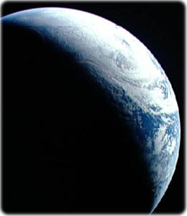
Reading
A Night
the Earth didn’t Sleep

Slide 9
Reading: A Night the Earth didn’t Sleep
Tangshan Earthquake
Place:
Tangshan, China
Time:
3:00am, July 28, 1976
Deaths & Injuries:
more than 400,000

Slide 10
Reading: A Night the Earth didn’t Sleep
before the quake
Para. 1: __________________
________ signs; ________ people
Para. 2-3: __________________
___________ power; ________ suffering
Para. 4: __________________
___________ action; ________ help
strange
poor
during the quake
destructive
extreme
after the quake
immediate
timely

Slide 11
Reading: A Night the Earth didn’t Sleep
Tangshan Earthquake
Place: Tangshan, China
Time: 3:00am, July 28, 1976
Deaths & Injuries: more than 400,000
A massive earthquake struck/hit Tangshan, China at 3:00am, July 28, 1976, leaving more than 400,000 killed or injured.

