Slide 1
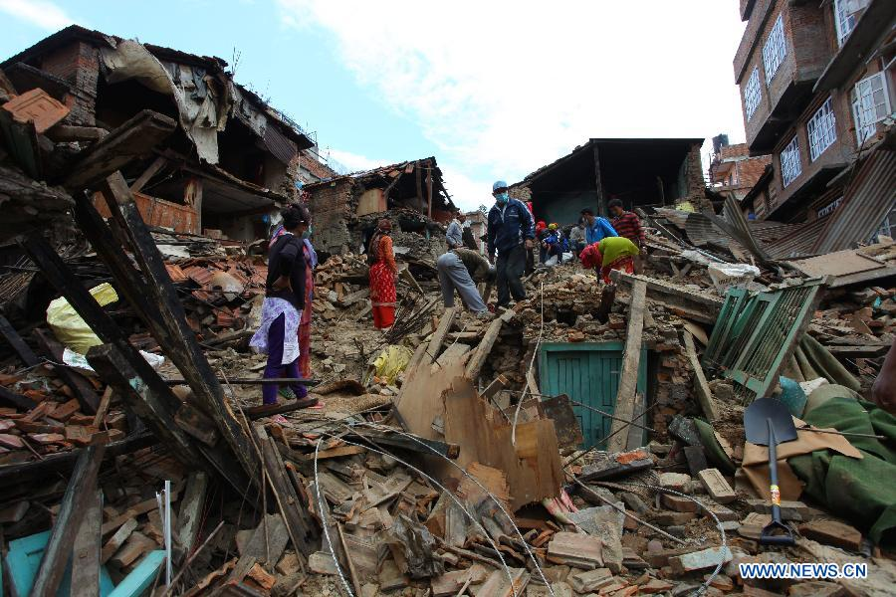
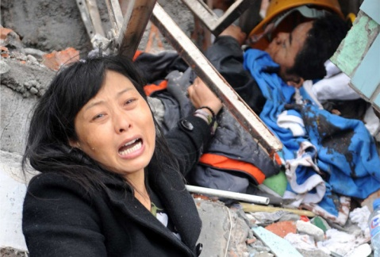
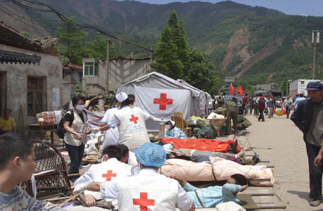
Notes:
Before class: Students review the words and expressions of Unit 4.
In class:
Lead-in: (teacher) What is an earthquake?
Teacher asks students to look at the pictures. Students form a group of four and brainstorm some words related to earthquakes.

Slide 2
A NIGHT THE EARTH DIDN’T SLEEP
Notes:
2. (描述，报幕）：In the history of mankind, there are several terribly destructive earthquakes. Can you name some?
A night the earth didn’t sleep: When did Tangshan earthquake happen?
Compared with “Tangshan Earthquake”, which one do you prefer? Why? (It has literary flavor.)

Slide 3
1ST Reading
Read the article and answer the following questions.
The article is organized in the order of _______.
Topic sentences:
3. How will you divide the four paragraphs?
time
Strange things were happening in the countryside of northeast Hebei.
It seemed as if the world was at an end!
Everywhere they looked nearly everything was destroyed.
All hope was not lost.
Notes:
3. 5 minutes for students to read the whole article and answer the three questions.
Q1: According to: “At about 3:00 am on July 28, 1976”; “At 3:42 am”; “began to shake”; “later that afternoon”; “soon after the shake”
Q2: Topic sentences: A topic sentence is not necessarily the first sentence of a paragraph. It sometimes appears in the middle of a paragraph.
Q3: Why are the 2nd and the 3rd paragraphs in Part 2? (Another big quake is mentioned in the 3rd paragraph.)

Slide 4
1ST Reading
Part 1 (Para. 1): _______ the earthquake
Part 2 (Para. 2-3): ________ the earthquake
Part 3 (Para. 4): ________ the earthquake
Before
During
After

Slide 5
2nd Reading Part 1 Before the earthquake
chickens
and pigs
a smelly gas
mice
water
cracks
animals
strange
things
fish
wells
bright lights
water pipes
sound of planes
Notes:
4. This is a mind map. The red circle stands for a central concept. It has branches, the blue circles and they are the level-one information connected closely to the central concept. The blue circle can have its own branches, the yellow circles which are the level-two information.

Slide 6
2nd Reading Part 2 During the earthquake
Draw a mind map together!
1. Please draw a mind map for Part 2 with your group members.
2. You have 4 minutes to finish it.
Notes:
5. Students are required to draw a mind map for Part 2. (4 minutes) The central concept “greatest earthquake” is given to them. Then they show their maps and retell Part 2.

Slide 7
2nd Reading Part 3 After the earthquake
survivors
miners
dug out
built shelters
rescued
soldiers and rescue workers
buried
the dead
hope
fresh water
Notes:
6. Ask students to retell Part 3 according to the mind map.

Slide 8
3rd Reading
Rhetorical devices
Personification
A NIGHT THE EARTH DIDN’T SLEEP
Slowly, the city began to breathe again.
Repetition
…the water in the village wells rose and fell, rose and fell.
Exaggeration
It seemed as if the world was at an end!
Simile
Bricks covered the ground like red autumn leaves.
Notes:
7. Please think about: if we want to express our feelings effectively, what should we use?

Slide 9
Assignment
Retell the whole article according to the three mind maps.

