Slide 1
主动表被动的词
感官动词
look、 feel 、taste、 sound、 smell
表事物特性的词
wash/sell/write/burn
特定词组
consist of
belong to
date back to
be worth doing
take place
break down
want/need/require doing=…+to be done

Slide 2
Jane was walking round the department store. She remembered how difficult __1__was to choose a suitable Christmas present for her father. She wished that he was as easy__2__(please)as her mother, who was always delighted with perfume.

Slide 3
adj + to do 形容词是表示难易、利弊等含义， （difficult, easy, comfortable, convenient, hard, cheap, expensive）
The question is difficult to answer. 这个问题很难回答。 The work is easy to do. 这项工作很好做。 I found the car comfortable to ride in. 我觉得这种车很好坐。 That makes poetry difficult to write. 那就使得诗很难写。

Slide 4
considering/given
（prep. &conj.鉴于，考虑到）
concerning/regarding
（prep.关于）
Considering/Given its high cost, this machine is not worth buying.
Last Monday, our class had a heated debate concerning whether human cloning should be allowed or not.
I am writing to make a complaint regarding the poor service I received from your restaurant.
有些分词已不再被看作是分词，失去了动词的本性，已演变成介词和连词。

Slide 5
Supposing /Provided /Providing
(conj. 假如）
Supposing that it rains tomorrow, our plan will be postponed.

Slide 6
有些分词已经是固定搭配
Generally speaking , dogs are more faithful to men than dogs.
(generally/roughly/frankly/honestly speaking)
Judging from his expression, he is in a bad mood.

Slide 7
Of+ great n. =adj.
Of great value
Of great help
Of great harm
Of great use
Of great necessity
Of great importance
Of great significance

Slide 8
和你们的作文比起来，他的作文写得更好。
他专心致志底工作，忘记了他最好的朋友的生日。
这座桥建于1192年，已经有700多年的历史了。
由于没有完成作业，他受到了老师的惩罚。
由于长期饱受洪水灾害的威胁，村民们向政府部门提出来在镇上修建一座大坝的建议。（expose）
所有事情安排好后，导游要求我们在3小时自由支配的时间内参观玩又有当地名胜。(available)
遗憾的是，由于要留心我们的包裹，我们忽略了一些著名经典。(keep one’s eyes on, leave out)

Slide 9
Compared with your compositions, his is better written.
Absorbed in the work, he forgot his best friend’s birthday.
Built in 1192, the bridge has a history of over 700 years old.
Not having finished the homework, he was punished by his teacher.
Exposed to the threat of the floods for so long, villagers put forward a suggestion that the government should build a dam in the town.
All things arranged, the guide required us to visit all local attractions within 3 hours available.
It is a pity that having to keep our eyes on the parcels , we left out some well-known scenic spots.

Slide 10
实义动词
及物动词必须跟宾语
不及物动词不直跟宾语
时态
语态
意思需要
时间标志
被动/主动
名称
谓动形式
意思
现在时
一般现在时
do/does
平时经常做
过去时
一般过去时
did
某次过去做
将来时
现在进行时
be+doing
现在正在做
情态动词
过去进行时
was/were+doing
过去正在做
有无被动,再考虑时态
一般将来时
will+do
现在将要做
该而不:感官动词
事物特性的词 ）
★过去将来时
would+do
过去将要做
使役动词正常不带to被动则带
现在完成时
have/has+done
到现在已做
★过去完成时
had+done
到过去已做

Slide 11
时态判断
所用时态
时间
标志
一般现在时
on Sundays
频率/真理/
时间条件状从句
一般过去时
ago, yesterday,
last week, in 1989
at the age of 5,just now
现在进行时
now
look, listen
过去进行时
at this time yesterday, at that time
when+过
一般将来时
tomorrow, this afternoon, next year
in+时间段
过去将来时
the next day
常用于宾从中
现在完成时
so far,in the past years,,since
already, yet,
ever, never,before, for
过去完成时
b
by yesterday/then/the end of
before+过，by+过

Slide 12
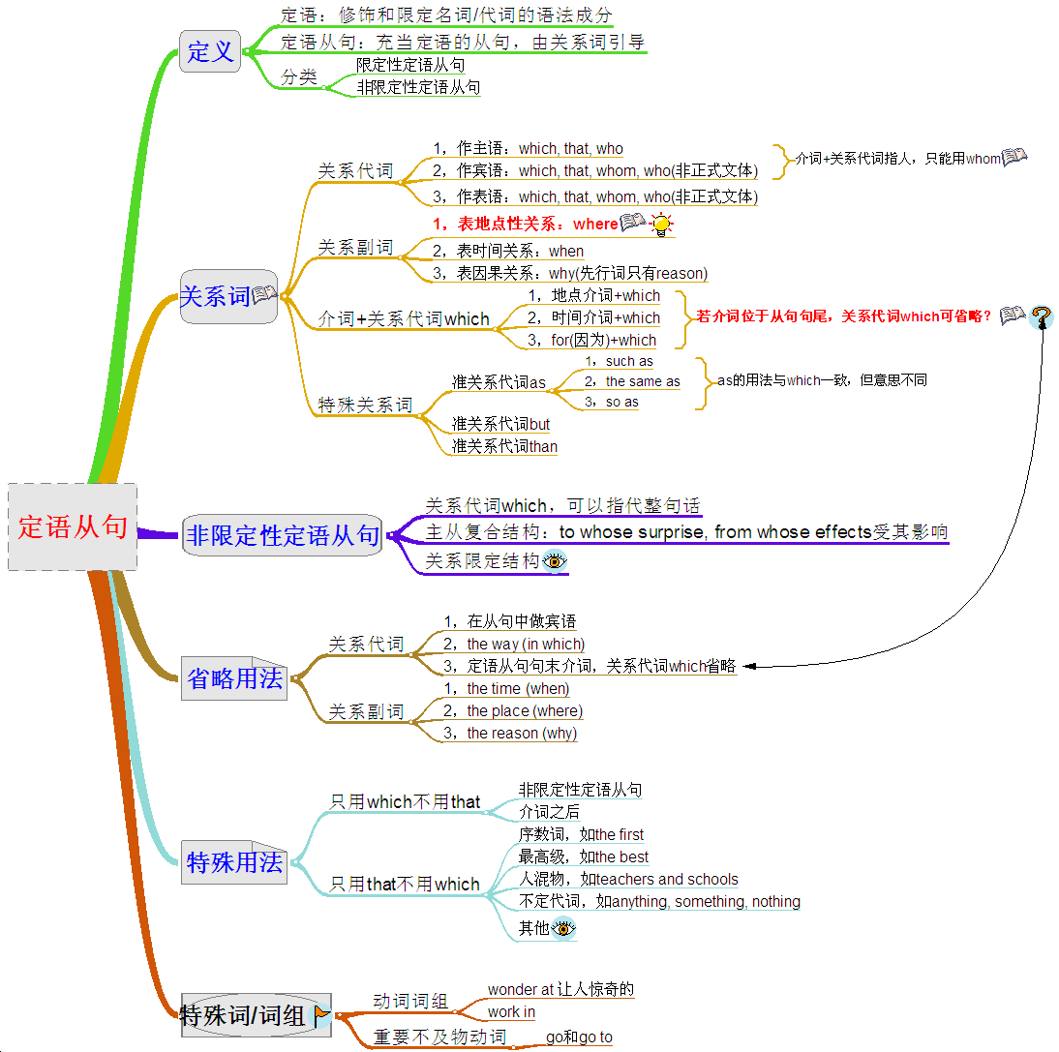

Test Paper Analysis
Poor Vocabulary
（Limited words& phrases）
Poor Grammar
(No systematic grammar knowledge)
Poor writing
(Simple words & sentence pattern)

Slide 13
高考书面表达 How to beautify a writing

Slide 14
高考评分标准
第五档（21-25） ： 完全完成试题规定的任务，完全达到了预期的写作目的，覆盖所有的内容要点，用了丰富的语法结构及高级词汇 ，全篇流畅，连词使用较好。
第四档（16-20） ： 完全完成试题规定的任务，达到了预期的写作目的，语法和词汇基本正确，但句式简单，没有亮点。想使用高级词汇与复杂句子，但有少些错误

Slide 15
高考阅卷特点：
1. 阅卷时间短；
2.阅卷的速度快；
3.阅卷老师的心理状态：给分中庸平均分 15
4. 高考卷其余部分是标准化计分
——书面表达是提高分数最大的潜力股

Slide 16
15分和20多分的作文到底差在哪里？
15分的作文中规中矩，该对的都对，包括内容要点的完整，语法与词形的正确，但句式简单，没有多少亮点。而20多分的作文句型词汇方面就做了很好的包装，它的句子如人穿的衣服，它已经不是普通校服，而是李宁、耐克等名牌，所以让人觉得很“拽”，而高考英语写作要的就是这种很“拽”的感觉.
词汇反映你知识贮存量的多少，也是衡量
英语水平的一个重要标志。

Slide 17
EX、运用高级词汇：
1.When he heard she had died, he went pale with sorrow.
Upon hearing the news that he was dead, he went pale…
At the news of her death, he went pale.
2. Computers are very important in our life.
computers are of great importance in our life.
Computers are highly significant in our life.
3. As a result, the plan failed.
The plan turned out to be a failure.
4. Suddenly I thought out a good idea.
A good idea suddenly occurred to me.
A good idea suddenly struck me

Slide 18
高考书面表达 各类书信体常用语

Slide 19
书信体
感谢信
致歉信
邀请信
建议信
求职/申请信
求助信
欢迎信
投诉信

Slide 20
Dear Mr. and Mrs. Smith,
I am now back to China safe and sound. In this letter I would like to
I will send the key to your house back to you, which I forgot to return before I left. And I feel terribly sorry for the inconvenience it may cause you.
I do hope that your whole family can pay a visit to China some day in the future, so that I could have the opportunity to repay your friendship. I assure you that you would enjoy visiting here as I did at your home.
I feel obliged to thank you once more.
convey my heartfelt thanks to you for your kindness and hospitality to host me in the summer holiday. Your generous help and tender care made me feel warmly welcomed and transformed my summer camp into a beautiful memory.

Slide 21
感谢信 (A letter of thanks)
Opening
I am writing to convey/show/ express my heartfelt gratitude /thanks to you for the…you have shown to me during/when…..
warm reception/entertainment
gracious hospitality,
loving/tender care,
kindness/assistance
On this special occasion, words have failed to express my heartfelt /deepest gratitude to you for …. (同上)
But for(Had it not been for) your generous help… …would not have…
(But for your generous help, my visit to/stay in Britain would not have been special and enjoyable)

Slide 22
感谢信 (A letter of thanks)
Ending
I, on behalf of my whole family/class/school, would like to thank you again for your generous help.
Nothing could ever return/repay the favor you gave me.

Slide 23
致歉信 (A letter of apology)
Opening
Now, I am writing to convey/show/ express my heartfelt apology to you for….
( long delaying in returning to you your book which I read through with great interest.)
(not being able to join you for the trip to the Beijing which we planned before.)
Had I …., I would have….
(Had I been more careful, I would have not dropped the vase on the ground)

Slide 24
致歉信 (A letter of apology)
Ending
I feel genuinely sorry for the inconvenience/trouble it may cause you. Hopefully you can understand my situation and accept our sincere apology.

Slide 25
邀请信 (A letter of invitation)
Opening
(On behalf of …), I feel genuinely/much honored to invite you to join ….as our ( guest, instructor, judge).
It is with great pleasure that I, (on behalf of…) am writing to invite you to…

Slide 26
邀请信 (A letter of invitation)
Ending
We will feel much honored if you could accept our invitation.
We should be more than happy if you could honor us with your presence.
Please don’t hesitate to contact me for further information (at1388888888 or at www.szsy.cn)

Slide 27
建议信 (A letter of suggestion)
Opening
You have asked me for my advice with regard to… and I am writing to give you/here are some suggestions, which I hope can be helpful to you to some extent

Slide 28
建议信 (A letter of suggestion)
Ending
Hopefully these suggestions will be of great help to you. If there is anything else I can do, I will be more than happy to help you.
Body
I think it would be a good idea/ more beneficial if you could…
Additionally, it is also of great importance to…
Beyond that, it is highly suggested that….
Why not…?/ Why don’t you…?

Slide 29
求职信/申请信 (A letter of application)
Opening
Learning from/Reading an advertisement in the newspaper that you are looking for /in need of...,I think I am qualified for the job/position. /I’m writing to apply for the position.
I am writing in response to the advertisement you placed in…. for a position as…., which I show great interest in.

Slide 30
求职信/申请信 (A letter of application)
Ending
I would be more than grateful if you could give a chance.
Any favorable consideration of my application will be highly appreciated.
If chosen/elected, I would dedicate all my energy and wisdom to the company/activity/club/class.
Looking forward to your reply at your earliest convenience.

Slide 31
求助信 (A letter for help)
Opening
Faced with some difficulties in…, I am writing to ask for your generous help.
Stressed and worried, I am writing to request you to assist me with my trouble/difficulty in….

Slide 32
求助信 (A letter for help)
Ending
I would be more than grateful if you could give me some help.
I would appreciate it if you could give your generous help.

Slide 33
欢迎信 (A letter of welcome)
Opening
Learning that you are coming to…I, on behalf of…. feel genuinely/much honored to extend our warmest welcome( and gracious greetings) to you.
It is with great pleasure that I am writing on behalf of …(our class,school) to extend our welcome to you.

Slide 34
欢迎信 (A letter of welcome)
Ending
Please allow me to extend again our welcome and wish you a pleasant journey/experience

Slide 35
投诉信 (A letter of complaint)
Opening
I am writing to make a complaint /to express my dissatisfaction about/regarding…
the poor service I received from your restaurant.
the tape recorder I bought/ordered in your store

Slide 36
投诉信 (A letter of complaint)
Ending
I do hope you can give me a satisfying reply and deal with this matter seriously.
Hopefully you will take my complaint seriously and do something with this matter.
Thank you for your favorable consideration.

Slide 37
假定你是李华，作为一名交换生（an exchange student）刚结束在英国为期一个月的学习。学习期间，你和房东Mr．Wilson结下了深厚的友谊。请按下列要点给Mr．Wilson发一封邮件：
1．对Mr．Wilson在你生活上的照顾和学习上的帮助表示感谢；
2．希望保持联系；
3．邀请他来中国游玩。

Slide 38
假定你是李华，前些天你的外籍教师David邀请你去他家吃饭，对你十分热情，席间还给你讲了许多西方的进餐礼节和习惯，你学到了不少知识。现在请你用英语给他写一封感谢信，并对由于你的粗心而将茶杯掉在地上表示道歉。顺便告诉他你已搬进新居，住在解放路58号，欢迎他来你家做客。

Slide 39
Dear Mr. Wilson, Time flies! I've been back home. How I miss the days we spent together! All I saw and experienced will be part of my memory. It was your help and kindness that made my study and life in the UK special and enjoyable. Thanks to your help, I got used to the life there soon. I still miss the delicious meals you prepared for me. Besides, I really appreciate your patience while talking with me. It was a wonderful time for me to improve my spoken English. And I also learned a lot about your country and the English culture. I hope we can stay in touch with each other. I am looking forward to your coming to China in the near future. Best wishes, Li Hua

Slide 40
I’m writing this letter to thank you for inviting me to dinner in your house the other day. You were so kind and I did feel at home. The food you cooked was very delicious, so I enjoyed it very much. And you also told me so much about good manners in Western countries, from which I got a lot of knowledge. Thank you again.
I will have to apologise for dropping your tea cup onto the floor because of my carelessness. Luckily, it didn’t break.
By the way, I have moved into my new flat at No. 58 Jie Fang Road. Welcome to my new flat.
Looking forward to seeing you.
Best wishes!

Slide 41
假设你叫李华，现是武汉大学的一名新生。请你根据以下提示，给你中学的英语老师李老师写一封感谢信，表达对他的爱戴和尊敬。词数100左右。
提示：
1．对英语李老师教学的评价。
2．回顾在校时你的心情。
3．对老师的理解和祝愿。
信的开头已经写好，但不计入总词数。

Slide 42
假设你叫李华，现是某中学的一名高二学生。你的美国笔友Jack来信谈及汉语学习的困难并请你提出一些汉语学习的建议。请你根据以下提示，给Jack写一封回信, 提示： 1、学习汉语一定要有兴趣，不怕困难； 2、不要怕犯错误，多听，多读，多练； 3、创造和利用学习汉语的机会，如：结交中国朋友等； 4、其他建议…… 注意：1)可适当增加细节，以使行文连贯； 2)信的开头已经写好，但不计人总词数； 3)词数120左右 Dear Jack, I’m glad to receive your letter asking for my advice on how to learn Chinese well. ________________________________________________________________________________ ________________________________________________________________________________ Good luck to you! Li Hua

Slide 43
假定你是李华，你的英国朋友Peter来信向你咨询如何才能学好中文。请你根据要点写封回信。
要点：
参加中文学习班 2. 看中文书刊、电视
3. 学唱中文歌曲 4. 交中国朋友
Dear Peter, I’m glad to receive your letter asking for my advice on how to learn Chinese
well.___________________________________
Best wishes,

Slide 44
Dear Peter, I’m glad to receive your letter asking for my advice on how to learn Chinese well. Here are a few suggestions. First, it is Important to take a Chinese course, as you’ll be able to learn from the teacher and practice with your fellow students. Then, it also helps to watch TV and read books, newspapers and magazines in Chinese whenever possible. Besides, it should be a good idea to learn and sing Chinese songs, because by doing so you’ll learn and remember Chinese words more easily. You can also make more Chinese friends，who will tell you a lot about China and help you learn Chinese. Try and write me in Chinese next time. Best wishes, Li Hua

Slide 45
信件类型：求职信 内容：写信人申请工作 主体时态：一般现在时，一般过去时 正文部分： 1、介绍信息来源（开篇交代句）,表明求职心愿（写信目的。） 3、介绍个人简历。 4、摆出求职优势。 5、提出获职打算。 6、请求答复联系。（通讯地址、邮政编码、电话号码、电子信箱等） 7、表明感激之情。

Slide 46
假设你是李华，申请到一家外资企业工作，你需要用英文给该公司经理写一封信，介绍自己的基本情况，信件必须包括下面全部内容： 姓名: 李华；出生年月: 1981年8月； 出生地: 广东省佛山市； 学历: 1994—2000 佛山第一中学 2000—2004 广州大学计算机系 2004—至今在一所中学工作 所学主要课程: 计算机、中文、数学、英语、体育 特长：计算机编程 爱好: 音乐、游泳（曾获大学游泳比赛一等奖） 联系电话：5673678 E-mail: lihua6688@yahoo.com.cn 要求：简介必须包括以上全部内容（信的开头和结尾已经写好） Dear Manager, ___________________________________________ I am looking forward to your reply. Thank you very much. Yours Truly, Li Hua

Slide 47
I learned from the newspaper that your company wanted to hire a computer engineer. I am interested in this position and writing to apply for it.
My name is Li Hua and I was born in Foshan City of Guangdong Province in August 1981. I studied in Foshan No. 1 Middle School from 1994 – 2000, and then I came to study in the Computer Department of Guangzhou University for four years. I majored in computer science, but my strong point is computer programming. In addition, I studied Chinese, maths, English, P.E. and now I am working for a high school. I also like pop music and swimming very much, and I once won the first prize for swimming in the school competition. If I am accepted, I’ll work hard and try my best to make a contribution to the company. My telephone number is 5673678. E-mail: lihua6688@yahoo.com.cn I am looking forward to your reply. Thank you very much.

Slide 48
抱怨信
内容：写信人针对未能解决的问题提出抱怨，希望得到对方的帮助 主体时态：一般过去时 正文部分： ①切中要害，客观说明存在的问题。 ②怨之有节，重在解决问题（ 有礼有节，说明存在的问题对自己造成的不利影响或危害；必要时也可提出自己对存在问题的解决办法或建议）。

Slide 49
假如你是卜曼宜，你购买了一部某外国公司生产的手机，因有质量问题，要求该公司更换。请根据下列要点，用英文写一封电子邮件。 要点： 1. 问题：手机不响铃，不能发短信； 该产品已售完，无法更换；型号新，无配件，无法维修。 2.要求：公司应尽快予以更换。 注意:1. 词数为100左右 2.参考词汇：配件 ——spare part 3.电子邮件的开头和结尾已为你写好 Dear Sir, I am writing to you for the mobile phone of Dephone-S250 I bought on 20th Apr.2008 at Tele Mall in Wuhan, P.R. China_____________________________________________ Thank you for your consideration. Sincerely yours Bu Manyi

Slide 50
Dear Sir, I am writing to you for the mobile phone of ... Ten days after that, it didn't ring and send short messages. Then I took it to the seller, but was told that the model had been sold out and I had to wait at least three months for a new one. Later I went to the repairman. He said since it was a new model in China, it was impossible to fix it without the right spare parts. I was so desperate on hearing that. How can I wait that long? Therefore, I require that you send me a new one of the same model within a month. Thank you for your consideration. Sincerely yours, Bu Manyi

Slide 51
假如你叫李华，你的家乡原来有座茂密的森林，但现在已变成了荒漠。请根据下面几幅图的内容，向一家英文报社写一篇“Protecting The Forest”的短文。注意：1. 词数100左右； 2. 开头已为你写好 Protecting The Forest My hometown used to be a beautiful place.

Slide 52
