Slide 3
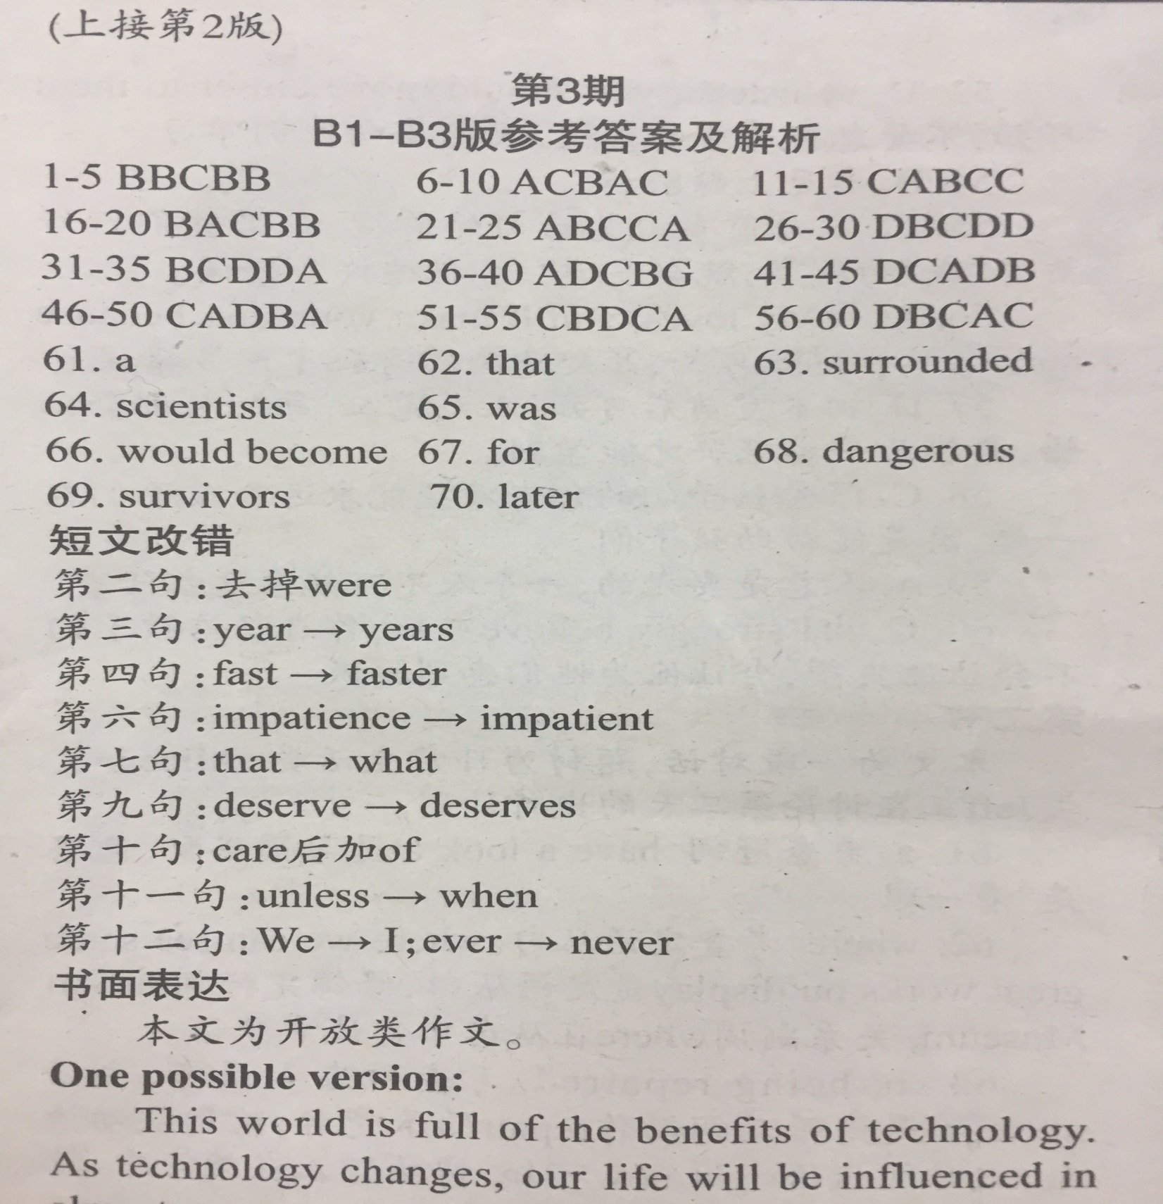

Slide 4
（7）
1.加上to 2. tell--told 3. friend—friends 4.sing--singing 5. many--much 6.so--but 7. How—What 8. are--were 9. him--them 10. 去掉with

Slide 5
（8）
1. side→sides 2.from→of
3.sit→sitting 4.easy→easily
5.is→was 6.them→it
7.not去掉 8.in a hurry
9.felt→feel 10.If→Although/Though

Slide 6
（9）
1.parent改为parents 2. on改为in 3. very去掉 4. looks改为looking 5. where改为that 6. begun改为began 7. telling改为told 8. a改为the 9. saw后加his 10. terrible改为terribly

Slide 7
（10）
1．去掉in 2．anything→something
3．better→best 4．decide→decided
5．step→steps 6.well→good
7.after→when/while 8．a→the
9．get前加to 10.enjoy→enjoying

Slide 8
（11）
1.before→ago 2．by→of
3.year→years 4．had→have
5．as a result 6．somewhere→everywhere
7．taste→tasty 8．much→many
9.but去掉或改为yet
10．wonderfully→wonderful

Slide 9
Examiner-friendly
Beautiful handwriting
Clear structure
Opening para.
Body
Ending para.

Slide 10
Opening Para.
I’m writing to tell you that…
I writing to invite you to…
One or two sentences.

Slide 11
Ending Para.
What are you waiting for? Come and have a try.
Looking forward to your reply.
I am looking forward to hearing from you.

Slide 12
Ending Para.
I sincerely hope that…
I really appreciate it if….
Looking forward to your early reply.

Slide 13
Body
Well organize the given information.
(not translate word by word)
Be more native speaking
(flexible sentence pattern)

Slide 14
I’m writing to tell you that our school is hunting for an English teacher, which I believe is quite appealing to you. The detailed information goes as follows.
The courses you are going to teach include Speaking, Writing, Britain Today and America Today, which are intended for senior students with at least 3 years of learning English experience. But you are expected to choose only three of them and work 12 hours per week. Beyond that, you will be invited to work as an advisor to our students’ English Club or our school’s English newspaper.
It will be highly appreciated if you can come to school for a work. Looking forward to your early reply.

Slide 15
假定你是李华，你校英文报“外国文化”栏目拟刊登美国节日风俗和中学生生活的短文。请给美国朋友彼得写信约稿，要点如下：
1.栏目介绍；
2.稿件内容；
3.稿件长度：约400词汇 ；
4.交稿日期：6月28日前天 。
Dear Peter,
How are you doing? I am writing to invite you to write an article for our school’s English newspaper.
I am sorry for the trouble that I’ve brought to you, but we truly need your help. Looking forward to your reply!

Slide 16
假设你是李华，刚结束学校安排的“加拿大之旅”返回中国，请给你在加拿大时接待家庭的主人Johnson夫妇写一封信，要点如下：
你已安全返回长沙；
感谢他们的盛情款待和照顾。
How are you doing? I am writing to tell you that I had a safe journey back to China. Thanks to your kindness and hospitality, I had a wonderful time in Canada. (opening para. )
Hopefully you can come to China some day and I have the chance to repay your kindness. Best wishes to you and your family. (ending para.)

