Slide 1
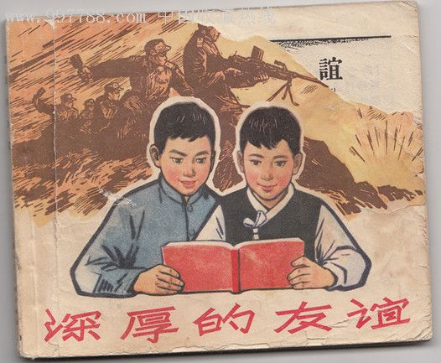
Unit 1. Friendship

Slide 2
Quotes
Love is blind;
Friendship closes its eyes. ---Unknown
The difficulty is not so great to die for a friend, as to find a friend worth dying for. ---Homer
Be slow in choosing a friend, slower in changing. ---Benjamin Franklin

Slide 3

P1

Slide 4

Words and
Expressions
upset
ignore
calm
concern
loose
adj. 心烦意乱的; 不安的; 不适的
vt. 使不安; 使心烦
vt. 不理睬; 忽视
vt. & vi. (使)平静; (使)镇定
adj. 平静的; 镇静的; 沉着的
vt. (使)担忧; 涉及; 关系到
n. 担心; 关注; (利害)关系
adj. 松的; 松开的

Slide 5

Words and
Expressions
add up
calm (…) down
have got to
be concerned about
walk the dog
合计
(使)平静下来;
(使)镇定下来
不得不; 必须
关心; 挂念
遛狗

Slide 6
Topic Reading （English Weekly）
Teammates

Slide 7
Friend = People?
Animal ?
Plant?
Lifeless thing?

Slide 8

Video A
Video B

Slide 9
True friendship can
exist between any two souls.
It can happen,
at any moment,
to anyone.

Slide 10
Anne Frank
Anne Frank was born on June 12, 1929 in Frankfurt, Germany. At that time the Jewish community formed an important part of the city’s economic and cultural success. Her father, Otto Frank, was a respected businessman whose family had lived in the city for many generations.

Slide 11
After the German invasion (侵略) of 1940, Anne was forced to leave her school. Almost right away, the Gestapo (盖世太保) began to send thousands of Dutch resisters (反抗者) to slave labour camps in Germany. Then in February 1941 the Gestapo began to arrest Jews.
It was at this moment that Otto Frank made plans to hide his family. They moved to Amsterdam, Netherlands.

Slide 12
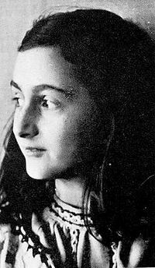
When Margot, Anne’s older sister died in March, 1945, Anne probably lost her desire to live. She died just before her 16th birthday and less than a month before the surviving Jews were liberated.

Slide 13
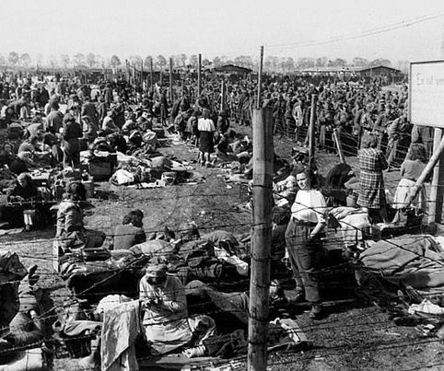
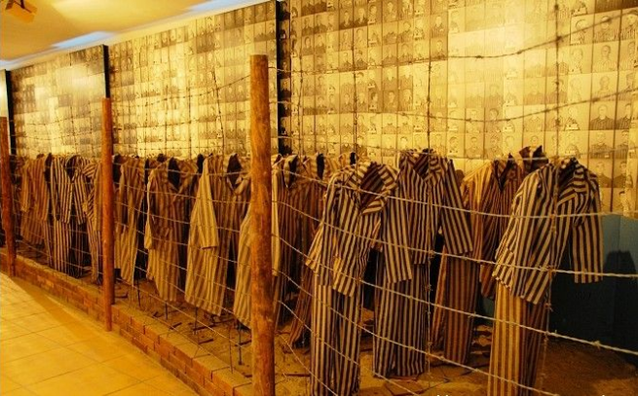
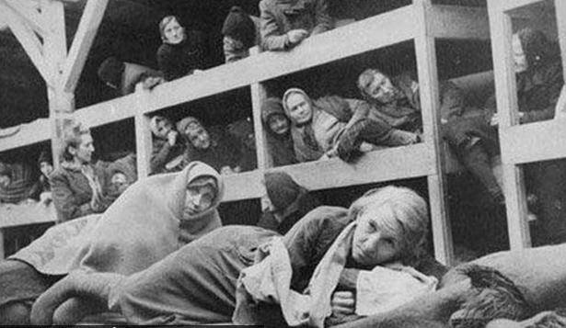
concentration camp

