Slide 1
Satisfaction Guaranteed

Slide 2
http://www.bilibili.com/video/av3532986/index_1.html
A brief introduction of Isaac Asimov

Slide 3
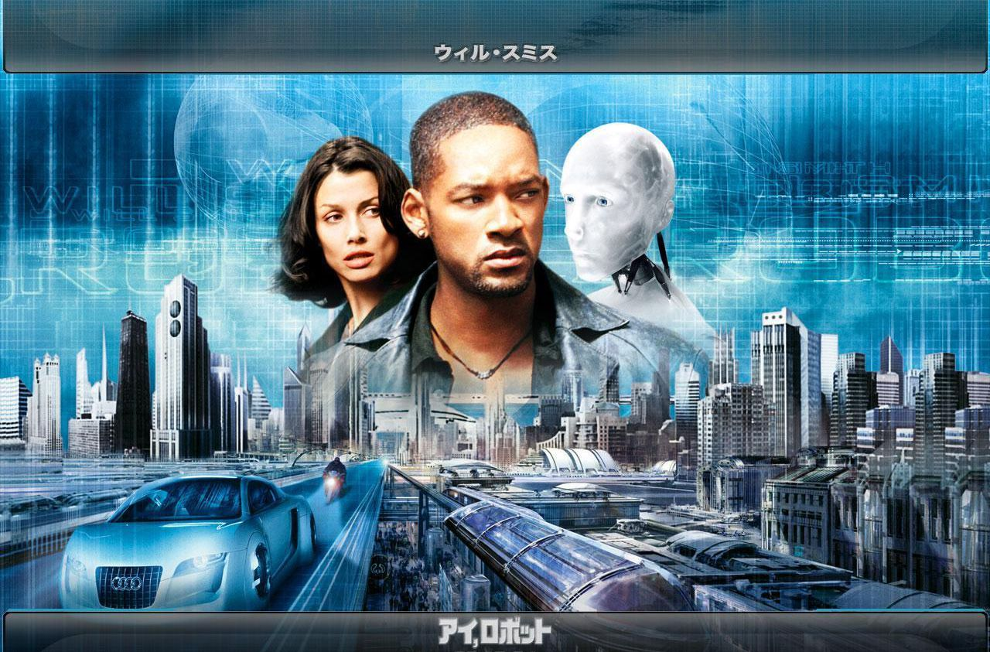
http://www.iqiyi.com/w_19rs5fny9p.html

Slide 4
The text mainly tells us ___.
A. why Claire fell in love with a human being
B. why a robot fell in love with a human being
C. a story about a household robot being tested out in a family
D. that a robot can save a human being from danger

Slide 5
How many characters are there in the story ?
Larry Belmont – employed in a company that makes robots
Claire – Larry’s wife, a housewife
Tony – the robot to be tested out by Claire in their family
Gladys Claffern – the most powerful women around, a woman that Claire envies

Slide 6
Claire’s feelings towards Tony changed as the story developed. List out stages and her feelings.
Before his arrival
When he arrived
When he offered to help her dress
When he offered to help her improve her house and herself
When he helped her with the salesman
When she fell off a ladder and was caught by Tony
When she heard Gladys’ whispering to another woman that she had never seen anyone so handsome as Tony
She remembered Tony was just a machine

Slide 7
Review Claire’s emotional development
Refuse to have Tony at her house
Accept him
Trust him
Proud of him
Love him
Sad to remember he was just a machine

Slide 8
In what aspects are Tony different from/similar to human beings?
Physically
Mentally

Slide 9
Did Tony fall in love with Claire in the end?

Slide 10
P12 five Qs

