Slide 1
Football / Soccer

Slide 2
Football was originally a kind of ball game in ancient China, called “cuju”.
Modern football originated in England. In 12th century, there was a war between England and Denmark. After the war ended, British soldiers saw a head of a Denmark soldier on the ground, so they started to kick it to give vent to(发泄) anger.

Slide 3
On October 26, 1863, the first football organization on the world, the English football association, was founded. The modern football was born officially.
There are lots of different kinds of competitions nowadays, such as the World Cup, the Chinese Super League and so on.

Slide 4
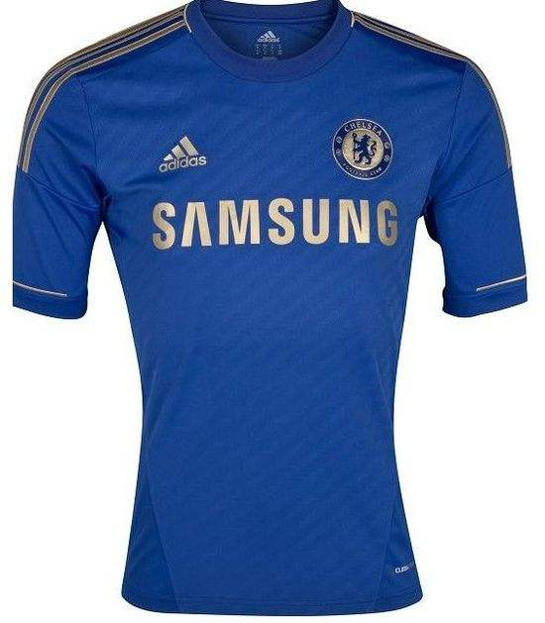
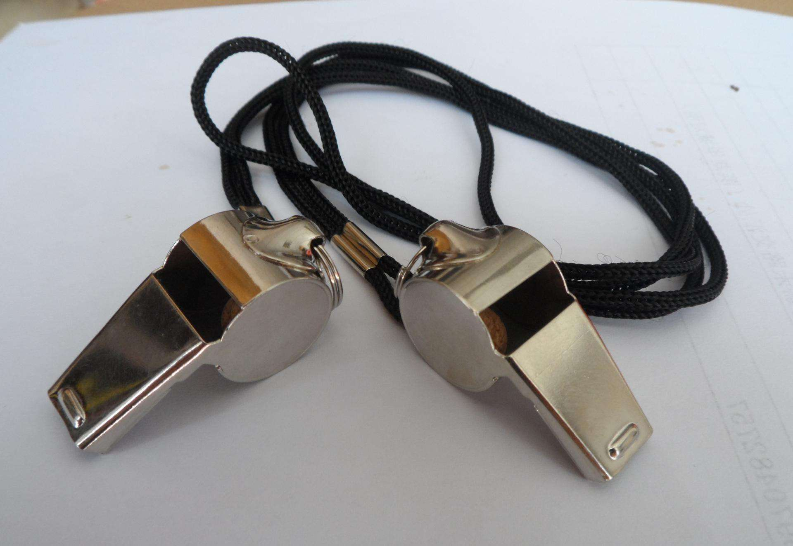
jersey
whistle

Slide 5

referee

Slide 6
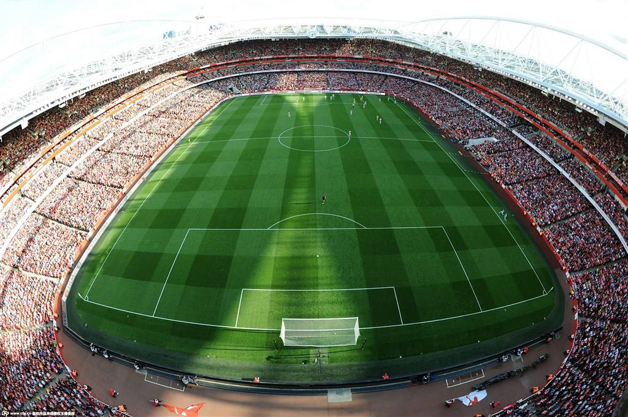
Football field / Football pitch

Slide 7
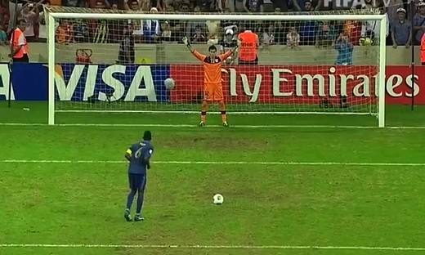
Penalty

Slide 8

Score
(nil three)

Slide 9
It is dangerous. People get hurt and even die.
It is infectious. People roar because of victory, and cry because of defeat.
Football is a sport about passion, struggle, respect and honor. And this is why it attracts so many people around the world.

Slide 10
Thank you

