Slide 1
Countries want our business too
各具特色的国家旅游宣传语

Slide 2


Marketers come up with catchy slogans（口号）to try sell us their products .
We are all familiar with——
Or NIKE’s——

Slide 3

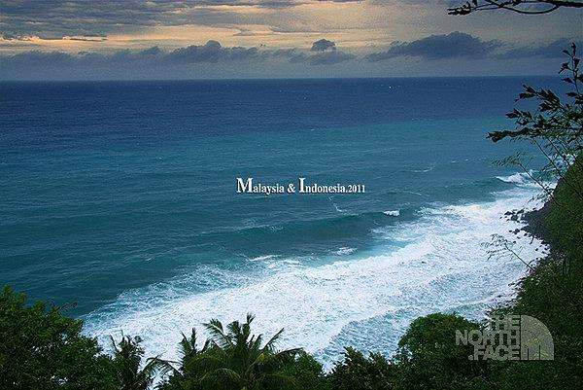
Countries too use slogans to attract people.
India’s——
And Indonesia’s——
“Indonesia , truly Asia”

Slide 4
LET’S SEE SOME TOURISM SLOGANS AND TRY TO TRANSLATE THEM!

Slide 5
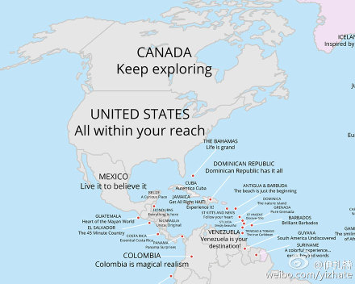
Translate it.
不断探索
一切触手可及
哥伦比亚魔幻现实主义

Slide 6
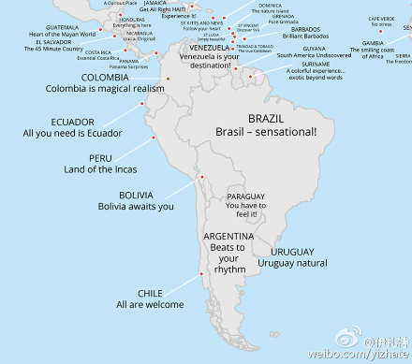
Translate it.
Sensational
adj.
耸人听闻的; 轰动的;
极好的; 绝妙的;
玻利维亚等待着你
来者不拒;
打出你的节奏

Slide 7
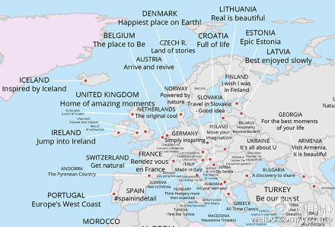
最好慢慢欣赏
令人神往的地方
到达并恢复
一块有故事的土地

Slide 8
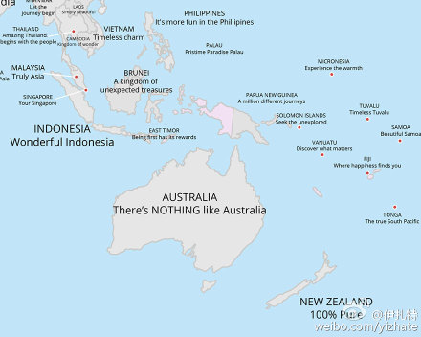
百分百纯正
没有什么像澳大利亚这么好
100%PURE

Slide 9


There are also quite a few clever slogans.
Some are alliteration（头韵; 双声; ）
Such as:
Brilliant Barbados
（辉煌的巴巴多斯）
美丽的孟加拉国

Slide 10
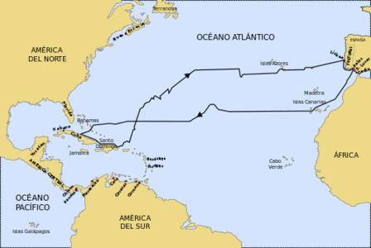
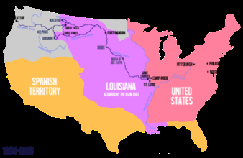
A lot of slogans are about discovery . There is Moldova([mɒl‘dəʊvə]摩尔多瓦）’s“Discovery the route of life.”And both Lesotho(莱索托,非洲南部一王国，首都Maseru)’s “Kingdom of wonder ” slogans make one want to buy a plane ticket and head there.

Slide 11
AT LAST,HERE IS MY FAVOURITE SLOGAN ABOVE ALL…

Slide 12



Coming in Shenzhen, you are Shenzhen’s master
It isn’t a tourism slogan
But it shows a welcome attitude of people
in Shenzhen towards the world

Slide 13
THANK YOU FOR WATCHING！☺

