Slide 1
Duty report by Group-
——张泰玮 张珅 王致远
吴俊杰 屈浩轩
3

Slide 2
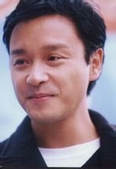
At 18:43，Ap.1st ，2003，the famous actor-Zhang Guorong’s death shocked everybody. According to his wife, he had suffered from a mental disease called “Depression illness” ,which made him could not control himself to jump off from the tall building. His last word said something such as ‘I haven’t done anything guilty,why does things going on like this?’

Slide 3
So, what’s depression means?? Why does it so harmful that even kills people?
That is our topic today—
Depression

Slide 4
a FORMAL expression
A medical condition that makes you very unhappy and anxious and often prevents you from living a normal life.
--Um…it seems like something very bad happened…So, what things?

Slide 5
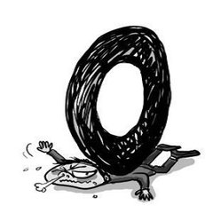
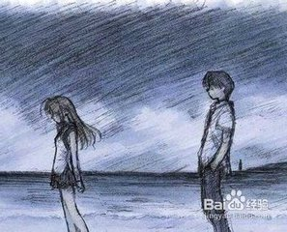
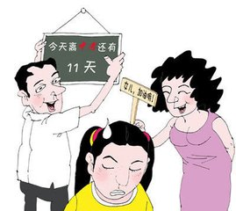
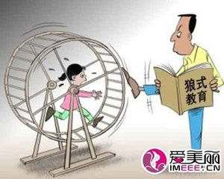
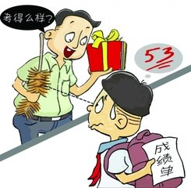

Such as…

Slide 6
The problem is：
A few students feels depressed about their marks, friendship, family and so on. Their study becomes more and more terrible, and their confidence runs away, even hide themselves and keep silense from others. If such things goes on, something more horrible may happen.

Slide 7
IF…
1.You thinks that things always goes bad.
2.People around couldn’t be trusted
3.Your parents is making you mad
4.You couldn’t sleep well
5.You don’t feel like eating so that you are becoming thinner and thinner
6.The world is your enemy
Be careful!!

Slide 8
Tips
Perhaps you need a better attitude through life.
Perhaps some club activities may help you
Perhaps some musics, books or movies will make sense?
Perhaps talk with your faithful friend?
Or your dear parents?
Or doctor Liu Meng??
Or some people like…

Slide 9
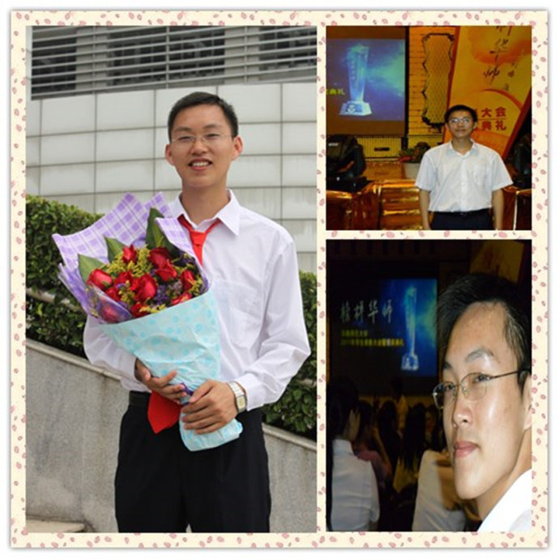
Um?What’s up?Tell me!

Slide 10
‘A saying from family’ (Translate by yourself)
Depression is not such a horrible thing that you imagine. It is just a small river on your life road. If you are afraid, even feel hopeless and jumped into it, death is waiting for you. But if you trust yourself, make a brige and cross it over, you will find that, it is just a beautiful, little stream. Then you could proudly say to those behind: ‘The bridges I have crossed is more than that the roads you have crossed!’

Slide 11
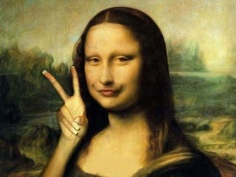
Thanks for watching~

