Slide 1
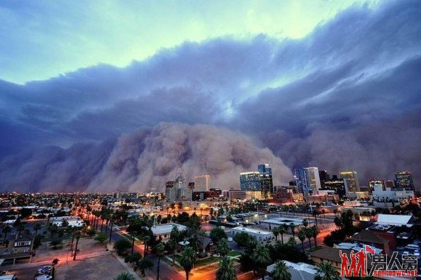
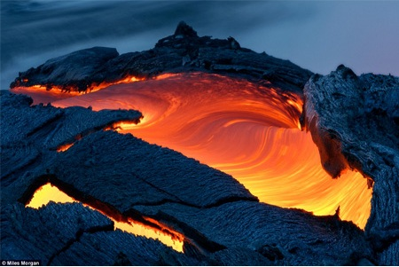
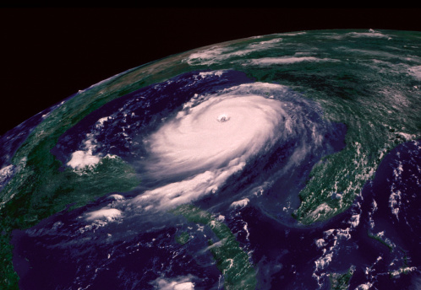
The power of nature

Slide 2
volcano
A volcano is a place on the Earth’s surface (or any other planet’s or moon’s surface) where molten（熔融） rock, gases and pyroclastic debris（火山碎屑） erupt through the earth’s crust（地壳）. Volcanoes vary quite a bit in their structure - some are cracks in the earth’s crust where lava（熔岩） erupts, and some are domes, shields, or mountain-like structures with a crater（陨石坑） at the summit.

Slide 3
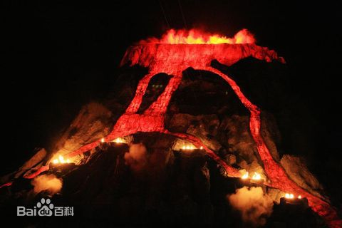
Volcanic classification
Active volcano
Extinct volcano
Dormant volcano
活火山
死火山
休眠火山

Slide 4
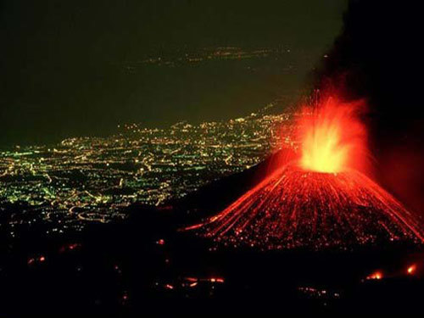
Eruption type
Quiet eruption
Blasting fierce type eruption
Middle type eruption
宁静式喷发
爆裂式喷发
中间式喷发

Slide 5
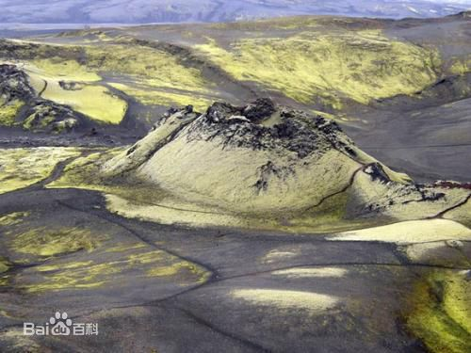
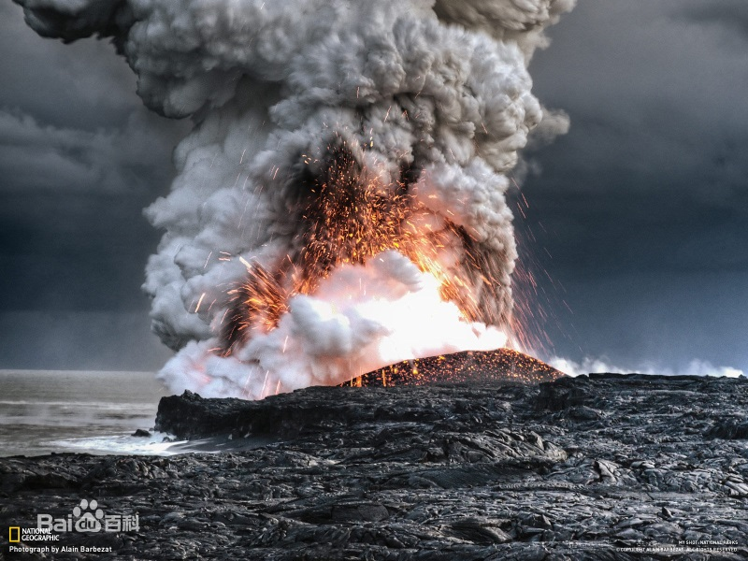
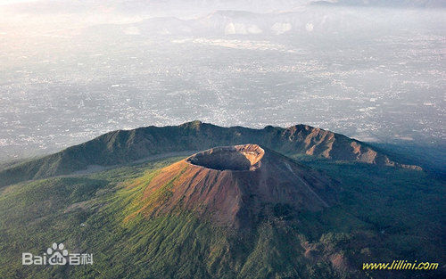
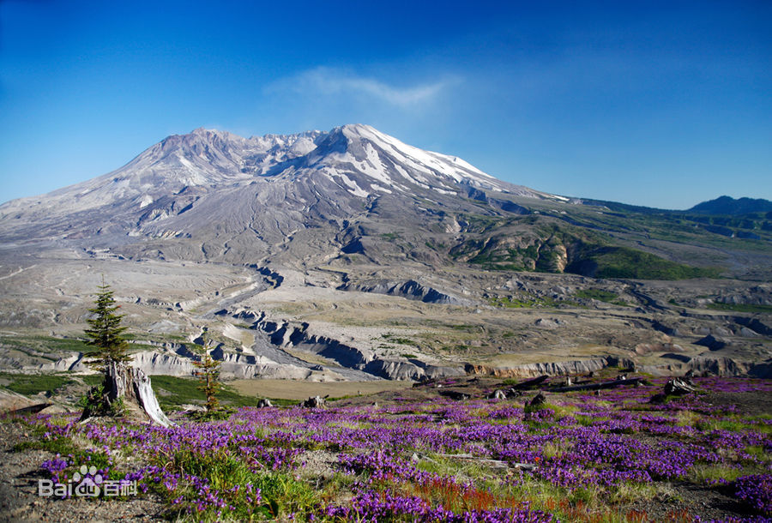
Several big active volcanos in the world
The laki（拉基）volcano in iceland
莫纳罗亚火山（Mauna Loa）
Vesuvius（维苏威火山）valcano
圣海伦火山（Mount St. Helen’s）

Slide 6
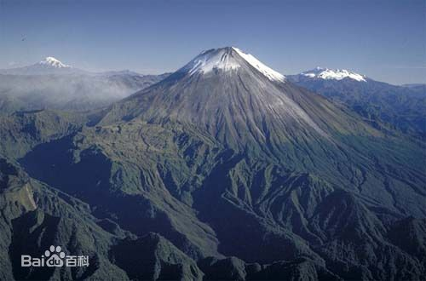
Sangay（桑盖）national park volcano

Slide 7
That ’s all
Thank you！

