Slide 1
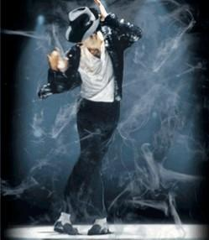
请在此放置您的文字

Slide 2
Michael Jackson is one of the most successful and influential pop recording artists of all time. Born in 1958, he began his career as a member of the Jackson 5 recording for Motown with four of his brothers. They hit 1 on the pop singles chart with "I Want You Back" in 1969. It was followed by three more consecutive 1 hits. The group's popularity faded in the mid 1970's, but, after moving to the CBS record label and calling themselves simply the Jacksons, they consistently hit the charts in the late 1970's and early 1980's.

Slide 3
Top Michael Jackson Hits
•1979 - "Don't Stop 'Til You Get Enough" (One week at #1)
•1979 - "Rock With You" (Four weeks at #1)
•1983 - "Billie Jean" (Seven weeks at #1)
•1983 - "Beat It!" (Three weeks at #1)
•1983 - "Say Say Say" with Paul McCartney (Six weeks at #1)
•1987 - "Bad" (Two weeks at #1)
•1987 - "The Way You Make Me Feel" (One week at #1)
•1988 - "Man In the Mirror" (Two weeks at #1)
•1991 - "Black Or White" (Seven weeks at #1)
•1995 - "You Are Not Alone" (One week at #1)

Slide 4
Michael Jackson's Controversies:
Michael Jackson's career and life have had their fair share of controversies. In the mid 1980's he was the subject of widespread tabloid stories including tales of sleeping in an oxygen chamber to slow aging, bleaching his skin, and undergoing multiple rounds of plastic surgery. In the early 1990's Michael Jackson was accused of sexually abusing a child in a case ultimately closed for lack of evidence. In 2005 Jackson was put on trial for allegations of sexual molestation. He was acquitted on all counts.

Slide 5
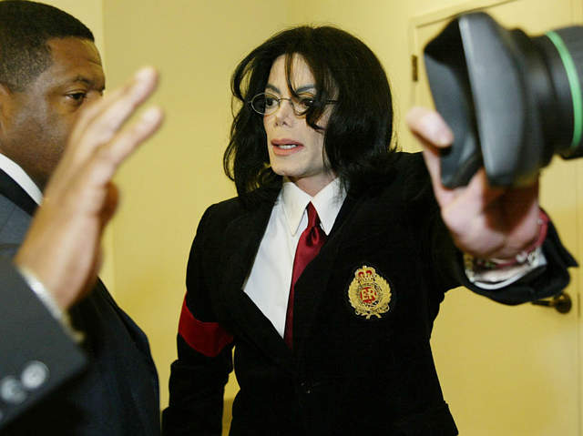

Slide 6
Thank you

