Slide 1

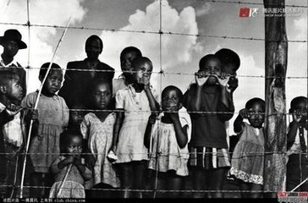
Unit 5 Reading
ELIAS’ STORY

Slide 2
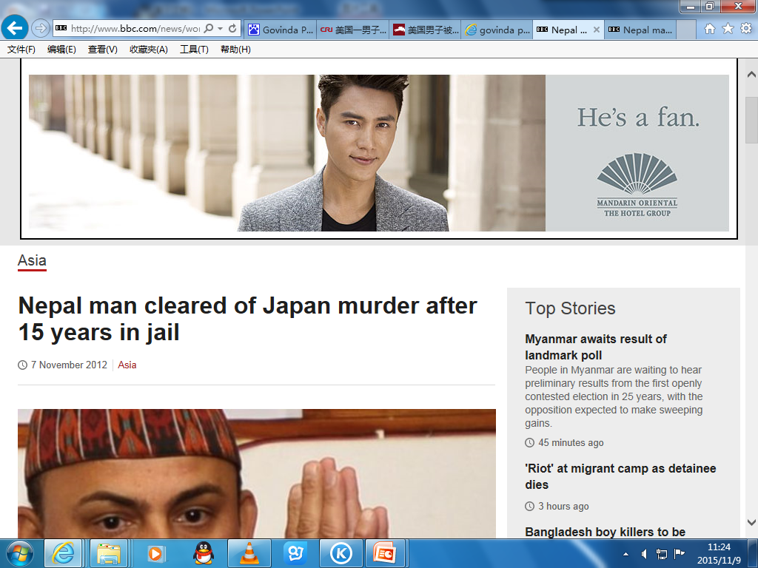
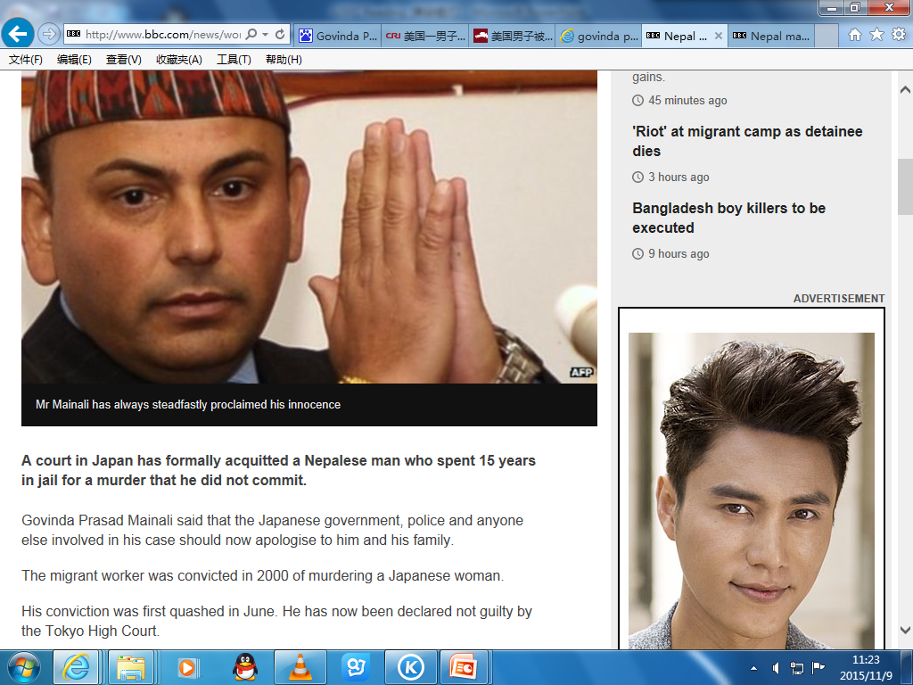

Slide 3

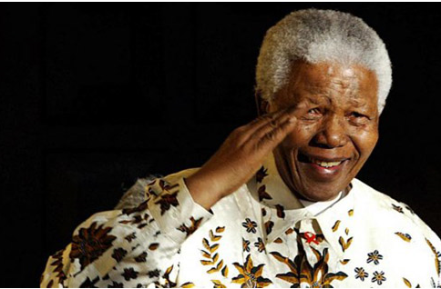

Slide 4

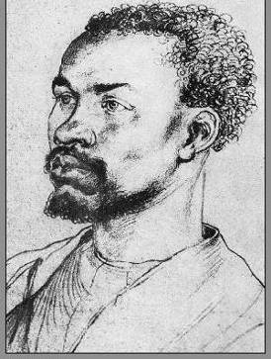
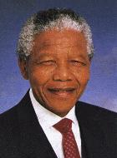
Listen to the tape. Figure out who Elias is and the connection between M & E?
?
E (Elias)
M (Nelson Mandela)

Slide 5
Skim Para.1 and fill in the blanks.
Elias:
black worker
a poor _____ ______ in South Africa
Nelson Mandela:
a _____ _______ who offered guidance to poor black people in South Africa
black lawyer
The text tells us about _____ (whose) life and what he did with _______________(whom) to fight for _____ people.
Elias’
Nelson Mandela
black

Slide 6
Skim the paragraphs and answer the questions.
1.Why did Elias visit Nelson Mandela? (Para. 2)
2. Why did Elias said it is the happiest day of his life? (Para. 3)
3. What was the unfair situation black people faced？(Para. 5)

Slide 7
Why did Elias visit Nelson Mandela? (Para.2)
Elias visited Nelson Mandela because he needed legal help. He was not legally allowed to work without a passbook.

Slide 8
2. Why did Elias said it is the happiest day of his life? (Para. 3)
Because with Mandela’s help, Elias could stay in Johannesburg. He became more hopeful about his future.

Slide 9
3. What was the unfair situation black people faced？(Para.5)
They could not vote or choose their leader.
They could not choose where to live, their jobs or their homeland outside the city.

Slide 10
Changes of Elias’ life and feelings
Para.2
Before E met M
Para.3
M helped E
Para.7
E joined ANC

Slide 11
Stage 1. Before Elias met Mandela（Para.2）:
What was Elias’ life like?
1. He had to leave school because his family could not pay the school fees and the bus fare.
2. He could not read or write well.
3. He might lose his job because he didn’t have a passbook to live in Johannesburg.

Slide 12
Stage 1. Before Elias met Mandela:
Adjectives to describe Elias’ life
Poor
Difficult
Worrying
Adjectives to describe Elias’ feelings
Hopeless
Sad
Worried

Slide 13
Stage 2. The day Mandela helped Elias (Para.3):
What help did Mandela offer to Elias? (Para 3)
He told Elias how to get the correct papers to get the passbook to stay in Johannesburg.
Which adj. did Elias use to describe the day?
Happiest
How did Elias feel about his future then?
Hopeful

Slide 14
Stage 3. After Elias joined the ANC (Para.7):
Adjectives to describe Elias’ life (Para.7)
Dangerous but meaningful
He blew up some government buildings, and if he was caught, he could be put in prison.
What he did helped the black people achieve their dream of making black and white people equal.
Adjective to describe Elias’ feelings
Proud

Slide 15
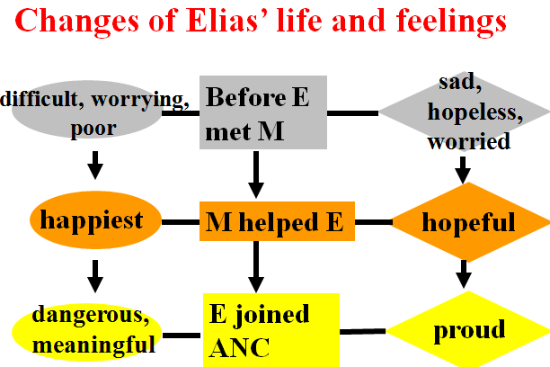

Slide 16
Choose the best answer.
1. According to the text, what was not the situation for black people in South Africa at that time?
A. Black people had no right to vote.
B. They couldn’t get the jobs they wanted.
C. They could choose where to live.
D. They were sent to the poorest areas
where no one could grow food.

Slide 17
2. Why did Elias turn to Nelson Mandela for help?
A. He didn’t have a passbook to live in
Johannesburg.
B. He was badly treated by his cruel
boss.
C. He was thought to have stolen some
gold.
D. He had a fight with a white boy.

Slide 18
3. Why did Elias help Mandela blow up some government buildings?
A. Because he liked violence.
B. Because it was not dangerous.
C. Because he thought it was a way to
make black people and white people
equal.
D. Because he wanted to be famous.

Slide 19

Discussion
Find out the great qualities of Mandela according to the passage.

Slide 20
Find out the great qualities of Mandela according to the passage.
He offered guidance to poor black people on their legal problems.
He told me how to get the correct papers so I could stay in Johannesburg.
Helpful
Kind & Intelligent

Slide 21
We were put into a position in which we had either to accept we were less important, or fight the government. We chose to attack the laws. We first broke the law in a way which was peaceful; when this was not allowed … only then did we decide to answer violence with violence.
Brave, Determined & Unselfish

Slide 22
Homework: （Textbook）
Read the passage on P38
Exercise on P70 T1.2

