Slide 1
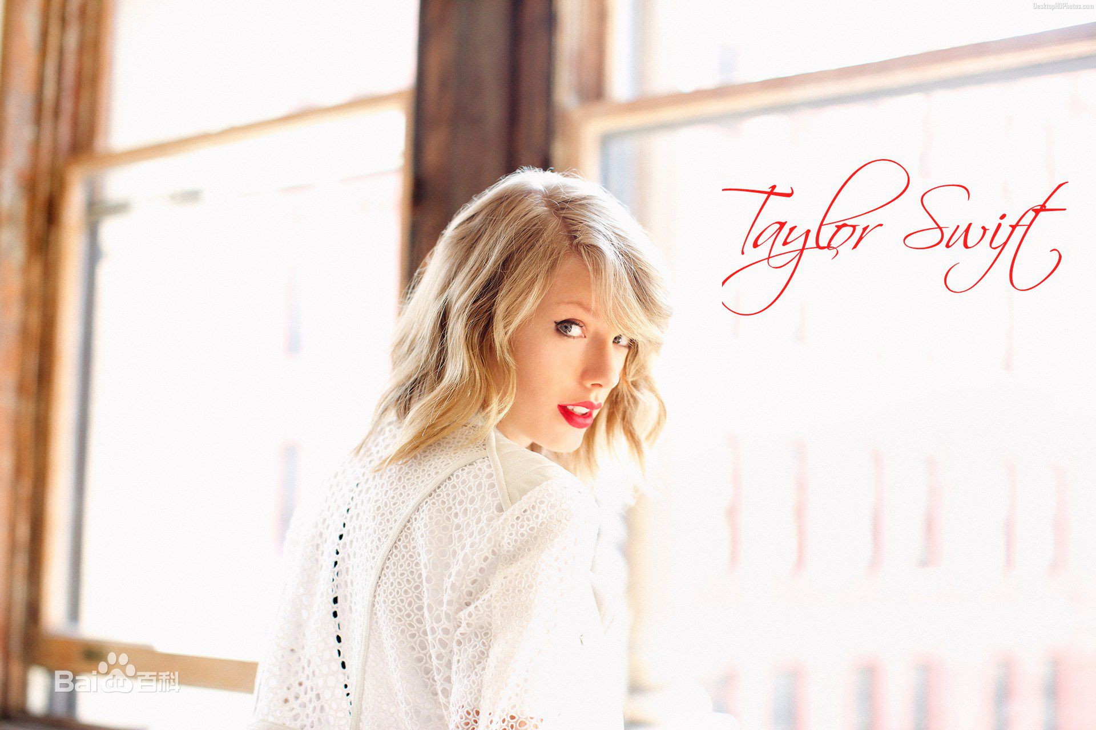
Taylor Swift
Lucky

Slide 2
Taylor Alison Swift (born December 13, 1989) is an American singer-songwriter. Throughout her career, she has become one of the most popular female contemporary singers. She is known for narrative songs about her personal life, which has received much media attention.

Slide 3
Famous songs
Love story
You belong with me~
I knew you were in trouble
We are never ever getting back together
Enchanted

Slide 4

Owl city

Slide 5
Owl City is an American electronica project created in 2007 in Owatonna, Minnesota; it is one of several projects by singer, songwriter and multi-instrumentalist Adam Young. Young created the project while experimenting with music in his parents' basement. Owl City developed a following on the social networking site MySpace, like many musicians who achieved success in the late 2000s, before signing with Universal Republic Records, now Republic Records, in 2008.

Slide 6
And i just wish you knew taylor i was so in love with you
Enchanted

