Slide 1

Explore the deepest secret of humans.

Slide 2
What is the dream?
1.The scene in your mind
2.From physiology or mentality
3.Uncontrollable
4.Fictitious(not ture)

Slide 3
Why we have dream?
During the daytime, what people experienced influenced the brain.
In the night , those things will reappear again in people’s dreams because of the brain .
Caused by the activity of the cells in your brain(nerve cells)

Slide 4
What our dreams can do?
1.Release the deep, secret desires
2. Solve problems that we can’t solve in real life(analyse them)
3. Cleaning up the brain’s hard disk, organizing the events,deleting the rubbish
4. Practising the behaviour that we need to survive

Slide 5

It’s reported that sleeping
takes up one-third time in our life.
In the same time dreaming
takes up one-fifth
of the sleeping time.
Do you want to know
the meaning of your dream?

Slide 6
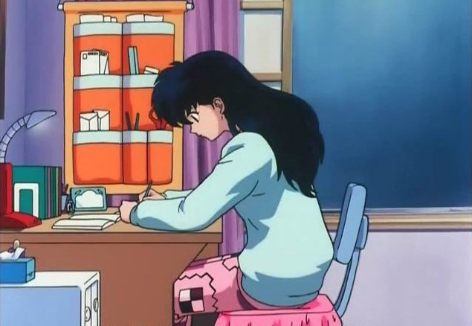
Dream : Examination
You are so nervous, anxious, under great pressure these days.
Maybe, you will face some important things in some days .

Slide 7

Dream : You are killed
The trouble which bothered you for a long time has been solved.You feel free yourselves that shows you will face a new life,so you should be enthusiastic in the future.

Slide 8

Dream: You are chased by someone
It means you want to escape something or something forces you that make you under stress.
So you want to release your presure in your dreams.

Slide 9
Conclusion
Dream is just a dream , as students we should pay more attention on the real life and the school life .

Slide 10
Hope is a waking dream.
——Aristotle
This moment will nap（打盹）, you will have a dream; But this moment study,you will interpret（诠释） a dream.
——Harvard University

