Slide 1

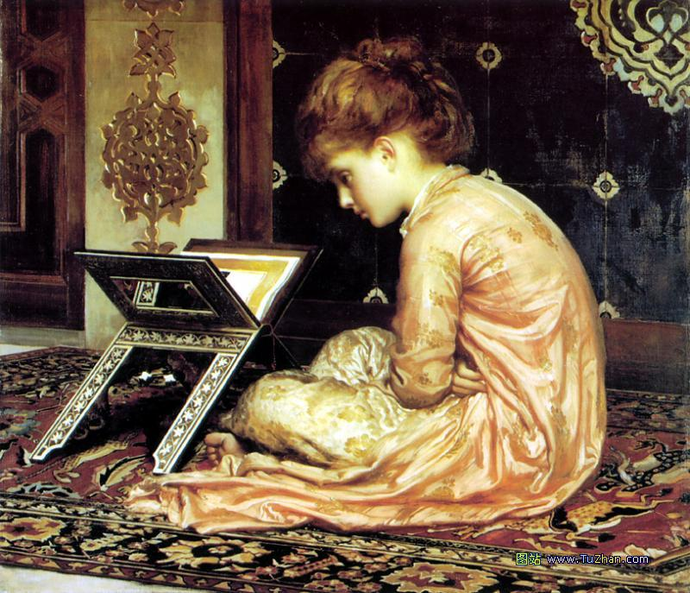
Module 4
Reading and Vocabulary

Slide 2
contemporary adj. 当代的, 同时代的,
电话和留声机是同一时代的产物。
The telephone and the gramophone were contemporary.
n. 同代人, 同龄人
约翰与我同龄。
John is a contemporary of mine.
delightful adj. 令人非常高兴的, 讨人喜欢的
这是一次愉快的聚会。
It was a delightful party.
draw vt. & vi. 绘画, 画
他画了一些画。
He drew some pictures.
拖, 拉
这辆马车很容易拉。
The cart draws easily.

Slide 3
vt. 拔出, 取出, 抽出
他拔出枪就开火。
He drew his gun and fired.
引起, 吸引
飞机引来敌人的炮火。
The airplane drew the enemy's fire.
vi. 移动, 来临
国庆节快到了。
The National Day is drawing closer.
n. 抽奖, 抽签
抽奖什么时候举行?
When does the draw take place?
平局, 不分胜负
比赛以平局告终。
The game ended in a draw.

Slide 4
paint n. 油漆, 涂料
别碰这门, 油漆未干。
Don't touch the door; the paint is wet.
颜料
我把颜料忘在家里了。
I left my paints at home.
化妆品
那个女孩妆化得太浓了。
That girl wears far too much paint.
vt. & vi. 画; 绘画
小姑娘的水彩画画得很好。
The little girl paints nicely in watercolours.
描绘, 描述
那位作家生动地描绘了他早年的生活。
The writer paints a vivid picture of his early life.

Slide 5
scene n. (戏剧的)一场, (电影)一个镜头, (小说的)一节
在开头他们又增加了一场戏。
They have added a new scene at the beginning.
背景, 现场
他设计了全部布景和服装。
He has designed all the scenes and costumes.
地点
这个杀人嫌疑犯解释不清为什么在杀人现场会留有他的指纹。
The murder suspect couldn't explain away his fingerprints at the scene.
景色, 景象
我们又往高处爬以便能更好地观看这景色。
We climbed higher so that we might see the scenes better.

Slide 6
traditional adj.传统的, 惯例的
感恩节吃火鸡是传统。
It's traditional to eat turkey at Thanksgiving.
alive adj. 活着的, 在世的, 存在的
他仍然活着。
He is still alive.
有活力的, 活跃的, 有生气的
他浑身是劲。
He is alive in every nerve.
aspect n. 方面
训练计划的范围包括了这种工作的各个方面。
The training program covers every aspect of the job.

Slide 7
方位, 朝向
这栋房子朝北。
The house has a north-facing aspect.
面貌, 模样, 神态
他是一个面目狰狞的彪形大汉。
He is a man of enormous size and terrifying aspect.
imitate vt.模仿
詹姆斯能逼真地模仿他父亲。
James can imitate his father perfectly.
把…作为例子
你应该效法她做事的方式。
You should imitate her way of doing things.

Slide 8
observe vt. & vi. 观察; 研究
他总是仔细观察, 很少说话。
He observes carefully but says little.
vt. 看到; 注意到
难道你没有看出差别?
Didn't you observe the difference?
遵守; 遵循
他们忠实地遵守规则。
They faithfully observed the rules.
reality n. 现实, 实际
我们以为他是认真的, 但实际上他是在开玩笑。
We thought he was serious but in reality he was joking.
真实的事物
影片非常逼真地展现了贫困地区的生活。
The film showed life in the poor areas with great reality.

Slide 9
style n. 风格, 格调; 文体
他是个很受欢迎的作家, 但我不喜欢他的文风。
He is a very popular writer but I don't like his style.
行为方式, 作风
他从不对人阿谀奉承。
Flattery is not his style.
种类, 类型; 流行式样; 款式
你喜欢什么式样的家具?
What style of furniture do you like?
风度; 格调; 气派
他很有风度。
He has great style.

Slide 10
contemporary adj. 当代的, 同时代的,
电话和留声机是同一时代的产物。
The telephone and the gramophone were contemporary.
n. 同代人, 同龄人
约翰与我同龄。
John is a contemporary of mine.
delightful adj. 令人非常高兴的, 讨人喜欢的
这是一次愉快的聚会。
It was a delightful party.
draw vt. & vi. 绘画, 画
他画了一些画。
He drew some pictures.
拖, 拉
这辆马车很容易拉。
The cart draws easily.

Slide 11
vt. 拔出, 取出, 抽出
他拔出枪就开火。
He drew his gun and fired.
引起, 吸引
飞机引来敌人的炮火。
The airplane drew the enemy's fire.
vi. 移动, 来临
国庆节快到了。
The National Day is drawing closer.
n. 抽奖, 抽签
抽奖什么时候举行?
When does the draw take place?
平局, 不分胜负
比赛以平局告终。
The game ended in a draw.

Slide 12
paint n. 油漆, 涂料
别碰这门, 油漆未干。
Don't touch the door; the paint is wet.
颜料
我把颜料忘在家里了。
I left my paints at home.
化妆品
那个女孩妆化得太浓了。
That girl wears far too much paint.
vt. & vi. 画; 绘画
小姑娘的水彩画画得很好。
The little girl paints nicely in watercolours.
描绘, 描述
那位作家生动地描绘了他早年的生活。
The writer paints a vivid picture of his early life.

Slide 13
scene n. (戏剧的)一场, (电影)一个镜头, (小说的)一节
在开头他们又增加了一场戏。
They have added a new scene at the beginning.
背景, 现场
他设计了全部布景和服装。
He has designed all the scenes and costumes.
地点
这个杀人嫌疑犯解释不清为什么在杀人现场会留有他的指纹。
The murder suspect couldn't explain away his fingerprints at the scene.
景色, 景象
我们又往高处爬以便能更好地观看这景色。
We climbed higher so that we might see the scenes better.

Slide 14
traditional adj.传统的, 惯例的
感恩节吃火鸡是传统。
It's traditional to eat turkey at Thanksgiving.
alive adj. 活着的, 在世的, 存在的
他仍然活着。
He is still alive.
有活力的, 活跃的, 有生气的
他浑身是劲。
He is alive in every nerve.
aspect n. 方面
训练计划的范围包括了这种工作的各个方面。
The training program covers every aspect of the job.

Slide 15
方位, 朝向
这栋房子朝北。
The house has a north-facing aspect.
面貌, 模样, 神态
他是一个面目狰狞的彪形大汉。
He is a man of enormous size and terrifying aspect.
imitate vt.模仿
詹姆斯能逼真地模仿他父亲。
James can imitate his father perfectly.
把…作为例子
你应该效法她做事的方式。
You should imitate her way of doing things.

Slide 16
observe vt. & vi. 观察; 研究
他总是仔细观察, 很少说话。
He observes carefully but says little.
vt. 看到; 注意到
难道你没有看出差别?
Didn't you observe the difference?
遵守; 遵循
他们忠实地遵守规则。
They faithfully observed the rules.
reality n. 现实, 实际
我们以为他是认真的, 但实际上他是在开玩笑。
We thought he was serious but in reality he was joking.
真实的事物
影片非常逼真地展现了贫困地区的生活。
The film showed life in the poor areas with great reality.

Slide 17
style n. 风格, 格调; 文体
他是个很受欢迎的作家, 但我不喜欢他的文风。
He is a very popular writer but I don't like his style.
行为方式, 作风
他从不对人阿谀奉承。
Flattery is not his style.
种类, 类型; 流行式样; 款式
你喜欢什么式样的家具?
What style of furniture do you like?
风度; 格调; 气派
他很有风度。
He has great style.

Slide 18
adopt vt.收养
许多无子女的夫妇收养孩子。
Many childless couples adopt children.
采用, 采纳, 采取
那几家工厂采用了现代的最新技术。
The factories have adopted the newest modern technology.
正式接受, 通过
他去法国后, 很快就接受了法国的生活方式。
After going to France he soon adopted the French way of life.
aim vt. & vi. (以…)瞄准; 针对
她用枪仔细瞄准了目标。
She aimed the gun at the target carefully.
vi. 以…为目标[目的]
你志向太低。
You aim too low.

Slide 19
stand n. 立脚点; 站立
他突然站住了。
He made a sudden stand.
售货处; 摊
车站入口处有一个卖汉堡的小摊。
There was a hamburger stand at the entrance to the station.
主张, 立场; 态度
他对这个问题的立场没有改变。
His stand toward the matter has not changed.
vi. 坐落, 位于
房屋坐落于小山上。
The house stands on a hill.
维持原状; 保持效力
本规则依然有效。
The rule still stands.

Slide 20
vt. 竖放
你应该把箱子竖着放。
You should stand the box on end.
忍耐; 忍受; 经得起, 受得起
我忍受不了那个人了。
I cannot stand that man.
vi. & link v. 处于某种状态
在假期中教室都空着。
The classroom stands empty during the holiday.
link v. 高度为…
他身高4英尺9英寸。
He stood 4 feet 9 inches.

Slide 21
exhibition n. 展览, 展览会
她将为自己的画作举办一个展览会。
She will have an exhibition of her pictures.
表现, 显示
这次测验是他显示知识的好机会。
The quiz was a good opportunity for the exhibition of his knowledge.
expression n.表示, 表现, 表达
他在那封信的结尾表达了自己的感激之情。
He closed his letter with expression of grateful thanks.
表情
他们所有的表情都不是真的。
All their expressions were not true.

Slide 22
感情
她的声音缺乏感情。
Her voice lacked expression.
landscape n. 风景, 景色
他站在山上眺望景色。
He stood on the hill surveying the landscape.
风景画, 风景照
他画风景画, 而他的妻子则画肖像画。
He paints landscapes but his wife paints portraits.
portrait n. 肖像, 画像
这肖像画都是艺术精品。
These portraits are great pieces of paint.
生动的描写
这篇文章详细地描写了一位伟大的战士。
The article gives a detailed portrait of a great soldier.

Slide 23
realise vt. 实现
入学考试通过了, 他的梦想就实现了。
He realised his dream when he passed the entrance examination.
了解; 认识到
如果你在撒哈拉大沙漠, 你就会知道淡水的价值了。
If you were in the Sahara, you would realise the value of fresh water.
realistic adj. 现实的, 实际可行的; 现实主义的
她是位很实际的女人。
She is a realistic woman.

Slide 24
watercolour n. 水彩颜料; 水彩画
通常说来与水彩画相比我更喜欢油画。
Generally, I prefer oils to watercolours.
destroy vt. 破坏, 毁灭
他似乎正在毁灭自己。
It seems he's destroying himself.
消灭, 杀死
这只受伤的狗要予以人道毁灭。
The injured dog had to be destroyed.

Slide 25

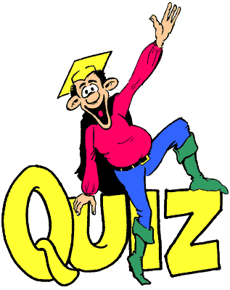

Individual activity

Slide 26

Quiz I: Retell the passage.
Here are some paintings by famous artists from home and abroad. One is by Picasso, _________ to be the greatest artist of the 20th century, with whom another painter, Braque, ______ cubism, one of the modern art __________. Cubist artists painted objects and people ____ different aspects of the objects or person ________ at the same time.
considered
started
movements
with
showing

Slide 27
The painting by Roy is a famous example of ___ ___, which _____ __ show ordinary 20th-century city life. The other two are Qi Baishi and Xu Beihong. Chinese painting __ ______ ___ its brush drawings in black inks and natural colors. Qi ________ the world of nature carefully and his paintings are special _______ __ this. Xu believed that artists should ____ ______ but not just imitate it. Instead, a picture should try to ____ ___ ___ of its subject.
pop art
aimed to
is known for
observed
because of
show
reality
show the life

Slide 28
Quiz II: Translation.
1. 他对《疯狂英语》很着迷。
He __ _____ _____ Crazy English.
2. 我无法忍受他再次迟到。
I _____ _____ his being late again.
3. 他读了许多的故事，目的是想扩大视
野。
He read many stories, _______ __
broaden his horizon.
is crazy about
can’t stand
aiming to

Slide 29
4. 我看电视都看腻了，咱们出去走走吧。
I ___ ____ ___ watching television, let’s
go for a walk.
5. 如何开发艺术方面的兴趣是最重要的。
How to _______ ___ _______ __ ___ is
the most important of all.
6. 我的父母喜欢去美术馆。
My parents ___ _____ __ _____ ___
the Art Gallery.
get tired of
develop the interest in art
was fond of going to

Slide 30
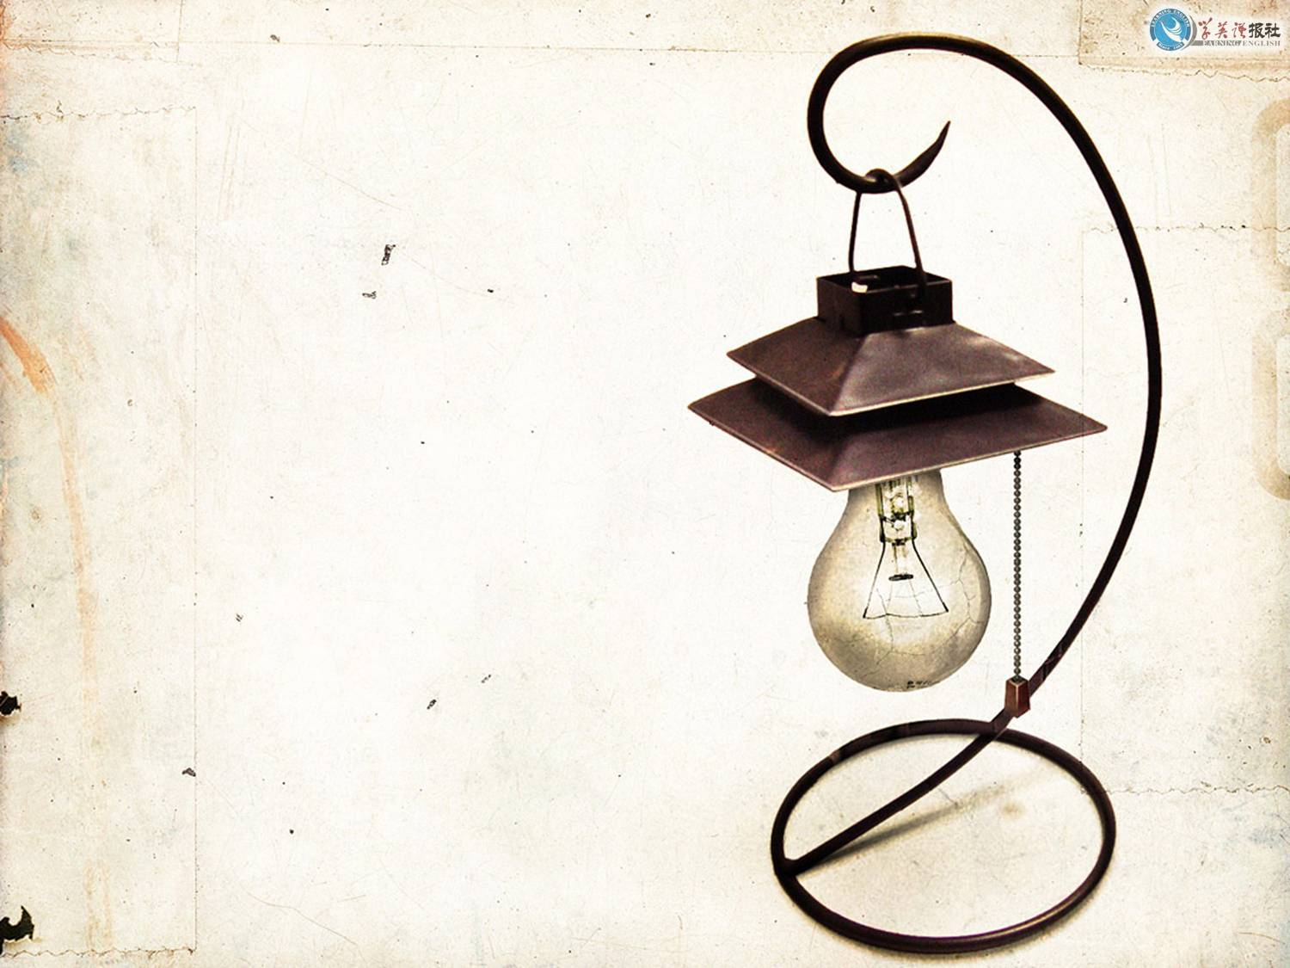
Thank you.

