Slide 1

外研新标准
第二册 必修2

Slide 2

Module 5
Listening

Slide 3


Objective
能识别听力中新学的词汇、短语并正确理解其含义。能听懂听力材料中主要内容并提取信息。

Slide 4
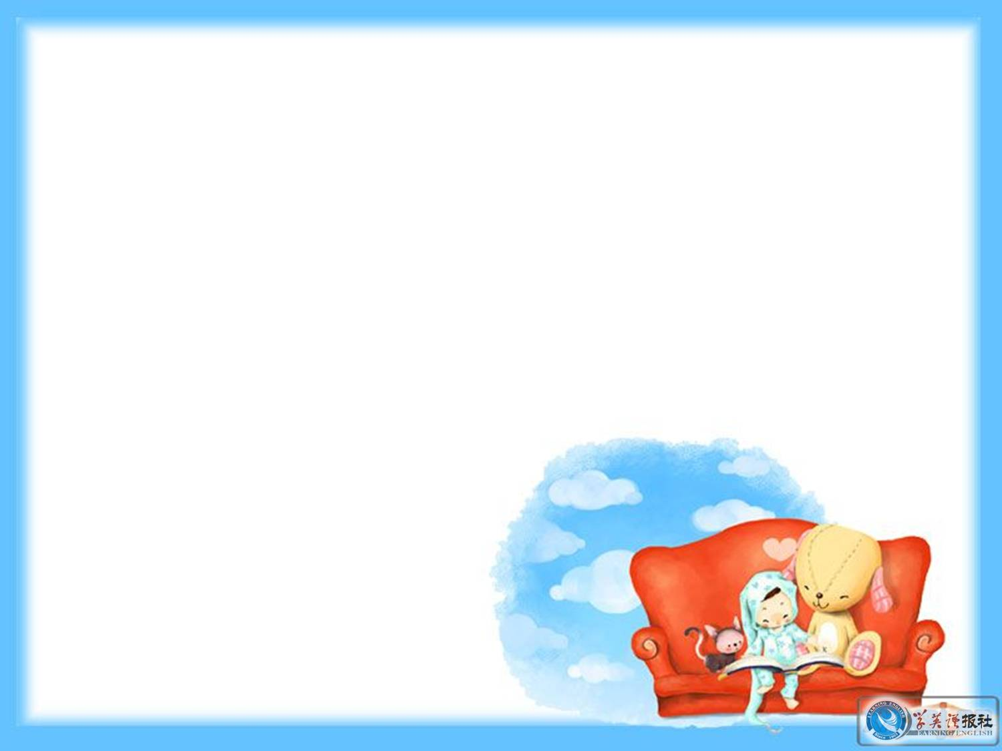

Listen to the passage.

Slide 5


Listen again and fill in the blanks.
A
The British Prime Minister _______ at Beijing Airport at nine o’clock yesterday morning at the start of a _______ ____ to China. His wife and son were with him. “This is my first visit to China, ” he said, “and I’m delighted to be here. ____ _____ I have made this first visit, I hope I can come many _____ _____.” The Prime Minister is also planning to visit Shanghai and Guilin.
landed
five-day visit
Now that
more times

Slide 6
B
American singer Bobbie Sharon ___ __ London yesterday. She went to the Channel 16 TV studio, where she sang Sometimes, a song from her ____ ______. While she was waiting for a taxi outside the studio, she met __________ Sam Parrish, who was ___ metres tall.
was in
new album
16-year-old
two

Slide 7
“I’m your _______ fan,” said Parrish. “Well, you’re my tallest fan,” replied Sharon. “Could I possibly have your _________ on my arm?” asked Sam. “___ you have asked me so nicely,” said Sharon, “I’d be ________ to sign your arm.”
biggest
autograph
As
delighted

Slide 8
C
Amateur astronomer David Bates was looking at the moon _______ his telescope last night when he got a big surprise. “I saw aliens on the moon,” he said. “They were _______ ___ ___ a spaceship.” ______ no one else saw the aliens, not many people believe Mr Bates. Mr Bates, who is ___, also saw aliens landing on the moon last year and two years ago.
through
getting out of
Since
68

Slide 9
Listen to the three radio reports.

Slide 10
Listen again and fill in the blanks.
Interviewer: I’m talking to Tom Johnson, who has just _____ __ ____ in Hollywood. Welcome, Tom.
Tom Johnson: Thank you. It’s very nice to be here.
Interviewer: So, you’re an English theatre actor, but you’ve just ____ _____ from making a film in Hollywood.
Tom Johnson: That’s right.
made a film
come back

Slide 11
Interviewer: ____ did you get the part?
Tom Johnson: Well, I was working in a play in New York and the _______ of the film came to see it. Actually, she came to see another actor in the play.
Interviewer: I see. And then what happened?
Tom Johnson: Well, __ ___ ___ __ the play, she came __________ to talk to the other actor.
How
director
at the end of
backstage

Slide 12
Interviewer: I see.
Tom Johnson: And my _______ _____ was next to his, so after she’d talked to him, she talked to me.
Interviewer: And _____ ___ ___ ____?
Tom Johnson: She said, “Why don’t you fly to Hollywood and we’ll give you a ______ ____.”
Interviewer: And what did you say?
dressing room
what did she say
screen test

Slide 13
Tom Johnson: I said, “Yes, of course!” So I went to Hollywood and did a screen test. Then I _____ ____ to New York and carried on with the play.
Interviewer: What were you doing when you heard that you had ___ ___ ____?
Tom Johnson: I was sleeping! When she rang, I was asleep. ________, I stopped doing the play and flew back to Hollywood.
flew back
got the part
Anyway

Slide 14
Interviewer: What did you do _____ you arrived in Hollywood?
Tom Johnson: I went to stay in a smart hotel.
Interviewer: What did you think when you arrived at the ____ _____?
Tom Johnson: I thought it was great. I was a bit nervous but it was all very exciting.
when
film studio

Slide 15

Thank you.

