Slide 1

外研版
高中英语
第二册
MODULE 5
Newspapers and Magazine

Slide 2
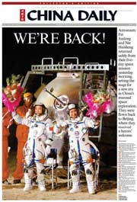
Daily

Slide 3
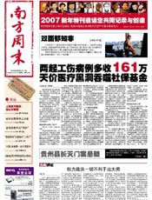
Weekly

Slide 4
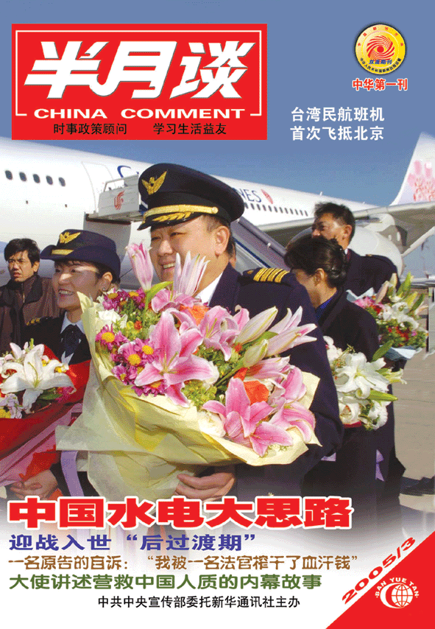
Fortnightly

Slide 5

Monthly

Slide 6

Bimonthly

Slide 7

Introduction
Match the words with the items.

Slide 8

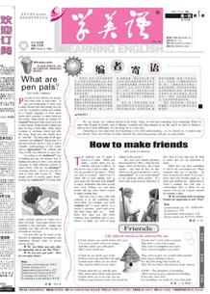
front page
headline
photograph
front cover
article

Slide 9
Pre-Reading
1. Learn some new words:
astronaut, cosmonaut, navigator, taikonaut universe;
2. Learn to predict what the article is about;
3. Learn to make questions.

Slide 10
Reading

Slide 11
True or false excises
1. The taikonaut was in space for twenty-one hours.
2. One of the astronauts aboard the International Space Station was born in China.
3. The other man aboard the Space Station is a Russian cosmonaut.
F
F
T

Slide 12
4. China received messages of congratulations from all over the world.
5. Sean O’ Keefe works for the United Nations.
6. Kofi Annan thought that the flight was very good news just for China.
F
F
F

Slide 13
Language learning
1. make 14 orbits of the earth;
2. offer his congratulations;
3. send messages of congratulations;

Slide 14
4. an important historical achievement
5. a step forward for the whole world
6. in total
7. in space
8. including
Use our dictionary and learn the phrases by yourself

Slide 15
Discussion:
1. What were your feeling when you heard the news about Yang Liwei in October, 2003?

Slide 16
2. Do you think China should continue with its space programme?
3. Would you like to travel into space?

Slide 17
Listening

Slide 18

Reading and listening
Check the meaning of these words

Slide 19
alien
amateur
a creature from a different world
taking part in an activity for pleasure, not as a job

Slide 20
astronomer
autograph
the person who studies the universe and of objects which exist naturally in space, such as the moon, the sun, planets and stars
a signature of a famous person

Slide 21
fan
spaceship
someone who admires and supports a person, sport, sports team, etc
(especially in stories) a vehicle used for travel in space

Slide 22
surprise
telescope
an unexpected event, or the feeling caused by something unexpected happening
a cylindrical device for making distant objects look nearer and larger, using a combination of lenses, or lenses and curved mirrors

Slide 23
Find the words
according to the definitions
1. Someone who plays in the theatre and in the film
2. A role in a play or film
3. The place where actors get read before a play
actor
part
dressing room

Slide 24
4. The person who tells actors what to do in a play or film
5. When an actor performs in front of a camera to try to get a part in a film
6. The area behind the stage in a theatre
director
screen test
backstage

Slide 25
Listen and make a note of the answers
1. How did you get the part?
2. What were you doing when you heard that you had got the part?

Slide 26
3. What did you do when you arrived in Hollywood?
4. What did you think when you arrived at the film studio?

Slide 27
Put these events in order
He went back to Hollywood.
The director talked to Tom backstage.
Tom went to New York to act in a play.

Slide 28
A director from Hollywood came to see the play.
Tom went to Hollywood to do a screen test.
Tom got a phone call while he was sleeping.
He flew back to New York and continued acting in the play.

Slide 29
Match the headlines with the paragraphs
1. British Prime Minister Arrives in China
2. Pop Star Meets Bigger Fan
3. Aliens Land Spaceship on the Moon
B
C
A

Slide 30
Homework
1. Try to repeat the text freely yourself.
2. Learn the new words again, using the dictionary if necessary.

Slide 31
3. Work in groups, discuss these questions with other Ss.
1) Do you remember the news about Yang Liwei in October, 2003?
2) What were your feelings when you heard the news?
3) Do you think China should continue with its space programme?
4) Would you like to travel into space?

