Slide 1

Skimming
(1) Who was Atlanta?
(2) What was she good at?
(3) Who did she want to marry?
(4) How could Hippomenes win Atlanta?

Slide 2
Main idea
It’s about Atlanta who races to marry the man who can run faster than her. In order to win the race, Hippomenes asked for help from the Goddess of Love.

Slide 3

True or False questions.
She practised running to compete in
the Olympic Games. ( )
2. At first Hippomenes understood
why men ran against Atlanta. ( )
3. Atlanta was not sure she could win.
( )

Slide 4

4. She was so angry about the fact that she could not run in the Olympics. ( )
5. She made as many men as she could share her pain. ( )
6. Her father did not understand her wish to compete in the Olympics. ( )
7. He did not refuse her wish to choose her husband in a race. ( )

Slide 5
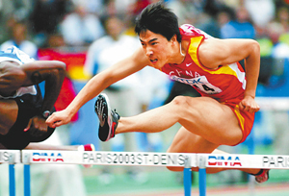
Events of sports
track and field

Slide 6

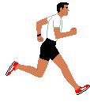
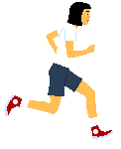
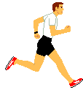
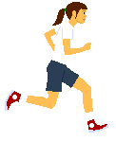
relay race

Slide 7
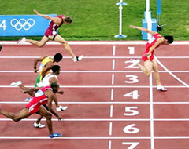
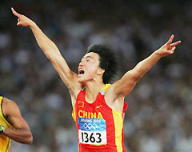
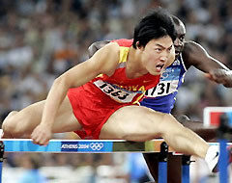
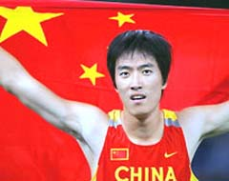
Olympic 110m hurdles champion

Slide 8

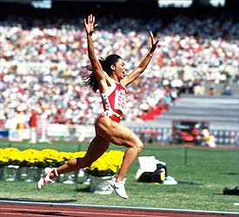
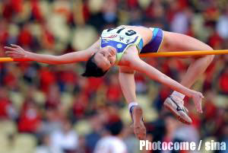
long jump
running
high jump

Slide 9
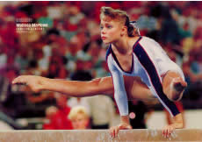
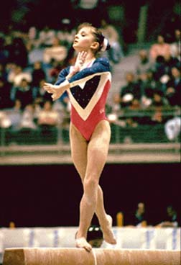
Events of sports
gymnastic
beam

Slide 10
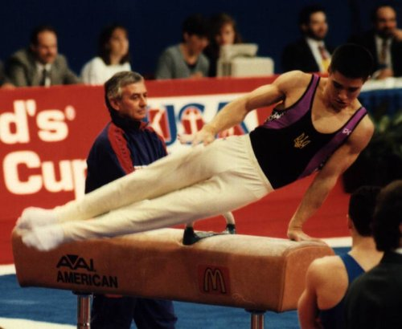
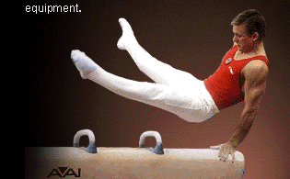

horse

Slide 11
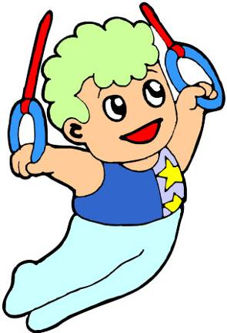
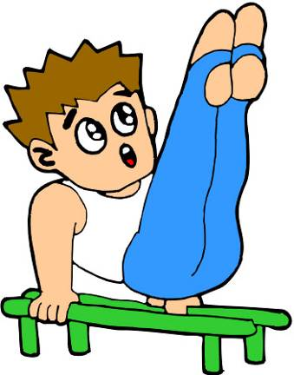
double bars
rings

Slide 12
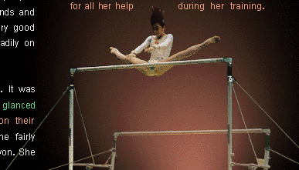
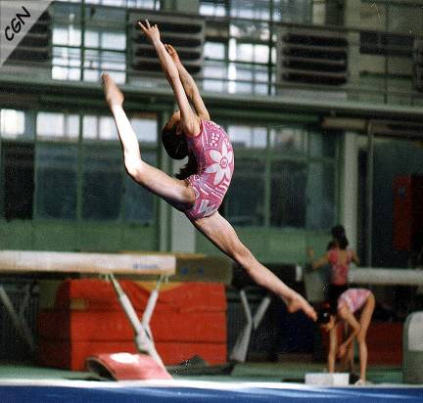
high and low bars
free exercise

Slide 13
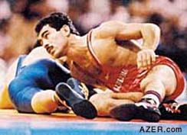
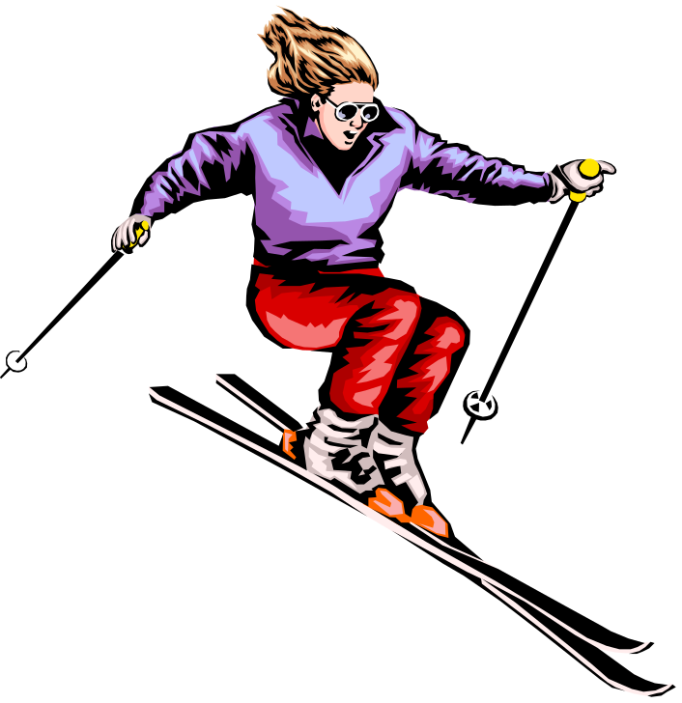
Events of sports
wrestling
ice sports

Slide 14
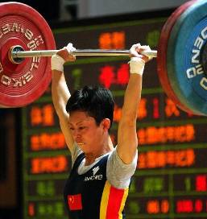
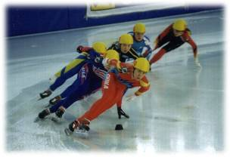
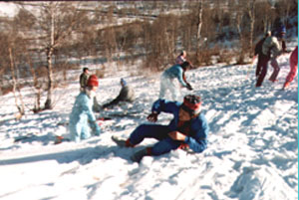
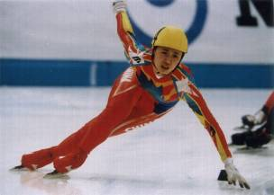
weightlifting
speed skating
skiing

