Slide 1

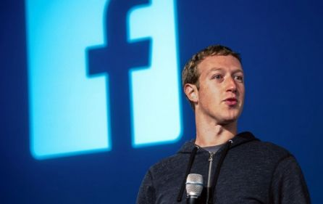
For Senior 1
2015-2016学年第16期总第618期
Giving to the future (P2)

Slide 2

If you had $45 billion, would you give 99% of it to charity?
I. Pre-reading

Slide 3
II. Reading
What’s the aim of the investment in the Chan Zuckerberg Initiative?
Its aim is to advance human potential and promote equality for all children.
Will Zuckerberg continue to do business to make money?
Yes.

Slide 4
II. Reading
Will Mark’s way of doing charity have a bad effect on the social media industry?
Yes.
Does Mark need to pay taxes for his donation?
No.

Slide 5
Look at these sentences and try to figure out the meanings of the underlined words.
III. Vocabulary
He and his wife, Priscilla Chan, would give away 99 percent of their Facebook shares.
股份

Slide 6
III. Vocabulary
The stock … will be invested (投资) in the Chan Zuckerberg Initiative “to advance human potential and promote equality for all children”.
potential: 潜力，潜能
promote: 促进，提升，促销

Slide 7
III. Vocabulary
You can write donations (捐款) off in your taxes to a large degree in the US.
在很大程度上
So it’s not the state that decides what is good for the people, but rather the rich.
not…but… 不是…而是…

Slide 8
Look at the sentences and pay attention to their structures.
IV. Structure
The Chan Zuckerberg Initiative is a limited liability (责任) company (LLC), a private organization that is free to partner with businesses or influence governments.
partner 本身是名词:合伙人，此处做动词：与…合伙

Slide 9
IV. Structure
又如：
The ship is heading for China.
Tom eyed the painting with interest.
This apartment houses six people and a dog.
Let me Google it on the web.

Slide 10
IV. Structure
Exercises:
Did you __________ (预订) your seat on the plane yesterday?
Please _________ (用手递) me that book.
They _________ (取名) their dog Bob.
She __________ (护理，照顾) her mother every day.
It __________ (尝起来) delicious.
book
hand
named
nurses
tastes

Slide 11
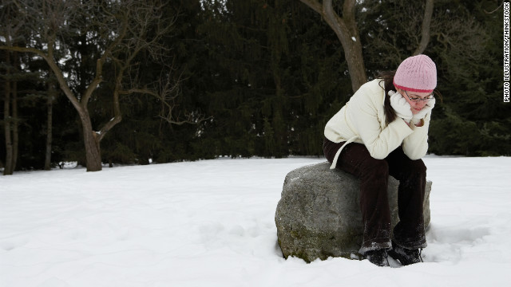
For Senior 1
2015-2016学年第16期总第618期
Why winter makes some sad (P5)

Slide 12
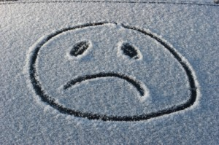
Do you feel sad in winter?
I. Pre-reading

Slide 13
II. Reading
What is winter SAD?
Seasonal affective disorder in winter.
What’s an unusual way of treating SAD?
Sitting near a very bright light for 30 minutes or so every morning.

Slide 14
II. Reading
Is SAD serious enough to cause long-lasting sadness and problems with eating and sleep?
No.
What’s the writer’s attitude toward SAD?
Don’t be so sure that you’re sad in winter because of a medical condition – you might just hate the cold weather like most people do.

Slide 15
III. Vocabulary
However, it is less likely to cause psychological (心理的) symptoms such as a very low mood (情绪).
症状
David Kerr … helped to carry out a study.
实施
So don’t be so sure that you’re sad in winter because of a medical condition.
状况

Slide 16
Look at the sentences and pay attention to their structures.
IV. Structure
Do you feel unhappy in winter? If so, you’re not alone.
if类省略结构小结

Slide 17
IV. Structure
if so 假如这样的话
if not 假如不是这样的话；不然的话
if any 即使有（任何）……，即使有……
There were few errors, if any.
if anything 如果有什么……的话
If anything, she works too hard. 要说的话呢，就是她工作太辛苦了。
if possible 如果可能的话
If possible, let me know beforehand.

Slide 18
IV. Structure
if anybody (anyone) 若有(任何)人的话
If anybody knows, he does. 如果有人知道，那就是他了。
if necessary 如果有必要的话
I could come earlier, if necessary. 如果有必要我可以早点来。

Slide 19

—I’m afraid the date for the interview is inconvenient.
—_____, we’ll do it another day.
A．If necessary
B．If so
C．If not
D．If possible
IV. Structure

Slide 20
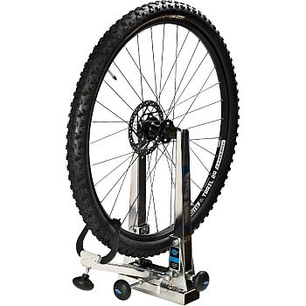
For Senior 1
2015-2016学年第16期总第618期
Remember praise (P6)

Slide 21

Do you often give people praise? Do you often hear praise?
I. Pre-reading

Slide 22
II. Reading
Does the writer often give praise to people?
No.
Does the writer want to give praise to people?
Yes.
Does the writer want to make a change?
Yes.

Slide 23
II. Reading
Did the father mentioned in the passage feel proud of his son?
Yes.
What does the writer want to challenge the audience to do?
She wants the audience to care about what they and their households really need.

Slide 24
Look at these sentences and try to figure out the meanings of the underlined words.
III. Vocabulary
I would want to take in their praise of me and then I’d just stop myself.
吸收；欺骗
I felt embarrassed.
尴尬的

Slide 25

III. Vocabulary
So, I’m going to challenge all of you.
挑战
I think it starts in each of our households.
家庭，家人

Slide 26
Look at the sentences and pay attention to their structures.
IV. Structure
The way I got interested in this was … I would want to say thank you to someone … then I’d just stop myself. I asked myself: Why?
在定语从句中，先行词way表示方式方法，后面的引导词是固定的三种：that, in which, 或省略。

Slide 27


IV. Structure
I don’t like the way he spoke to me.
I wasn’t happy with the way (that/in which) he told you yesterday.

Slide 28
The way_____ Miss Liu teaches English is quite different from the way Miss Zhao teaches.
A. /
B. that
C. in which
D. all of the above
IV. Structure

Slide 29
This is the way _____ I want to do it.
A. /
B. with which
C. how
D. by which
IV. Structure

