Slide 1
Grow by Speaking
Grow by Speaking up
say something, especially to defend a person or protest about something, rather than just saying nothing.
Grow by Speaking out
speak out against something or in favor of something, you say publicly that you think it is bad or good.
to talk to someone about something

Slide 2

Techniques that work well with peers, subordinates, and immediate supervisors can actually work against you.
Speaking Up features extensive comments from executives explaining exactly what they want and don‘t want。

Slide 3

How do you speak up to others when you feel you've been wronged, not thought of, or otherwise hurt intentionally/unintentionally especially if its subtle?
“When my feelings get hurt, I usually hide it until I can comfort myself and if I can do that alone, I’ll never bring it up first.”
“ I also don't want to be viewed as someone who is "always mad about something" or "never happy". ”
“ Maybe it is easy for me to feel disconnected at times and feel the need to protect myself by hiding my true thoughts.”

Slide 4
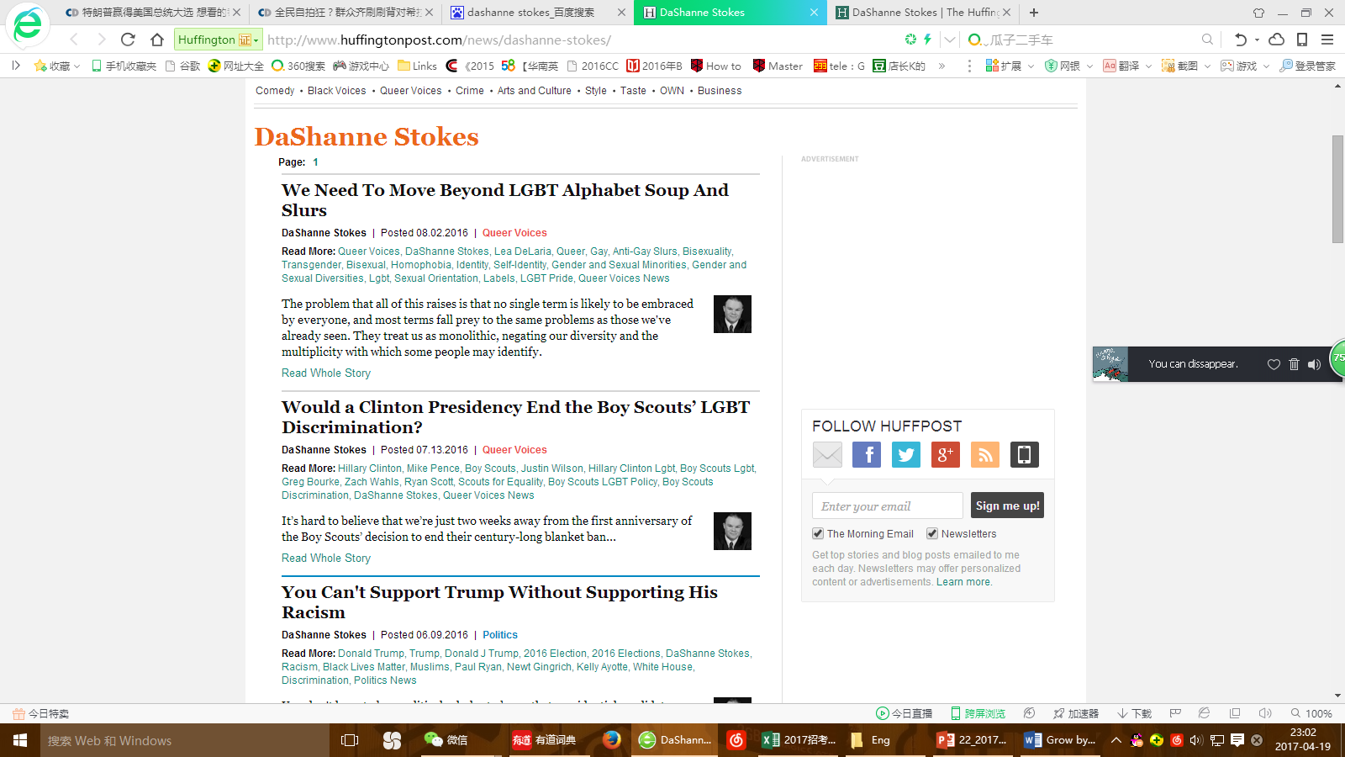

Slide 5
While-reading
Read and draw a mind-map with the key information.
…not speaking up (P1—P4)
…treated badly and hurt…
…learned to protect myself by not speaking up
surrounding myself with caring ,loving people…
taught me how to slow down, to breathe, to be thankful for what I’ve got…
…taught me to turn my past experiences into strength - to make negatives into positives
…learned to speak uo(P5-P7)
…I am a common man…
Pain and fear teach us to be silent. It's time for that to change.
…hold on and find help… not only survive…stronger…
…inspiration all on its own..
…help others to speak out (P8-P12)

Slide 6
Post-reading
What’s your understanding of “Our very survival can be an inspiration all on its own. ”？

Slide 7
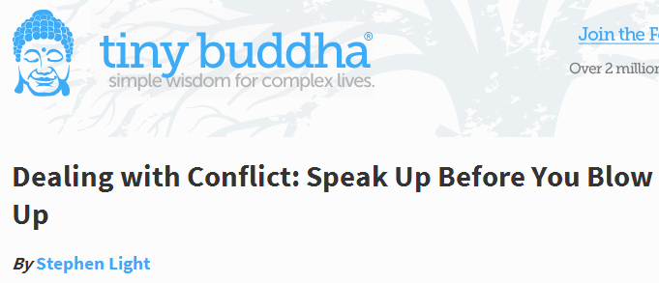
http://tinybuddha.com/blog/you-are-enough-speaking-up-without-blowing-up/

