Slide 1

同步教学辅助课件
必修5

Slide 2


Unit 4 Making the News
Listening
注: 另附 word 文档。
点击此处链接

Slide 3


Using Language
Listen to Part 1.

Slide 4


Listen again and fill in the blanks.
CAN I HELP YOU?
Zhou Yang (ZY) is hoping to interview Liu Ming, a famous tennis player, about his decision to work ______. So he calls Liu Ming’s assistant, Lily Wong (LW), to make an ____________.
abroad
appointment

Slide 5
Part 1
(Telephone ringing)
LW: Hello. This is Lily Wong, Liu Ming’s ________. Can I help you?
ZY: Hello. I’d like to speak __ Liu Ming
please.
LW: I’m sorry but he’s _____ now.
Who’s speaking?
assistant
to
busy

Slide 6
ZY: This is Zhou Yang from ______ ______. I’d like to interview Liu Ming about his decision to play professional ______ abroad.
LW: It’ll be difficult. You know that
he’s _______ Beijing at the end of
this week.
China
Daily
tennis
leaving

Slide 7
ZY: Well, I’m free tomorrow afternoon and all of __________.
LW: OK. Now, let me see … Liu Ming’s going to see his family _________ and then talk to some students on Wednesday morning. Then at _____ o’clock he’ll go to a special party given by the leaders of our city. What about meeting him in the
early _________?
Wednesday
tomorrow
four
afternoon

Slide 8
ZY: How about over ______? Our readers will be very interested ___ his views.
LW: Hmm … I know that he’s very
happy about going abroad and
hopes to _______ to China in a few
years. Then he wants to ________
Chinese tennis.
lunch
in
return
improve

Slide 9

Listen to Part 2.

Slide 10
Listen again and fill in the blanks.
Part 2
ZY: Many of his ____ will be sorry not to see him play in person. Watching him on _____ is not quite the same.
LW: Yes, I understand, but he needs to develop his _____. On TV you can still ______ his play.
fans
TV
skills
enjoy

Slide 11
ZY: What if he ______ comes home? We’ll have lost a great sportsman.
LW: I don’t think that he’ll stay abroad. He says that he has no ________ of doing that.
ZY: I’m glad to hear that. But what if he gets a wonderful _____ to stay?
LW: I think you’ll have to discuss that with him ________.
never
intention
offer
yourself

Slide 12
ZY: So will ___ o’clock be OK? Where
would be the best place to meet?
LW: Why not _____ at the Garden
Hotel at 12 o’clock? I’ll put it in
his ______ for Wednesday so he’s
sure to come.
ZY: Thank you so much. Goodbye.
LW: Goodbye.
12
meet
diary

Slide 13
Workbook-Listening
Listen to Part 1.

Slide 14
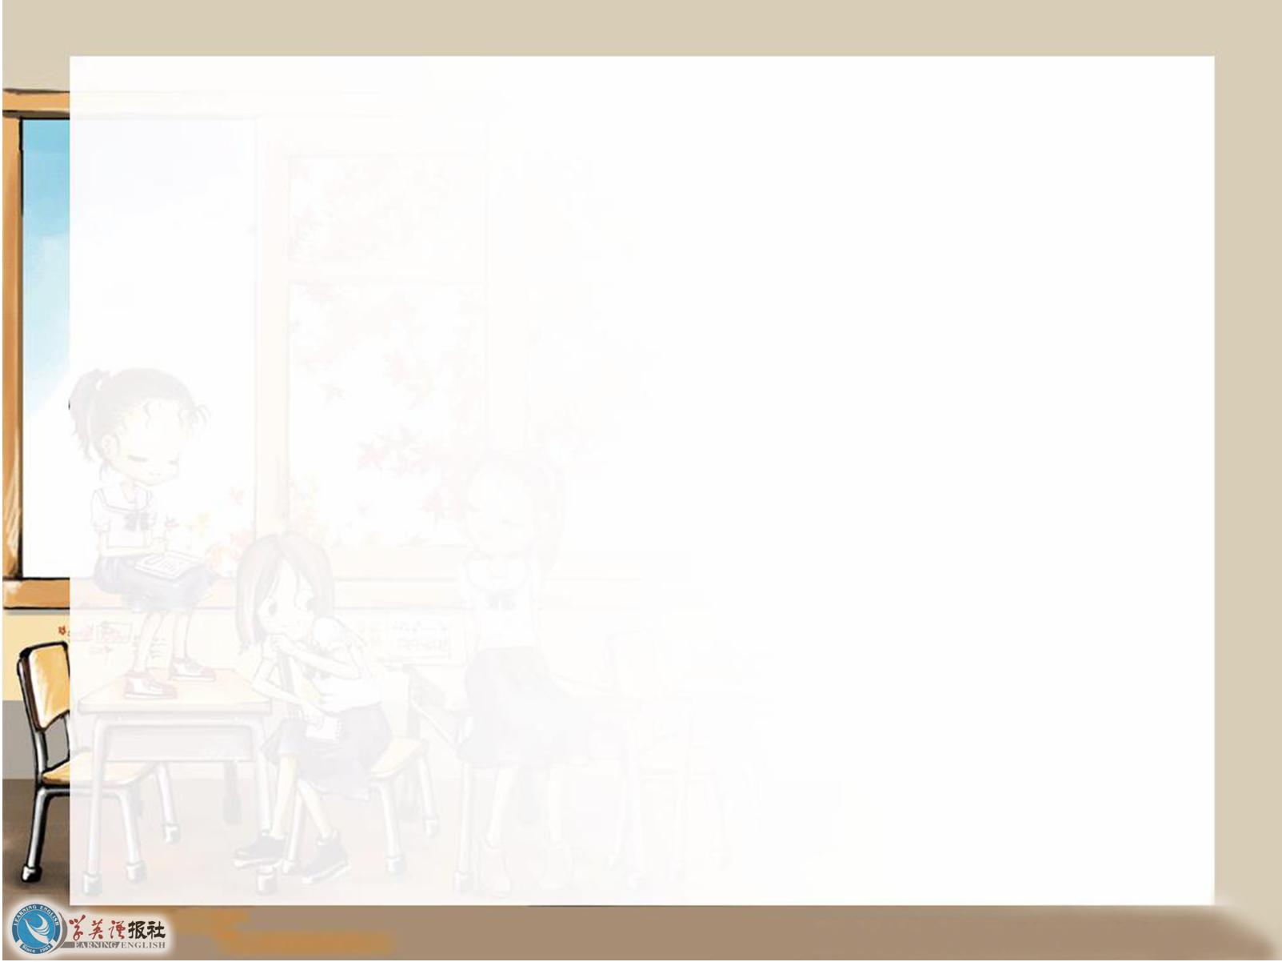
Listen again and fill in the blanks.
A TRUE STORY
It is Thursday and Greg (G) has just come home from a ______ interview on the “Today” programme. He is talking to his _____, Susan (S).
radio
wife

Slide 15
Part 1
S: Hello. I heard you on the radio and it
all _______ to go very well.
G: Yes, it did __ ____ __ we got started.
But I had a bad time before they
phoned me.
S: Why? I thought you _____ it ____
yesterday!
seemed
as soon as
fixed
up

Slide 16
G: Yes, I did. You _________ I told
you that they didn’t want to phone
me at home because the sound
______ were better at the BBC radio
station here in Reading.
S: Yes. I remember.
G: Well, I arrived at the building
before __ am. They were going to
ring me in the studio at _____ to
check that all was well.
remember
effects
6
6:15

Slide 17
S: So what was the problem?
G: When I arrived I found that there
was _______ waiting to let me into
the building. It had many windows
____ they were all dark. They
reminded me of large, _____ eyes.
S: Oh dear!
nobody
but
tired

Slide 18

Listen to Part 2.

Slide 19
Listen again and fill in the blanks.
Part 2
G: The building was so tall and ____.
S: Did you feel __________?
G: No, but I did get worried. I
wondered if I’d got the right day
or _____ and _____.
S: Did you ring the bell?
old
frightened
time
place

Slide 20
G: Yes, I did. It sounded very loud
and echoed through the ______
rooms. I began to feel very
________. I was sure I must have
got things wrong.
S: But you hadn’t. I heard you ___
the radio.
empty
anxious
on

Slide 21
G: Luckily just at that moment a man
________ and opened the studio
for me. As soon as I _______ the
room, the telephone rang. It was the
interviewer _____ the “Today”
programme.
S: So all’s well that _____ well!
appeared
entered
from
ends

Slide 22
G: Yes, thank goodness. Never ____ I
so relieved to see anyone! I really
thought I was going to _____ the
programme. But once I was on the
____ everything was fine.
was
miss
air

Slide 23
Workbook-Listening Task
Listen to Part 1.

Slide 24

Listen again and fill in the blanks.
THE IMPORTANCE OF EYEWITNESSES
Zhou Yang (ZY) and his ____________ Fred Smith (FS) are talking about a
story that they are going to ______.
FS: Have you heard? We’re going to
Moscow to cover the international
football ______ tomorrow.
photographer
cover
match

Slide 25
I’m getting my _______ ready. Isn’t
it exciting?
ZY: Yes, and it’s the Chinese national
team _______ the Russians.
FS: I think that China will ____, don’t
you? The team did well against
Mexico last ______.
ZY: Did you go to that match?
camera
against
win
month

Slide 26
FS: No, but I went to the one ______
Britain played Turkey in Beijing.
That was a good match, but
something __________ happened.
ZY: What happened?
FS: Well, our ______ fans were not
happy that their team lost.
when
unpleasant
British

Slide 27
They became _____ upset when the
Turkish fans began calling them
_____ names. I wondered what
would happen and started ______
photos.
ZY: What did happen?
FS: The Turkish fans started throwing
______. I kept taking my photos as
________.
more
rude
taking
bottles
evidence

Slide 28

Listen to Part 2.

Slide 29
Listen again and fill in the blanks.
Part 2
ZY: Did the ______ come?
FS: Yes, but by the time they came it
was serious. They were ________
each other. It was terrible.
ZY: How did it end?
police
fighting

Slide 30
FS: Well, police _____ them to the police
station. They _______ the British
fans of starting the fight because
they had _____ the match. And the
British fans have a _____ reputation
for fighting. But I was able to put
them right. Not only ____ I an
eyewitness but I had my
photographs as evidence too.
took
accused
lost
bad
was

Slide 31
ZY: Gosh! So it was lucky you _____
there.
FS: Yes, and ____ I had my camera with
me. Without it I wouldn’t have been
able to _____ the police they were
wrong. So you see why it’s so
important to be on the _____ when
something happens.
were
that
show
spot

Slide 32
ZY: Yes. You’re able to get the right
end of the _____. Did you give
a _________ to the police?
FS: Yes, I did. I helped set many
British fans _____.
stick
statement
free

