Slide 1

外研新标准
第二册 必修2

Slide 2
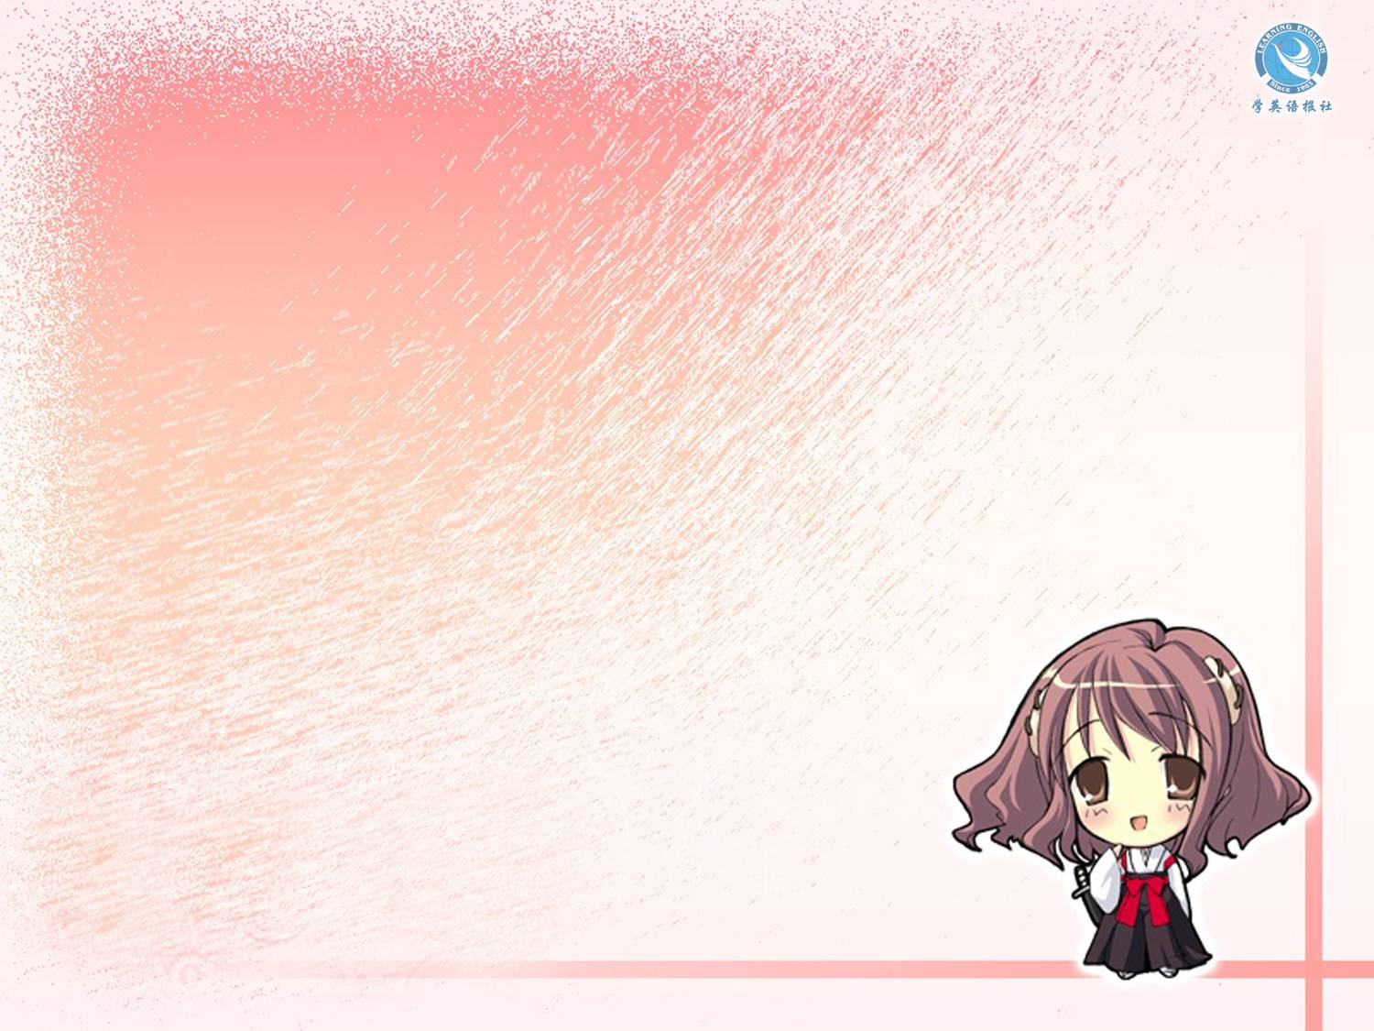
Module 1
Listening

Slide 3


Objective
能识别听力中新学的词汇、短语并正确理解其含义。能听懂对话中主要内容并提取信息。

Slide 4
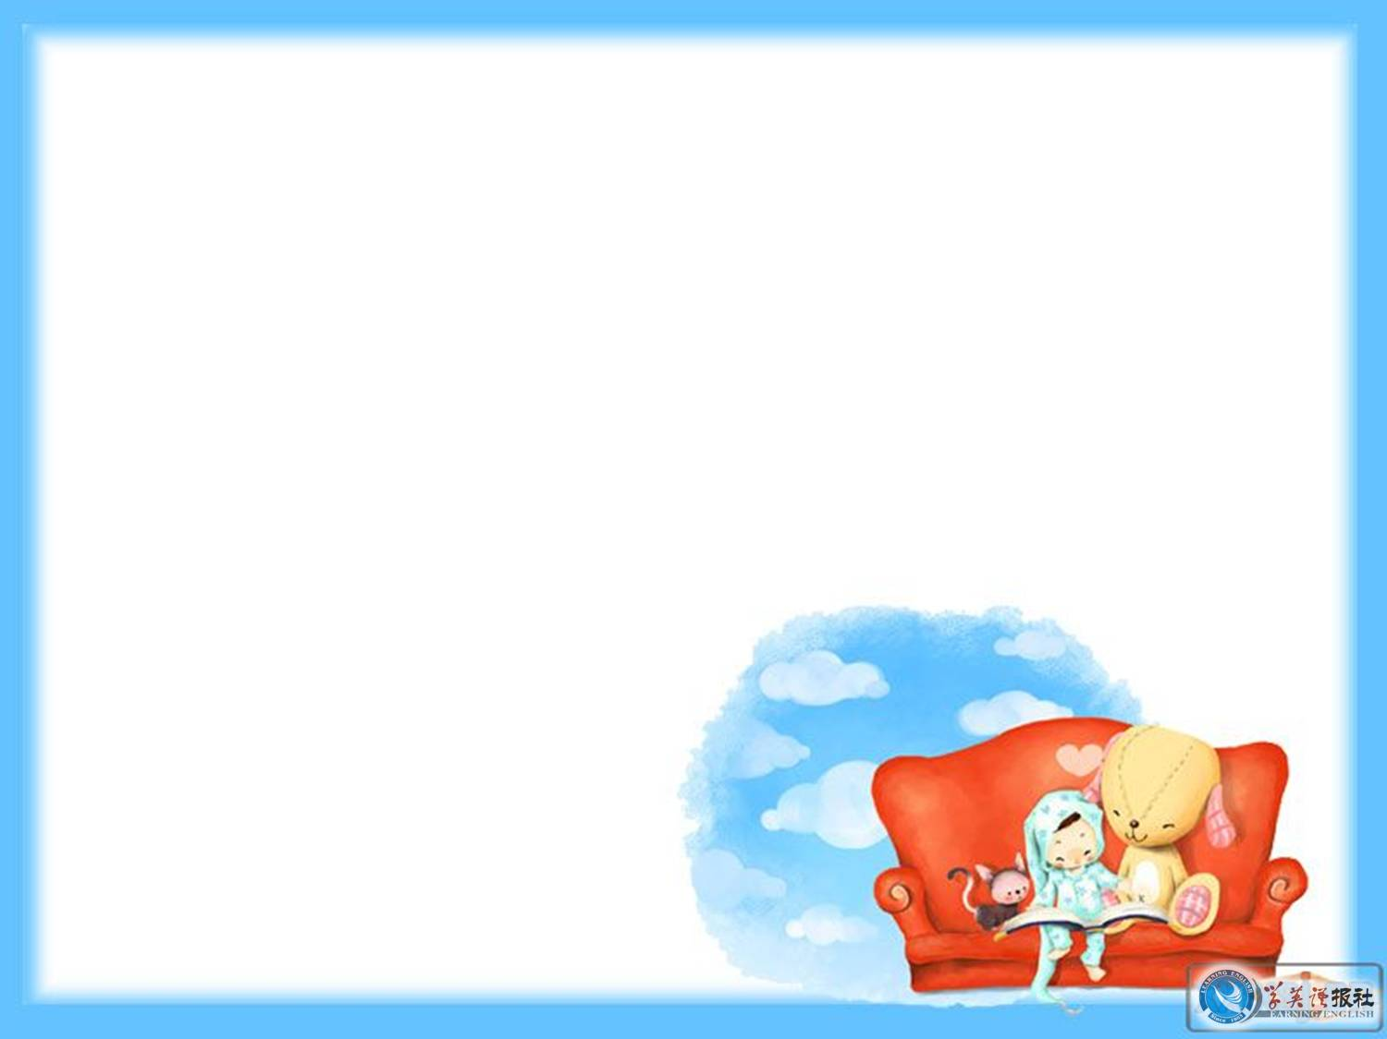

Listen to the conversation.

Slide 5


Listen again and fill in the blanks.
Doctor: Hello, Mr. Chen, how can I help you?
Mr. Chen: I’m not feeling at all well, doctor. In fact, I fell _____. I’ve got a temperature of 38℃ and my chest _____ when I breathe.
Doctor: ____ _____ have you had the temperature? Two or three days?
Mr. Chen: About four days, actually.
Doctor: Four days. Do you have any other _________?
awful
hurts
How long
symptoms

Slide 6
Mr. Chen: Yes, I’ve got a ____ ______ and a cough.
Doctor: Can you ___ _____, please, and I’ll examine you?... Can you take a ____ ______?... And another one …
Doctor: Well, I’m afraid you’ve probably got pneumonia. We’ll need to ___ __ ______ to be certain, and we may need to take you into hospital.
Mr. Chen: Oh dear!
sore throat
lie down
deep
breath
do an X-ray

Slide 7
Doctor: Don’t worry. Nowadays, with the right drugs, people get better very rapidly. I’ll write you a ___________. Are you _______ to penicillin?
Mr. Chen: No, I’m not.
Doctor: Good. Is there someone who can take you to hospital?
Mr. Chen: A friend of ours is __ _______ at the moment and my wife’s going to visit her this afternoon. She can ____ ___ __ at the same time.
prescription
allergic
in hospital
take me in

Slide 8
Doctor: That _______ ___ _____. And how are you planning to get home now?
Mr. Chen: My wife’s going to ____ ___ ___ in a quarter of an hour.
Doctor: _____ ____. I’ll write a note for your employers saying that you’re sick. And I’ll ring the hospital and ________
that X-ray for you.
Mr. Chen: How long will I __ ____ ____? About a week?
couldn’t be better
pick me
up
Jolly good
arrange
be off work

Slide 9

Doctor: No, I should imagine about two weeks, __ ____.
Mr. Chen: Two weeks! Well, thank you, doctor.
Doctor: Goodbye, Mr. Chen.
at least

Slide 10

Thank you.

