Slide 1


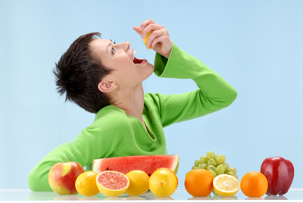

高中第二册
Module 1
Our Body and Healthy Habits

Slide 2


Vocabulary
lung
throat
breathe
pneumonia
prescription
symptom
X-ray
awful
n. 肺
n. 喉咙，咽喉
vi. 呼吸
n. 肺炎
n. 处方
n. 症状
n. X光
adj. 可怕的，吓人的

Slide 3


chest heart lung stomach throat
When we breathe, the air goes into
our _____.
2. The _____ sends blood round the body.
3. Your ______ is inside your neck.
4. Your lungs are inside your _____.
5. When we eat, food goes into the
________.
lungs
heart
throat
chest
stomach

Slide 4
breathe have a temperature pneumonia
prescription symptom X-ray
Which words mean ...?
1. A photograph of inside the body
2. something shows that you have an
illness
3. to take air in and out of your lungs
X-ray
symptom
breathe

Slide 5
breathe have a temperature pneumonia
prescription symptom X-ray
Which words mean ...?
4. an illness in which your chest hurts
when you breathe
5. to be hot when you are ill
6. a piece of paper on which a doctor
writes down the medicine a sick person needs
pneumonia
have a temperature
prescription

Slide 6
Doctor or Patient
A In fact, I feel awful.
B My chest hurts when I breathe.
C How long have you had the temperature?
D Yes, I’ve got a sore throat and a cough.
E Can you lie down, please, and I’ll
examine you?
F We may need to take you into hospital.
G I’ll write you a prescription.
H And how are you planning to get home
now?
I How long will I be off work?
P
P
D
P
D
D
D
D
P

Slide 7
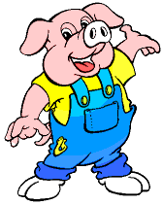

Listen to the conversation.

Slide 8

Listen again and fill in the blanks.
Doctor: Hello, Mr. Chen, how can I help you?
Mr. Chen: I’m not feeling at all well, doctor. In fact, I fell _____. I’ve got a temperature of 38℃ and my chest _____ when I breathe.
Doctor: _________ have you had the temperature? Two or three days?
Mr. Chen: About four days, actually.
Doctor: Four days. Do you have any other _________?
awful
hurts
How long
symptoms

Slide 9
sore throat
Mr. Chen: Yes, I’ve got a _________ and a cough.
Doctor: Can you ________, please, and I’ll examine you?... Can you take a deep breath?... And another one …
Doctor: Well, I’m afraid you’ve probably got pneumonia. We’ll need to __________ to be certain, and we may need to take you into hospital.
Mr. Chen: _______!
lie down
do an X-ray
Oh dear

Slide 10
Doctor: Don’t worry. Nowadays, with the right drugs, people get better very rapidly. I’ll write you a ___________. Are you _______ to penicillin?
Mr. Chen: No, I’m not.
Doctor: Good. Is there someone who can take you to hospital?
Mr. Chen: A friend of ours is _________ at the moment and my wife’s going to visit her this afternoon. She can _________ at the same time.
prescription
allergic
in hospital
take me in

Slide 11
Doctor: ____________________. And how are you planning to get home now?
Mr. Chen: My wife’s going to __________ in a quarter of an hour.
Doctor: _________. I’ll write a note for your employers saying that you’re sick. And I’ll ring the hospital and arrange that X-ray for you.
Mr. Chen: How long will I __________? About a week?
That couldn’t be better
pick me up
Jolly good
be off work

Slide 12
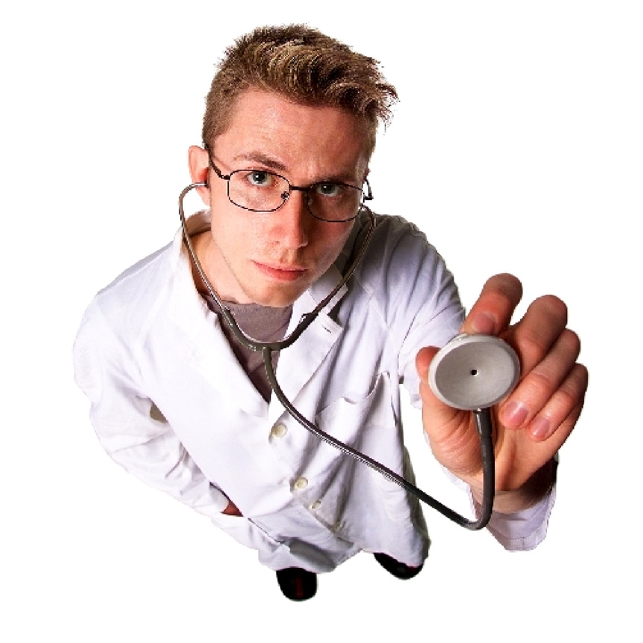
Doctor: NO, I should imagine about two weeks, _______.
Mr. Chen: Two weeks! Well, thank you, doctor.
Doctor: Goodbye, Mr. Chen.
at least

Slide 13
Ask and answer
1 What is the matter with Mr. Chen?
His chest hurts when he breathes and he has a temperature, a sore throat and a cough.
2 What does the doctor say he will do?
The doctor says she will examine Mr. Chen and write him a prescription.

Slide 14
Correct the mistakes
38℃
1. I’ve got a temperature of 37℃.
2. Can you breathe deeply?
3. Well, I’m sorry, but you’ve probably got
pneumonia.
4. My sister’s going to visit her this
afternoon.
5. My wife’s going to pick me up in half an
hour.
6. I should imagine about three weeks, at
least.
take a deep breathe
I’m afraid
wife
a quarter of an hour
two

Slide 15

Everyday English
1. Terrific! means _____.
(a) Wonderful (b) Quite good
2. To be off work means ____.
(a) not to go to work
(b) to stay longer at work
3. Oh dear! means ___.
(a) That’s bad news (b) My good friend

Slide 16
4. That couldn’t be better means ___.
(a) That’s excellent news
(b) Well done
5. I have a sweet tooth means ___.
(a) I like sweet things
(b) I have toothache
6. I’m crazy about football means ___.
(a) I love football
(b) Football is crazy

Slide 17



