Slide 1


外研版
高中英语
第二册
MODULE 1
Our Body and Healthy Habits

Slide 2

Warming up

Slide 3
Some Chinese proverbs on health
1) 病从口入。
A close mouth catches no flies.
2) 健康胜于财富。
Health is over wealth.

Slide 4
3) 饭后百步走，延年又益寿。
After dinner sit a while; after supper walk a mile.
4) 冬吃萝卜夏吃姜， 不用医生开药方。
Carrots in winter and gingers in summer keep the doctor away.
5) 饮食决定人生
You are what you eat.

Slide 5
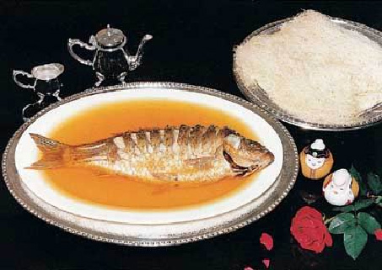
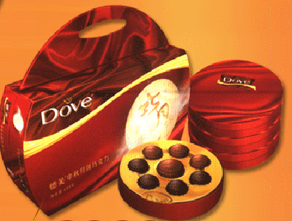
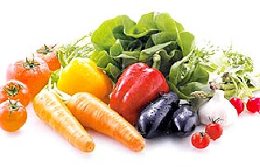
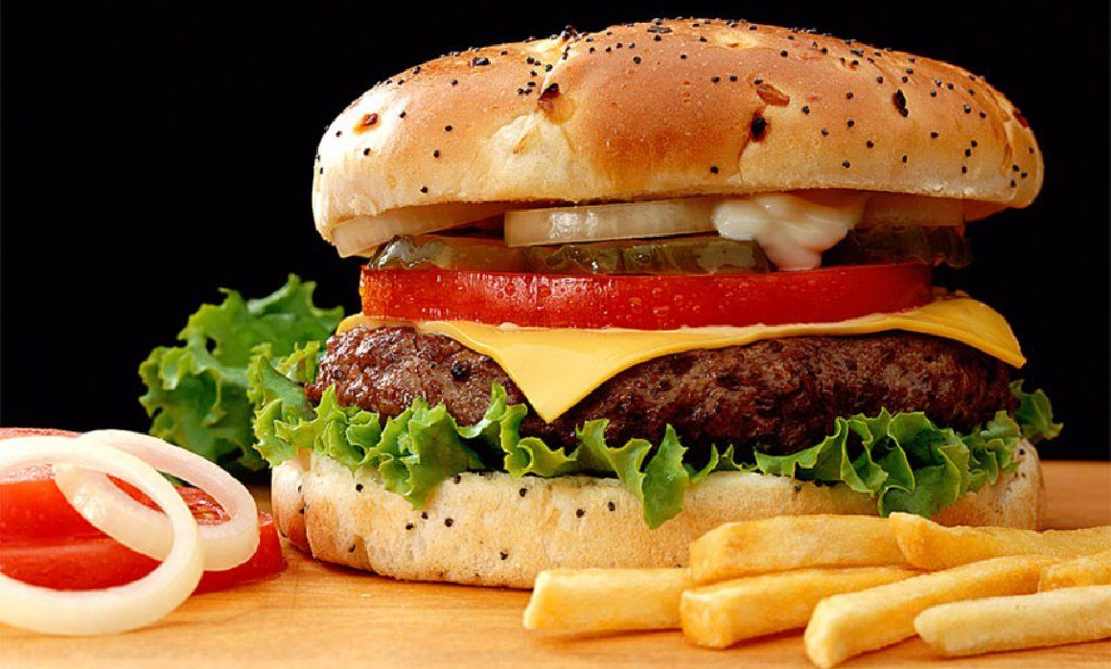
What these sports and foods are beneficial to health?

Slide 6
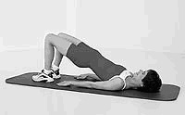
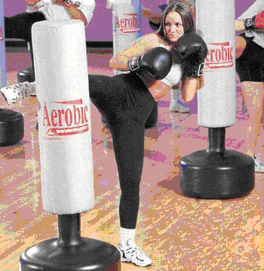


Slide 7
Vocabulary and Reading

Slide 8
1 Look at these words and answer the questions.
anxious break (an arm) captain fever injure injury pain painful normal sweets

Slide 9
1.Which word is connected with food? ________
2.Which words are connected with the body?____________________
_______________________________
sweets
break (an arm) fever
injure injury pain painful

Slide 10
3.Which word means usual or ordinary? _________
4.Which word means leader? _________________
5.Which word means worried about something that may happen? __________________
normal
captain
anxious

Slide 11
Read Zhou kai (1). Answer these questions.
2
1. Why is zhou Kai’s mother anxious?
Because she sees Zhou Kai heading towards the front door without a jacket on .

Slide 12

2. What does she think will happen?
She thinks that he’ll catch a bad cold.
3. What does she ask him to do?
She asks him to go and get his jacket.

Slide 13
Read Zhou Kai (2) again. Choose the correct answers.
3

Slide 14
1. Zhou Kai’s family ______________.
(a) avoid eating too much fat or sugar
(b) eat a lot of vegetables, fruit and meat
(a)

Slide 15
2. Zhou Kai ______________.
(a) sometimes gets colds and flu
(b) seldom gets colds or flu
(b)

Slide 16
3. A week ago, Zhou Kai____________
(a) caught a cold (b) injured his arm
(a)

Slide 17
4. Two years ago, Zhou Kai _________ while playing football.
(a) hurt his leg (b) hurt his arm
(b)

Slide 18
5. Zhou Kai describes himself as ____________
(a) crazy
(b) someone who loves football
(b)

Slide 19
Complete these sentences using one of the words and expressions from the passage. You may need to change the form of the word or expression.
4

Slide 20
Do you think that a __________ arm is very painful?
When was the last time you had a bad _______?
I have a friend who often _________ because she wants to be thinner.
broken
cold
diets

Slide 21
4. I hurt my leg while playing football.Because of this __________, I had to miss school for a week.
5. _____ is an illness in which you get a cold and a fever.
6. If you exercise a lot and eat well, then you are probably very_______.
injury
Flu
fit

Slide 22
FUNCTION Talking about the future

Slide 23
1
Look at these sentences from Zhou Kai (1) in Vocabulary and reading. Choose the correct answer.
1. “You’ll catch a bad cold,” said his mother.
2. “I’ll be fine,” said Zhou Kai, as he opened the door.
3. “ Zhou Kai, you’ll get ill, you know you will.”

Slide 24
Do these sentences …
A make a prediction?
B talk about an intention?
A

Slide 25
2
Complete the sentences with these verbs.
be become fall get hurt

Slide 26
1. The doctors are going to examine my keg. I think it ________.
2. Take more exercise and you ____________ really fit.
3. Don’t eat so many sweets. You _________ fat.
will hurt
will become
will get

Slide 27
4. Eat well and you ________ always ______ healthy.
5. Don’t climb that wall. You ____________ and break your leg!
will
be
will fall

Slide 28
Thank you

