Slide 1


Unit 5

Slide 2
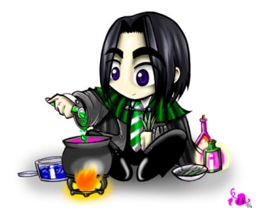
Words and
Expressions
musician
dream of
karaoke
pretend
to be honest
attach
attach…to
form
fame
n. 音乐家
梦见；梦想；设想
n. 卡拉OK录音
vt. 假装；假扮
说实在地；实话说
vt. & vt. 系上；缚上；附加；连接
vt. & vi. 认为有(重要性、意义)
附上；连接
vt. (使)组成；形成；构成
n. 名声；名望

Slide 3
Words and
Expressions
passer-by
earn
extra
instrument
perform
performance
pub
cash
in cash
studio
n. 过路人；行人
vt. 赚；挣得；获得
adj. 额外的；外加的
n. 工具；器械；乐器
vt. & vi. 表演；履行；执行
n. 表演；演奏
n. 酒馆；酒吧
n. 现金
用现金；有现钱
n. 工作室；演播室

Slide 4
Words and
Expressions
millionaire
play jokes on
actor
rely
rely on
broadcast
humorous
familiar
be/get familiar with
n. 百万富翁；富豪
戏弄
n. 男演员；行动者
vi. 依赖；依靠
依赖；依靠
n. 广播；播放
vi.& vt. 广播；播放
adj. 幽默的；诙谐的
adj. 熟悉的；常见的；亲近的
熟悉；与……熟悉起来

Slide 5
Words and
Expressions
or so
break up
attractive
addition
in addition
sort out
dip
confident
brief
大约
打碎；分裂；解体
adj. 吸引人的；有吸引力的
n. 加；增加；加法
另外；也
分类
vt. 浸；蘸
adj. 自信的；确信的
adj. 简短的；简要的
n. 摘要；大纲

Slide 6
Words and
Expressions
briefly
devotion
afterwards
invitation
beard
sensitive
painful
above all
adv. 简要地；短暂地
n. 投入；热爱
adv. 然后；后来
n. 邀请；招待
n. 胡须
adj. 敏感的；易受伤害的；灵敏的
adj. 痛苦的；疼痛的
最重要；首先

Slide 7
Match
dream of
to be honest
attach … to
in cash
play jokes on
rely on
be/get familiar with
or so
break up
等等
戏弄
依赖; 依靠
梦见; 梦想; 设想
大约
说实在地; 实话说
熟悉; 与……熟悉起来
认为有 (重要性、意义);附上; 连接
用现金; 有现钱
打碎; 分裂; 解体

Slide 8
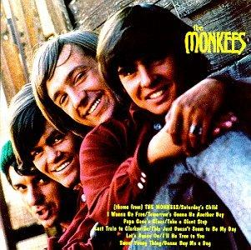
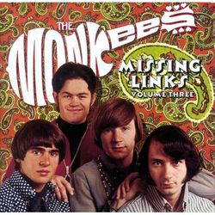
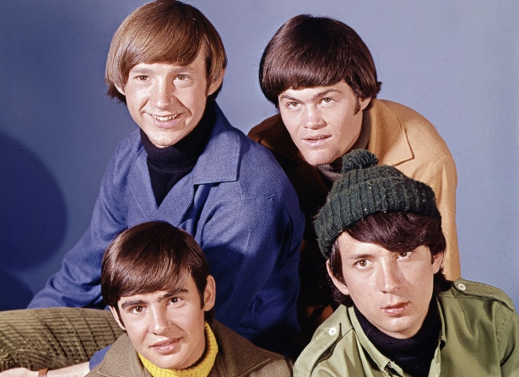
THE BAND THAT WASN’T

Slide 9

1. To summarize the main idea of the passage
2. To know more about the Monkees
3. To learn some useful words, expressions and patterns in the passage

Slide 10
Focus on
Words:
pretend, attach, form, earn, perform, rely, humorous, familiar
Expressions:
to be honest, play jokes on, rely on, be/get familiar with, break up
Patterns:
Have you ever …
sb. attach great importance to …

Slide 11


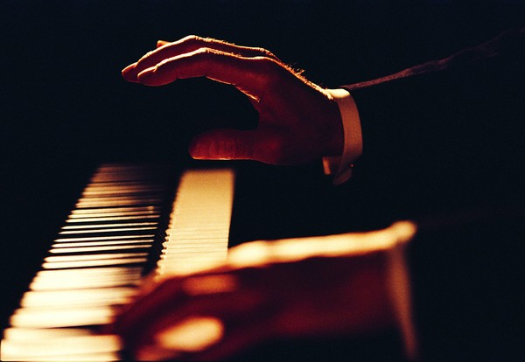
Skimming for general idea

Slide 12
Match the main ideas and the paragraphs.
This is how most bands start.
Para. 1
Many people want to be famous as singers or musicians.
Para. 2
How the Monkees became popular and how they developed as a real band.
Para. 3
The Monkees started in a different way.
Para. 4

Slide 13
Scanning for specific information

Slide 14



(1) True or False
A famous singer or musician usually
belongs to a band.
2. Many musicians form a band because
of their common interest in music.
3. Playing music to passers-by in the
street is the first step to fame.
4. When performers make records and
sell millions of copies, they are successful.

Slide 15
5. If we are honest with ourselves, most
of us are afraid of being famous.
6. Many musicians meet and form a band
because they like to write and play
their own music.
7. The TV organizers had looked for five
musicians who were lively and who
could make good music.
8. “The Monkees” broke up in about
1960, but reunited in 1980.

Slide 16
(2) Join the correct parts of the sentences together.
They produced a new record in 1996
2. Most musicians get together and
3. They put an advertisement in the newspaper looking for four rock musicians,
4. The first TV show
5. However, the band
broke up about 1970,
but only one person was accepted.
B. but reunited in the mid-1980s.
C. form a band because they like to write and play music.
D. to celebrate their time as a band.
E. was a big hit.
P351

Slide 17
(3) How do most people form a band?
Put the following steps in right order.
4
Make records.
Give performance in the pubs or clubs.
Musicians get together and play music at home.
Play music in the street or subway.
3
1
2

Slide 18



Slide 19
I. Complete the passage with proper words, which will help you retell the text.
A great many people dream of becoming singers and they often attach great importance to __________(become) rich and famous. Many __________(music) form a band to perform their own music in the street or in pubs. The Monkees, a famous band, started in a different way. At first, the musicians were to play jokes on each other as well as play music. The TV organizers ____________(plan) to find four musicians who could not only act but also sing, ________they found only one who
becoming
musicians
had planned
but

Slide 20
was good enough. As a result, they had to use actors. Due to their lack of singing
skill, they had to rely __________other musicians to help them, and they just pretended __________(sing). However, their performances were so humorous
_________they became popular. They had many fans, _________formed clubs to get more familiar with them. In about 1970, the band broke up. _______(lucky), they reunited in _______mid-1980s.
on
to sing
that
who
Luckily
the

Slide 21


II. Task-based reading.
True or False questions.
1. The Black Eyed Peas has been
popular since their first album came
out.
2. The Black Eyed Peas is much
concerned about the world problems.
3. The Black Eyed Peas is always
looking for new ideas and directions
to earn more fans.

Slide 22


After the class
TIME FOR REFLECTION
It’s time to stop the class for us to look back in silence.
Think in English
Think about what we’ve just learnt today.
Study without reflection is a waste of time.

Slide 23

Homework
Write a composition about your favorite band in about 100 words.
2. 发挥想象，连词成文(50-100字)。
dream of, to be honest, attach, form, earn, perform, in cash, humorous, or so, break up.

