Slide 1

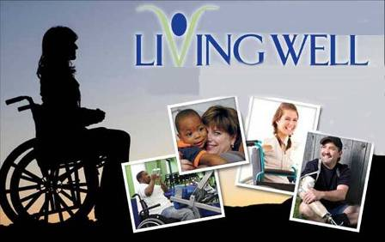
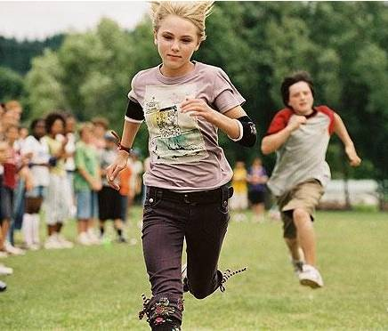
Living well

Slide 2


To think about the different kinds of disability people might have
To look at the four people in the pictures on Page 1 to find out what their disabilities are
To understand that people with a disability can lead fulfilling lives

Slide 3
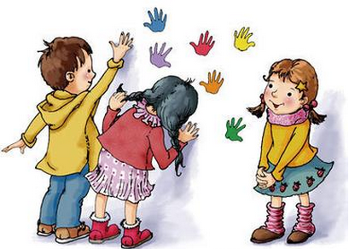
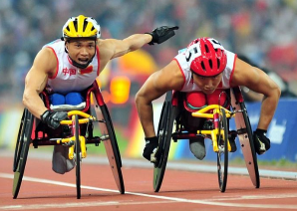
Discuss
Do you know anyone with a mental
or physical disability?
Does their disability make it
difficult for them to do some things?
What have they tried to do to overcome
these difficulties?

Slide 4

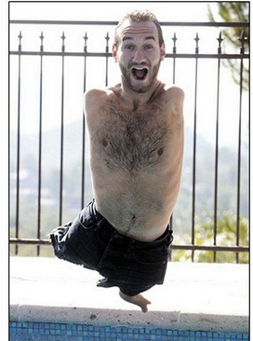
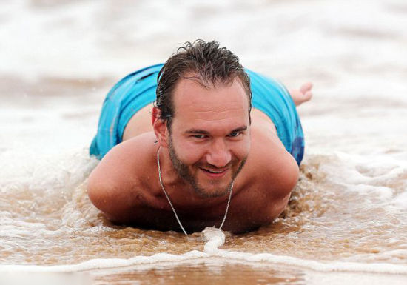
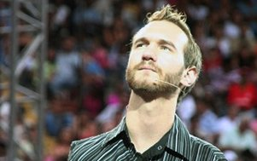
What can you do without your arms and feet?
Life Without Limbs

Slide 5

尼克•武伊契奇 (Nick Vujicic)，塞尔维亚裔澳大利亚籍人，是“无四肢生命” (Life Without Limbs) 组织的创办人。他天生没有四肢，却勇于面对身体残障，创造了生命的奇迹。尼克的“足迹”已经遍布全世界，与数十亿人分享了他的经历。

Slide 6


Do you know these people
below and what disease they have?

Slide 7
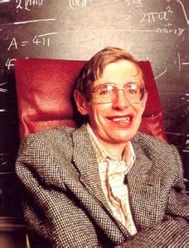
Steven Hawking
physicist /
mathematician
ALS (肌萎缩侧索硬化)
famous scientist
known for his theory about black holes and big bangs:
A Brief History of Time
Notes:
肌萎缩侧索硬化（ALS）也叫运动神经元病（MND），后一名称英国常用，法国又叫夏科（Charcot）病，而美国也称卢伽雷氏（Lou Gehrig）病。我国通常将肌萎缩侧索硬化和运动神经元病混用。它是上运动神经元和下运动神经元损伤之后，导致包括球部（所谓球部，就是指的是延髓支配的这部分肌肉）、四肢、躯干、胸部腹部的肌肉逐渐无力和萎缩。

Slide 8
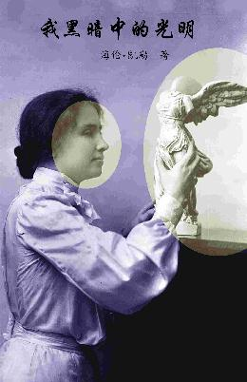
Light in My Darkness
Helen Keller
difficulty with eyesight
American educator/writer

Slide 9
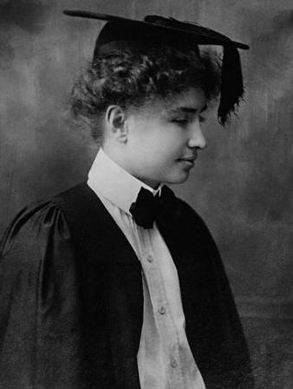
Helen Keller became
blind when she was
less than 2 years old.
She was deaf soon after
that. She grew into a
highly intelligent
woman with her teacher’s
help. Her most famous article is Three Days
to See.

Slide 10
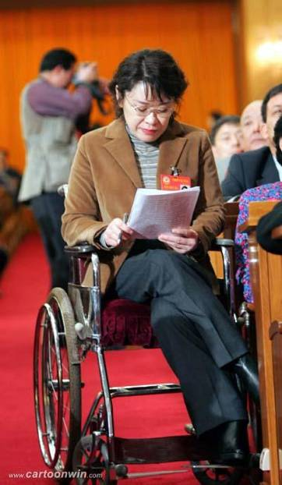
Zhang Haidi (张海迪)
paraplegia
(截瘫/下身麻痹)
became disabled at the
age of 5, taught herself
English and took up
writing in 1983

Slide 11
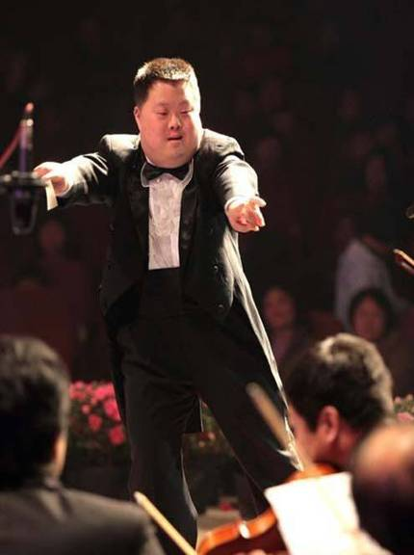
Zhouzhou (舟舟)
famous conductor
Down’s Syndrome
born mentally
disabled with an
IQ of a child

Slide 12
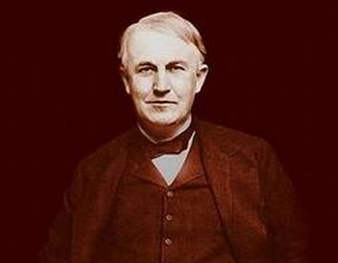
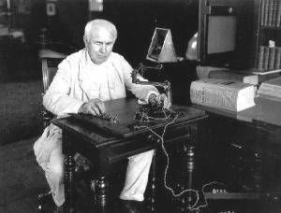
Thomas Alva Edison was a very famous and successful American inventor. His inventions greatly influenced life around the world. But he has hearing problems. Do you know it?

Slide 13
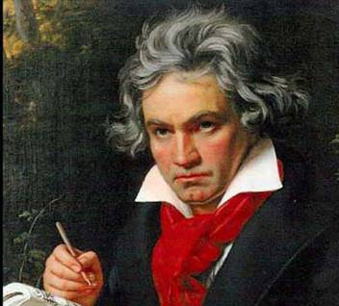
Ludwig van Beethoven was one of the most famous and influential German composers and pianists in the world. During the last decade of his life although he was almost totally deaf, he continued to compose. Many of his most admired works came from this period.

Slide 14
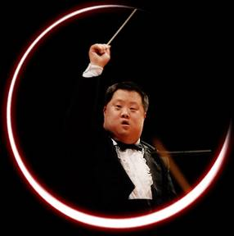
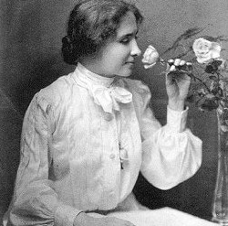
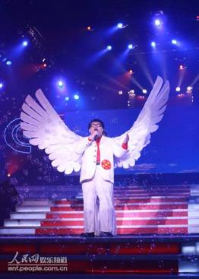
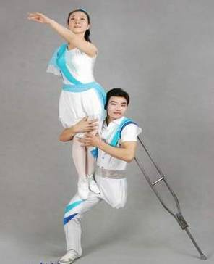
Pair Work
What can you learn from them?

Slide 15

diligent
passion
devoted
confident
courageous
perseverant
optimistic
patient
independent
strong-minded

Slide 16
P1 2
Discuss
Look at the pictures on page 1 and read what these people have achieved even though they each have a disability. Discuss what their disability might be with your partner.

Slide 17
The following list might help you.
mental disability learning difficulty
hearing problem difficulty with eyesight
brain injury loss of an arm or a leg
Down’s Syndrome (唐氏综合症)
infantile paralysis (小儿麻痹)
walking difficulty

Slide 18
Rosalyn is in a wheelchair.
Richard has very poor eyesight and so could not read the questions or write the answers for his college entrance exams.
Sally is hearing impaired (though not deaf as she can still understand loud speech in the cinema).
Gao Qiang was born with Down’s Syndrome, which is a mental disability. Some Down’s Syndrome sufferers have made a good career as actors.

Slide 19
Discuss
What are their achievements?
What extra help may be needed for disabled students to make these achievements?

Slide 20
Rosalyn needs encouragement with her sports and special places to practise in her wheelchair. She may need a special coach too who understands how to improve the skills of physically impaired athletes.
Richard needs special equipment for his studies and perhaps a special room in which to take his exams. In this way he does not interfere with other students’ concentration.

Slide 21
Sally does not need special facilities. She only needs hearing aids to improve her hearing so she can join in with everyone else.
Gao Qiang needs special teachers while he is still at school to develop his academic abilities and teach him how to look after himself.

