Slide 1

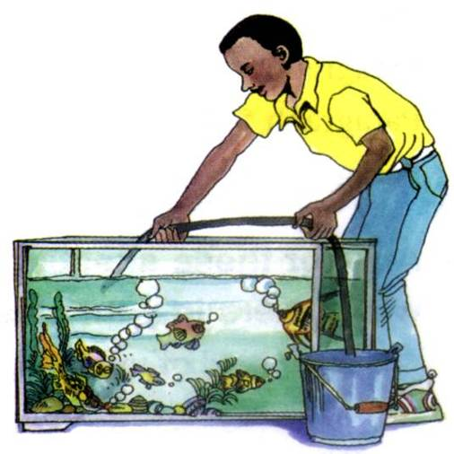
Unit 1 Reading
MARTY’S STORY

Slide 2

1. To summarize the main idea of the passage
2. To study Marty’s optimistic (乐观的)
attitude towards life
3. To learn to use some useful words, expressions and patterns in the passage

Slide 3

certain
information
a general
idea
Reading strategy
skimming
scanning
titles and headings
Scan the text for
key words and phrases, dates, etc.
the first and last
sentences of paragraphs
the first and last paragraphs
Do not need to
read the whole
text.
pictures and charts

Slide 4


Skimming for general idea

Slide 5
(2)Find out the main idea of each paragraph.
An introduction to Marty and his
muscle disease
2. How his disability developed
3. Marty met a lot of difficulties at school
4. How his life has become easier
5. The advantages of his disease

Slide 6
Scanning for specific information

Slide 7

1. Why does Marty say “I am one in a million”?
Because there are not many people like Marty. He has a muscle disease which even the doctors don’t know how to cure.
Read the passage and answer the questions.
2. What’s his attitude towards his disability?
He is very outgoing and has learned to adapt to his disability.
His motto is: live one day at a time.
How to translate this sentence?
过好当下每一天

Slide 8
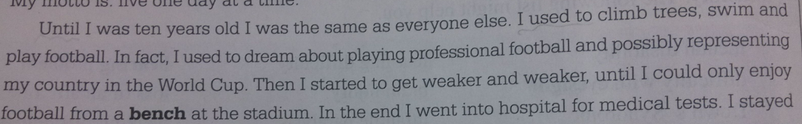

3. Was Marty born with that disease?
No, he wasn’t. he was the same as everyone else until he was ten years old.
4. How has Marty’s life changed since he was ten years old?
Marty’s life has changed a lot since he was ten years old.

Slide 9

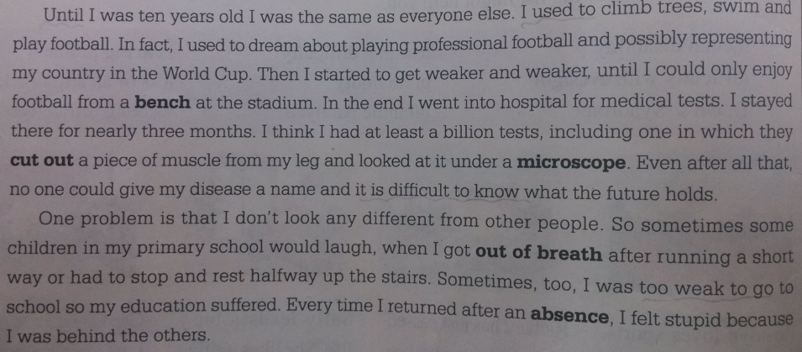
Problems caused by his disability
at primary school
weak and can’t run or climb stairs as
quickly as others
He was the same as an ordinary one.
Before 10
2. clumsy and often drop things or bump
into furniture
after 10
He get weaker and weaker
3. can’t play football and can only enjoy
football matches from a bench at a stadium
problems
4. has missed a lot of school
How did he feel?
5. feels stupid because of being behind the
others
Hopeless and stupid.

Slide 10
Life has become happy, hopeful and satisfying.
at high school
have an easier life
My fellow students have accepted me. The few who cannot…ignore them.
have a good life
Find many things to do…
My ambition is to…
Have no time to feel sorry for myself
have a busy life
movies, football matches, pets and a lot of work

Slide 11
(4) Fill in the form below.
P3 1
Problems caused by his disability | What Marty does in spite of his disability
1 weak and can’t run or climb stairs as quickly as others 2 3 4 5 | 1 enjoys writing and computer programming 2 3 4

Slide 12
Problems caused by his disability
weak and can’t run or climb stairs as
quickly as others
2. clumsy and often drop things or bump
into furniture
3. can’t play football and can only enjoy
football matches from a bench at a stadium
4. has missed a lot of school
5. feels stupid because of being behind the
others

Slide 13
What Marty does in spite of his disability
1. enjoys writing and computer
programming
2. invented a computer football game
3. looks after pets
4. disability has helped him grow stronger
psychologically and become more
independent

Slide 14
(5) Answer the following questions.
P3 3
1 What kind of person do you think Marty is?
2 What do you think is the most difficult
thing that Marty has to deal with in his
life?
3 What kind of thing does Marty do in
order to make his life happy and satisfying?
4 What can other people do to help Marty
and others like him live a good life?
5 Why has his fellow students’ conduct
changed towards Marty?

Slide 15
Reference answers
1 What kind of person do you think
Marty is?
Marty seems to be a fairly positive
person who considers he has a good
life. He is realistic about his disability,
but does not let this stop him doing as
much as he can. He is a psychologically
strong, independent boy.

Slide 16
2 What do you think is the most difficult
thing that Marty has to deal with in his
life?
Missing lots of school, not being able to run around and play sports like other boys at his age, people not understanding that he has a disability.

Slide 17
3 What kind of thing does Marty do in order to make his life happy and satisfying?
Marty keeps busy doing things that do
not require physical strength, like
computer programming. He has friends
with whom he can go to movies and
football matches and he has lots of pets.
He also studies hard.

Slide 18
4 What can other people do to help Marty and others like him live a good life?
They can accept people with disabilities
like Marty for who they are rather than
focus on their disability. They can
encourage them to live rich and full lives.

Slide 19
5 Why has his fellow students’ conduct
changed towards Marty?
Because they found that Marty was
able to live as rich and full a life as
everyone else.
It is not frightening if you are disabled in body, but it is so if you are not healthy in mind.

Slide 20

Marty Fielding has a muscle disease that ______ him very weak, so he is very clumsy __________, he drops things or bumps into furniture. __________some students look down upon him, Marty never gets ________. He ______ a meaningful life and has learned to ___________ his disability.
His ambition is to work in a computer firm and last year he _________ a computer football game. In many ways, Marty’s disability __________ (make) him more independent. According to Marty, people needn’t feel sorry for the disabled or ___________ (取笑) them. Just accept them and give them ________________ .
makes
sometimes
Although
annoyed
leads
adapt to
Complete the passage with proper words,
which will help you retell the text.
invented
has made
make fun of
encouragement

Slide 21


When one door of happiness closes, another opens; but often we look so long at the closed door that we do not see the one which has been opened for us.
当通往幸福的一扇门关闭时，另一扇会打开，但是我们往往太久注视着关上的那扇门而看不到已经为我们打开的那扇门。

Slide 22
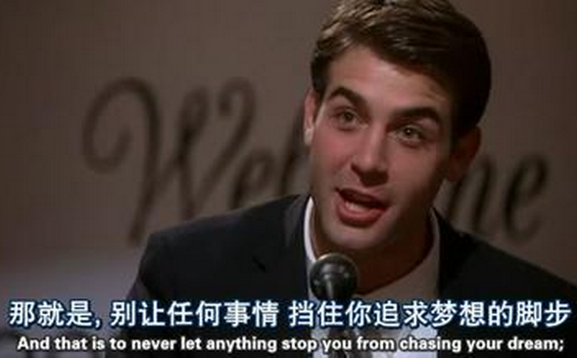
What’s the problem with him?
He had Tourette Syndrome (秽语多动综合征). He was misunderstood by the people around him, including his father. Besides, he met with many difficulties in applying for a job.
Have you met such persons like him?

