Slide 1

Unit 1 Grammar
Revise the Infinitive

Slide 2

To revise the infinitive and use the infinitive properly

Slide 3

1. Two years ago she bought an
expensive mountain bike and then
she persuaded me _______ one.
2. Anyhow, my goal is __________
humans with a life of high quality.
3. … the Monkees started _______ and
sing their own songs like a real band.
4. Many millions of years later, the first
extremely small plants began ________
on the surface of the water.
to buy
to provide
to play
to appear

Slide 4
5. John Snow wanted _______ the
challenge and solve this problem.
6. I knew it was time ________ smoking.
7. Unfortunately, the doctors don’t know
how _______ me better, but I am very
outgoing and have learned _______ to
my disability.
8. Then I started _______ weaker and
weaker, …
to face
to quit
to make
to adapt
to get

Slide 5
9. Even after all that, no one could give
my disease a name and it is difficult
________ what the future holds.
10. Sometimes, too, I was too weak _____
to school so my education suffered.
11. I am happy ______________ many
things I can do, like writing and
computer programming.
12. My ambition is _______ for a firm
that develops computer software
when I grow up.
to know
to go
to have found
to work

Slide 6
13. Last year I invented … and a big
company has decided ______ it from
me.
14. I have a very busy life with no time
_____ around feeling sorry for myself.
15. _______ after my pets properly takes
a lot of time …
16. Just accept them for who they are,
and give them encouragement ______
as rich and full a life as you do.
to buy
to sit
To look
to live

Slide 7



1. Last summer I took a course on _____.
A. how to make dresses
B. how dresses be made
C. how to be made dresses
D. how dresses to be made
Notes:
“碰壁点拨式”教学法是素质教育的一种方式，这种教学法的基本模式是：编拟题组—练中碰壁—讲评点拨—巩固消化。该教学法以问题为载体，以训练为主线，目标导控，问题教学，先练后讲，碰壁点拨，反馈矫正。增强了学习的方向性、选择性及目标性，使学生在克服困难消除障碍的过程中发展自己的观察力、想象力和思维能力，使他们的智慧升华，创造思维得以开发。

Slide 8
2. I’ve worked with children before, so
I know what _____ in my new job.
A. expected B. to expect
C. to be expecting D. expects
3. There are five pairs _____, but I am at
a loss which to buy.
A to be chosen B to choose from
C to choose D for choosing

Slide 9
4. I find these problems are easy _____.
A. to be worked out
B. to work them out
C. to work out
D. to be worked them out
5. _____ late in the morning, Bob turned
off the alarm.
A. To sleep B. Sleeping
C. Sleep D. Having slept

Slide 10
6. Tom kept quiet about the accident
_____ lose his job.
A. so not as to B. so as not to
C. so as to not D. not so as to
7. The patient was warned _____ oily
food after the operation.
A. to eat not B. eating not
C. not to eat D. not eating

Slide 11

不定式
不定式由“to+动词原形”构成,其否定形式是“not/never to do”,不定式可以带宾语或状语构成不定式短语,没有人称和数的变化,但有时态和语态的变化。不定式可以作主语、宾语、状语、表语和定语，但不能单独作谓语。不定式的逻辑主语有时用“for+名词或代词宾格”构成。

Slide 12
动词不定式的作用
Functions of Infinitive
1 主语 (subject)
2 表语 (predicative)
3 宾语 (object)
4 宾补 (object complement)
5 定语 (attribute)
6 状语 (adverbial)
7 独立结构 (absolute construction)

Slide 13
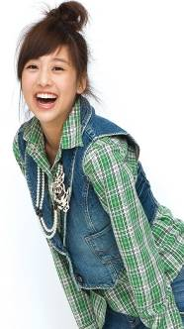
一、不定式作主语 (subject)
To keep smiling is healthy for you.
It’s important to look up the new
words in the dictionary when you
study English.
单个不定式作主语时, 谓语动词用单数。
若不定式太长, 往往用it作形式主语, 不定式后置。

Slide 14
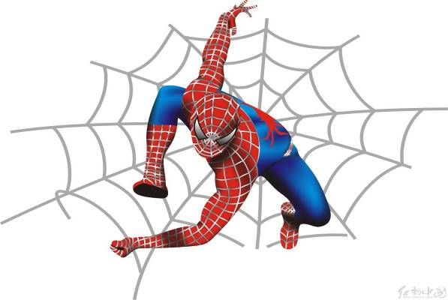
二、不定式作表语 (predicative)
My job to protect the world.
Your task is to _____________.
is

Slide 15
不定式常用在系动词 be, seem, appear,
get, remain等后作表语。
Seeing is believing.
To see is to believe.
All you have to do is (to) finish the
job quickly.
如果主语部分有个表示不定式内容的do, 用作表语的不定式可省略to。

Slide 16
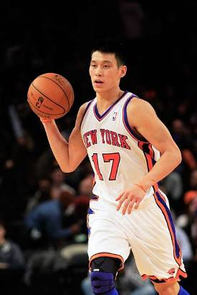
三、不定式作宾语 (object)
Jeremy Lin likes to play
basketball.
The girl decided to do it herself.
We hope to get there before dark.

Slide 17
常接动词不定式作宾语的动词有：
agree, afford, appear, ask, attempt,
care, choose, claim, dare, decide, demand, deserve, determine, expect, fail, get,
hate, hesitate, hope, hurry, intend, learn, manage, offer, plan, prepare, pretend, promise, refuse, seem, tend, threaten,
want, wish

Slide 18
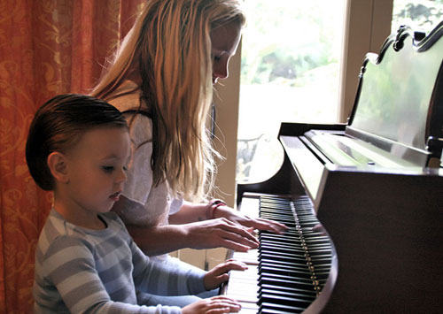
四、不定式作宾补 (object complement)
My mum asks me to play the piano for
two hours every day.

Slide 19

引导不定式作宾补的动词：
warn, tell, allow, help, ask, force等
+ sb. to do sth.
The teacher told me to clean the blackboard.
I expect you to give me some help.

Slide 20

watch
see
let
五看
look at
三使
make
observe
have
notice
+ sb. do sth.
（不带to）
listen to
二听
hear
一感觉:
feel

Slide 21
当以上的动词用于被动式，to要还原：
1. They saw the boy fall suddenly from
the tree.
The boy was seen to fall suddenly
from the tree.
Mother made John wash the car for
a week.
John was made to wash the car for
a week.

Slide 22
不定式做宾补时不带to的情况
1 不定式在感官动词(feel, hear, listen to, watch, look at, notice, observe)后；
2 使役动词(let, have, make)后边作
宾补时, 省去to, 但是在被动语态中
要还原to；

Slide 23
3 不定式用在介词but, except, besides
后时, 如果这些介词前有行为动词do的
各种形式, 那么介词后的不定式不带to,
相反则带to。
1) She could do nothing but cry.
2) I have no choice but to go.
3) What do you like to do besides sleep?

Slide 24
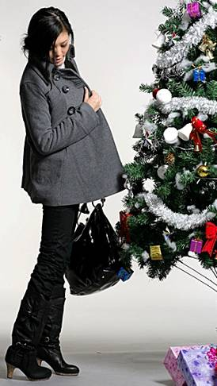
五、不定式作定语 (attribute)
1. Kate is looking for a
suitable coat to wear.
2. Tom has a nice pen
to write with.

Slide 25
不定式作定语
1. 不定式做定语时常放在被修饰的名词或代词之后
(a) She was very busy and had no time
to visit her friends.
(b) Ladies and gentlemen, I have
something important to tell you.

Slide 26
不定式作定语与所修饰的词之间有
三种关系：
(1) 动宾关系
I have a lot of work to do.
我有很多工作要做。
He is always the first to come.
他总是第一个来。
We all have a chance to go to college.
我们都有上大学的机会。
(2)主谓关系
(3)同位关系

Slide 27
2. 当被the first, the last, the only等词以及形容词最高级修饰时
eg: She is always the first to come and
the last to leave.
3. something, anything, nothing, everything等复合不定代词常用不定式做后置定语。
eg: I’ve grown so crazy about everything to do with nature.

Slide 28
注意比较：
1) Have you anything to send?
你有什么东西要寄吗？
2) Have you anything to be sent?
你有什么要（我或别人）寄的东西吗？
（不定式to send的动作执行者是you）
（不定式to be sent的动作执行者是
已被省略的me或someone else）

Slide 29
4. 也可用在have … to do和there be
句型中。
There is no one to take care of her.
I have no jewelry to wear.
5. 如果不定式是不及物动词, 则后面需
适当的介词。
Please pass me some paper to write
____.
on

Slide 30

I got up early to _____________.
You came here to ________.
六、不定式作状语 (adverbial)
catch the train
在一些短语中也有体现
in order to,
so as to,
enough to,
only to,
too ... to

Slide 31
不定式作状语
1) 表示目的: to
in order to
so as to
eg: He spoke loudly (so as / in order)
to be heard.

Slide 32
2) 表示原因:
不定式可以用在作表语的形容词后作
状语, sorry, surprised, happy, glad,
eager, angry, foolish, right, wrong,
slow, quick, rude, cruel, disappointed
等。
eg: I’m glad / pleased to see you.
We were surprised to hear the news.

Slide 33
3) 结果状语:
so + adj. / adv. + as to do …
such + n. + as to do …
adj. / adv. + enough + to do
too + adv. / adj. + to do
He was so foolish as to believe it.
= He was such a fool as to believe it.
= He was foolish enough to believe it.

Slide 34

七、独立结构 (absolute construction)
To tell the truth, I am not happy at the
moment.
to be frank
to be honest
to tell the truth

Slide 35

Identify its function.
想一想
1. It is good to help others.
2. It is my ambition to make sure that the disabled people in our neighborhood have access to all public buildings.
3. My ambition is to work in the computer industry when I grow up.
(subject)
(subject)
(predicative)

Slide 36
4. I don’t have time to sit around feeling sorry for myself.
5. I am the only student in my class to have a pet snake.
6. A big company has decided to buy it from me.
7. My fellow students have begun to accept me for who I am.
(attribute)
(attribute)
(object)
(object)

Slide 37
8. I have had to work hard to live a normal life.
9. Some days I am too tired to get out of bed.
10. We must call on local government to give financial assistance to disabled people.
(adverbial)
(adverbial)
(object complement)

Slide 38
动词不定式的时态和语态
时 态 | 主 动 | 被 动
一般时
进行时
完成时
完成进行时
to do
to be done
to be doing
to have been
done
to have done
to have been
doing

Slide 39
(1) They pretended not to see us.
(一般时表示与谓语的动作同时/几乎/发生在它之后。)
(2) He pretended to be sleeping.
(在谓语动词发生的同时,不定式的动作也正在进行。)
(3) She pretended to have known it before.
(完成时表示动作发生在谓语动作之前。)
(4) We’re happy to have been working with
you.
(完成进行时表示谓语动作发生之前,不定式的动作一直在进行而且可能之后也继续。)

Slide 40
不定式的体态
不定式的一般体 to do
I am glad to see you.
He has decided to give her some money.
表示的动作通常与谓语所表示的动作
或状态同时或者几乎同时发生，或是
在它之后发生。

Slide 41
不定式的进行体 to be doing
I am very glad to be working with you.
He pretended to be working hard
when his boss passed him.
表示的动作通常与谓语动词表示的动
作同时发生。

Slide 42
不定式的完成体 to have done
He happened to have seen the
film before.
The novel is believed to have been
translated into Chinese.
不定式所表示的动作发生在谓语动作
或状态之前。

Slide 43
He wanted to have met you at the
airport, but he didn’t get there in time.
表示过去没有实现的期待或者计划
hoped, promised, wanted, wished,
expected, planned …
He would like to have played the
violin at the concert.
不定式的完成体在would like后边表示
未能实现的愿望。

Slide 44
不定式的语态
主动语态 to do
被动语态 to be done
It is an honor for me to be invited to
attend the meeting.
Everyone likes the hero to be praised.

Slide 45
固定词组和句型
1. prefer n. (doing) to n. (doing)
2. prefer to do sth. rather than do sth.
3. would rather do
4. would rather + 句子（虚拟语气）
5. advise / allow / permit / forbid sb. to do
advise / allow / permit / forbid doing

Slide 46
几对易混淆的词组：
stop to do sth. 停下来去做某事
doing sth. 停止做某事
forget to do sth. 忘记去做某事
doing sth. 忘记已做了某事
remember to do sth. 记得去做某事
doing sth. 记得曾经做某事

Slide 47
主动形式表被动意义的不定式
1. 主语 + be + adj. + to do
能用于此句型的形容词有: difficult, easy, comfortable, fit, hard, pleasant, tiresome
(使人疲劳的), interesting, nice, heavy, dangerous, light, important, etc.
The question is very difficult to answer.
The problem is difficult to deal with.

Slide 48
2. 主语 + be + adj. + enough + to do
The box is light enough to carry.
The river water is warm enough to
swim in.
3. 主语 + be + too + adj. + to do
The books seemed too heavy to carry.
The ice is too thin to skate on.

Slide 49

Review
不定式可以作主语、表语、宾语、宾补、状语和定语。
不定式的完成时：
to + have + 动词的过去分词
不定式的被动式：
to + be + 动词的过去分词

Slide 50




Slide 51

I. Multiple choice.
1. _____the early flight, we ordered a taxi in advance and got up very early.
（2015北京）
A. Catching. B. Caught.
C. To catch. D. Catch

Slide 52
2. There are still many problems ______ before we are ready for a long stay on the Moon. （2014北京）
A. solving B. solved
C. being solved D. to be solved

Slide 53
3. ourselves from the physical and mental tensions，we each need deep thought and inner quietness.
（2014湖南）
A. Having freed B. Freed
C. To free D. Freeing

Slide 54
4. Harrison Ford is thought to be one
of the few movie stars ______ as a
carpenter before. (2011上海春)
A. to work
B. to be working
C. to have worked
D. to have been working

Slide 55
5. The difference in thickness and weight
from the earlier version makes the iPad
2 more comfortable ______. (2011福建)
A. held B. holding
C. be held D. to hold
6. The ability ______ an idea is as
important as the idea itself. (2011湖南)
A. expressing B. expressed
C. to express D. to be expressed

Slide 56
7. Having finished her project, she was
invited by the school _____ to the new
students. (2012江西)
A. speaking B. having spoken
C. to speak D. to have spoken
8. This machine is very easy ______.
Anybody can learn to use it in a few
minutes. (2012辽宁)
A. operating B. to be operating
C. operated D. to operate

Slide 57
9. Volunteering gives you a chance _____
lives, including your own. (2013北京)
A. change B. changing
C. changed D. to change
10. I stopped the car _____ a short break
as I was feeling tired. (2013山东)
A. take B. taking
C. to take D. taken

Slide 58
11. _____ warm at night, I would fill the
woodstove, then set my alarm clock
for midnight so I could refill it.
(2013湖南)
A. Staying B. Stayed
C. To stay D. Stay

Slide 59
II. Translation.
1. 爱和被爱都是最大的幸福。
____________________ are both great happiness.
2. 据说他已经完成了他的工作。
He is said _________________________
________.
3. 根据报道他们已安全到达。
They are reported ___________________.
To love and to be loved
to have finished/completed
his work
to have arrived safely

Slide 60
4. 我想叫人立刻修理这辆自行车。
I want this bike _____________________
______________.
5. 玛莉仿佛已经被告知此事了。
Mary seemed ______________________.
6. 众所周知，奥运会上他被授予了一枚
金牌。
He is known _________________ a gold medal at the Olympics.
to be repaired at once
/immediately
to have been told about it
to have been given

