Slide 1
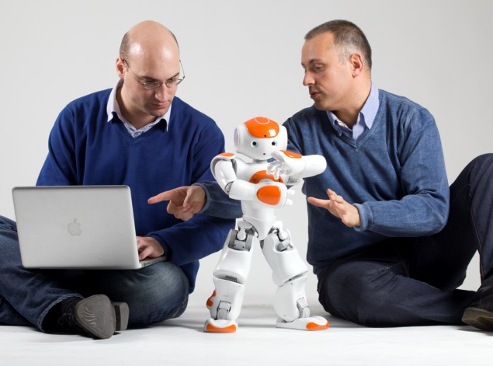
Unit 2
Robots

Slide 2

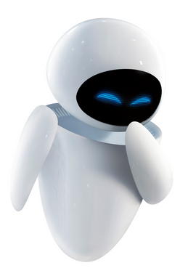
1. To know what a robot is
2. To learn about the use of robots
3. To know the Laws of Robotics

Slide 3
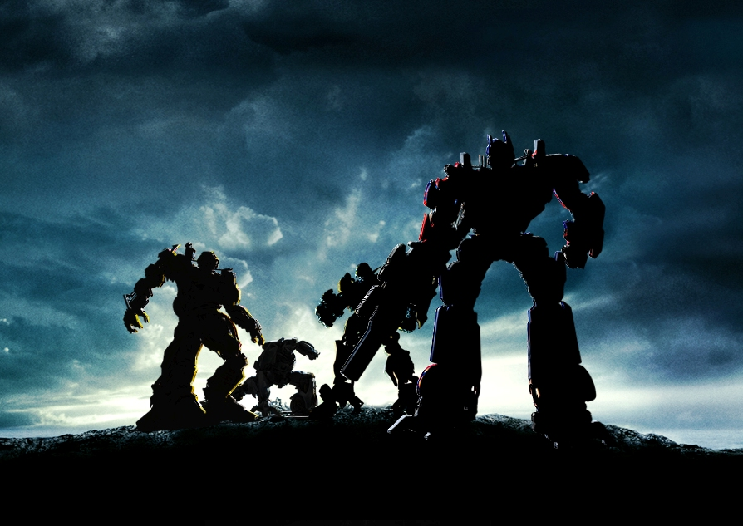
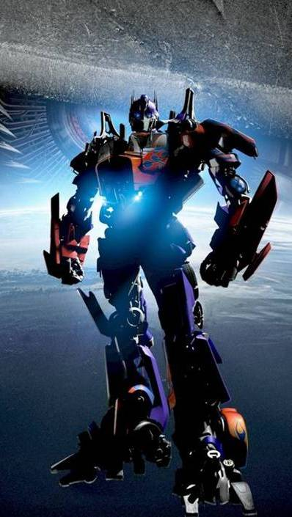
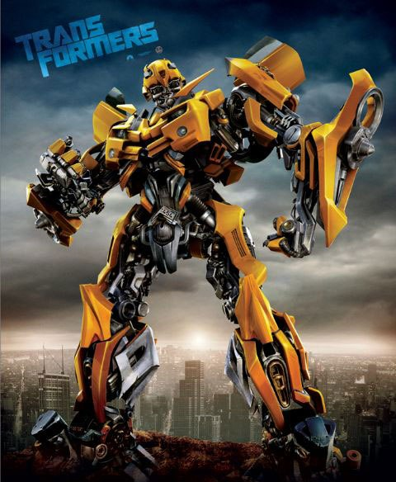
such as
Do you know any science fiction, literature, films, video games, TV shows and cartoons that include robots as character?
Transformers 《变形金刚》

Slide 4
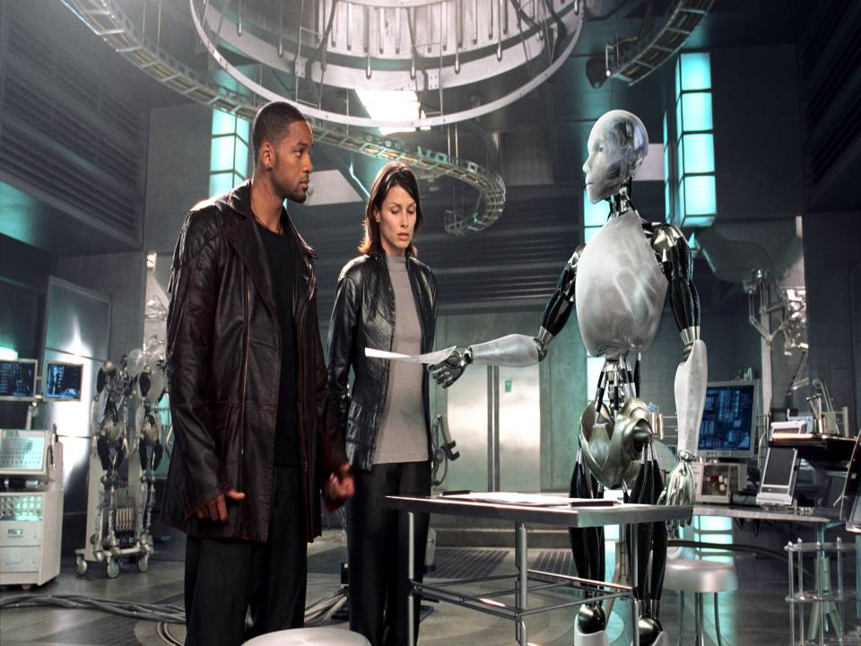
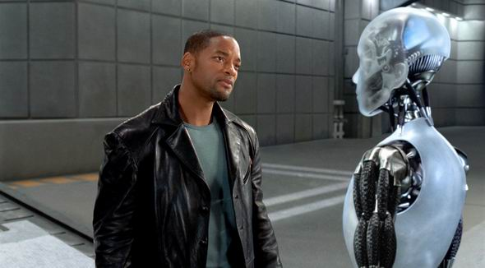
I, Robot 《我，机器人 》

Slide 5
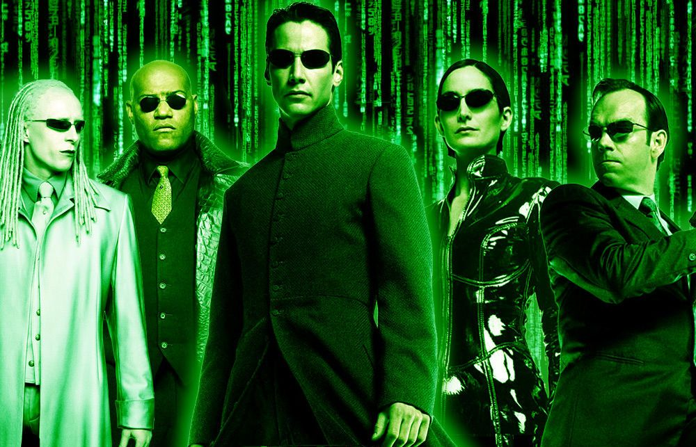
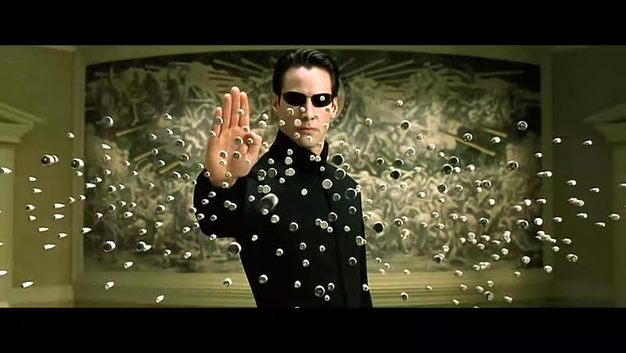
The Matrix 《黑客帝国》

Slide 6
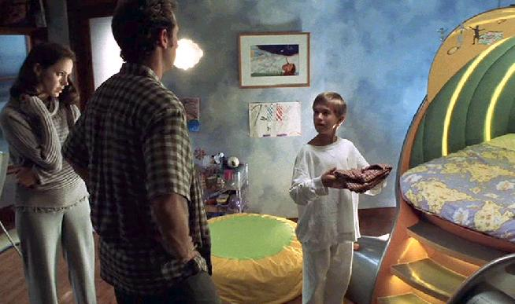
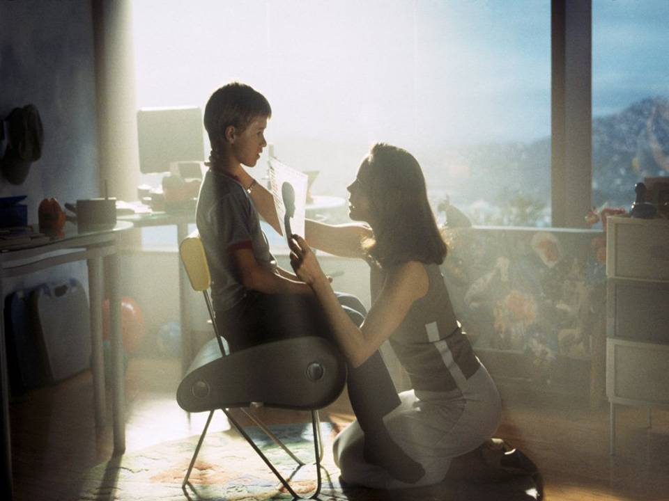
AI - Artificial Intelligence 《人工智能》

Slide 7
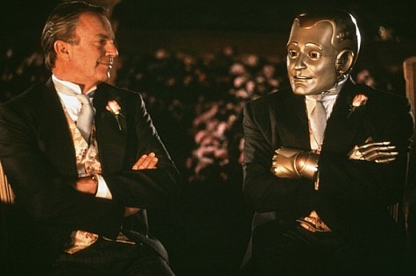
Bicentennial Man《机器管家》

Slide 8
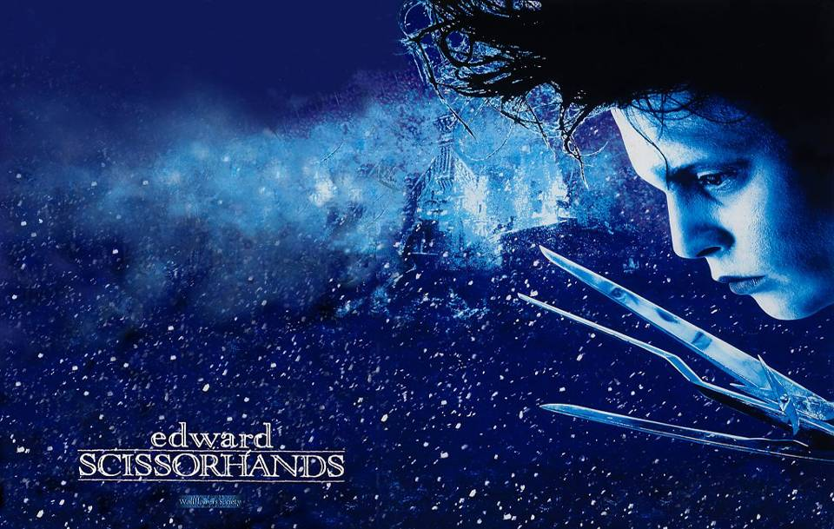
Edward Scissorhands 《剪刀手爱德华 》

Slide 9
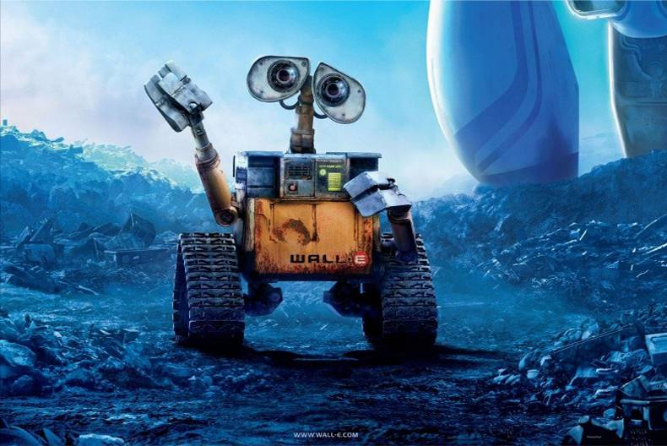
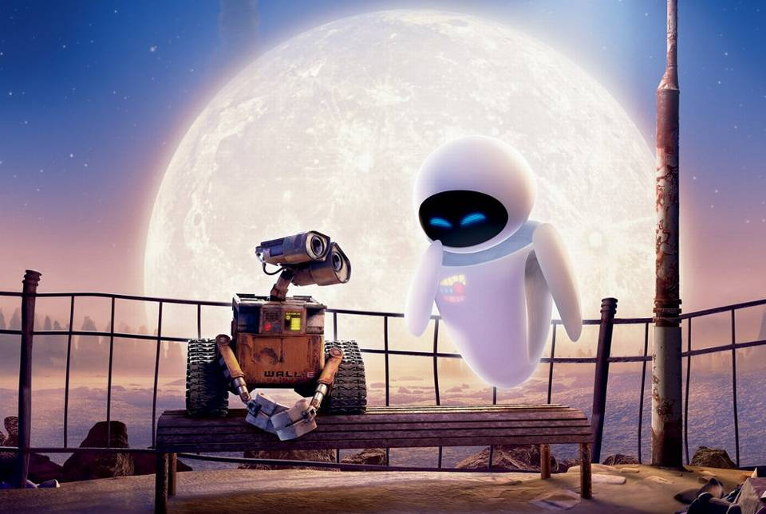
WALL·E 《机器人总动员》

Slide 10

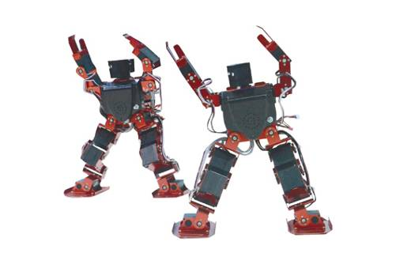
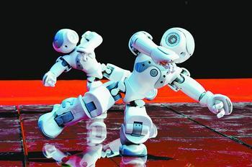
What is a robot? What can a robot do?

Slide 11

What is a robot?
A robot is a machine designed to do jobs that are usually performed by humans. Robots are programmed and controlled by a computer. Today there are different kinds of robot, including industrial robots, household robots, and entertainment robots. Robots also often appear as characters in stories.

Slide 12
A robot can…
act as a policeman
/a seller..
do the labour work
take care of
children and elders
do the
housework
Robots
do research
do some
shopping
talk with humans
play with humans

Slide 13
Robots are made to perform different tasks. Many of them are used for tasks that are either dangerous or unpleasant for us human beings. In other cases, robots are used in repetitive, or boring tasks in which human performance might degrade (降低价值) over time. Robots can perform these repetitive, high-precision operations 24 hours a day without fatigue.

Slide 14

Why do we use Robots?

Slide 15
Why use Robots?
There are many benefits to use robots instead of humans. The good thing about robots is that they will never get bored, and they will do things more efficiently than people. Also, robots never get sick, or need to rest. They will never need time off, or lunch breaks. Sometimes, when a task is too dangerous or difficult for a human, a robot will be able to do it without any risks or problems.

Slide 16
Do you think it is possible for a
robot to:
think for itself?
have feelings?
have its own needs and desires?
look and feel like a human being?
Maybe in the future, robots will be more like a human being.

Slide 17
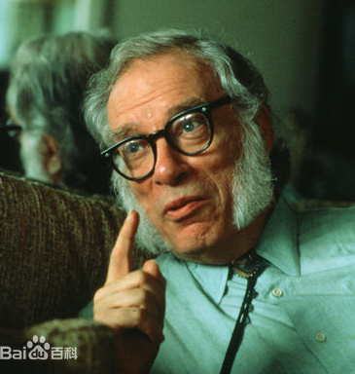
Isaac Asimov is an American scientist and author, who wrote science fiction and proposed three Laws of Robotics in the 1940's:

Slide 18
Law One: A robot may not injure a human being or through inaction allow a human being to come to harm.
Law Two: A robot must obey the orders given it by human beings, except where such orders would conflict with the First Law.
Law Three: A robot must protect its own existence, as long as such protection does not conflict with the First or Second Laws.
Isaac Asimov’s three Laws of Robotics

Slide 19
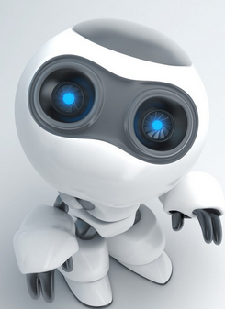
Law Zero: A robot may not injure humanity, or, through inaction, allow humanity to come to harm.

Slide 20

Discuss
What’s your opinion about the three Laws of Robotics? Do you agree with Isaac Asimov’s ideas? Discuss them with your partner.

Slide 21
Some sentences you can use as reference:
Personally I think…
As I see it, …
From my point of view…
I’m inclined to think that…
How do you feel about that?
Are you for or against that?
I’m not really sure you are right.
That may be true, but…
Why do you think so?
Let me put it this way…

Slide 22
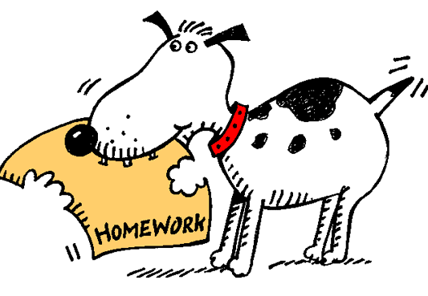
Homework
1. Look up the new words
and expressions of the
Reading in the dictionary.
2. Preview the Reading:
SATISFACTION
GUARANTEED

