Slide 1
6．—Have you known Dr.Jackson for a long time?
—Yes，since she________the Chinese Society.
A．has joined B．joins
C．had joined D．joined
解析：选D。since自从……以来，引导时间状语从句，强调过去认识时的时间，第一句话所用的现在完成时是判断该句子时态的重要依据。

Slide 2
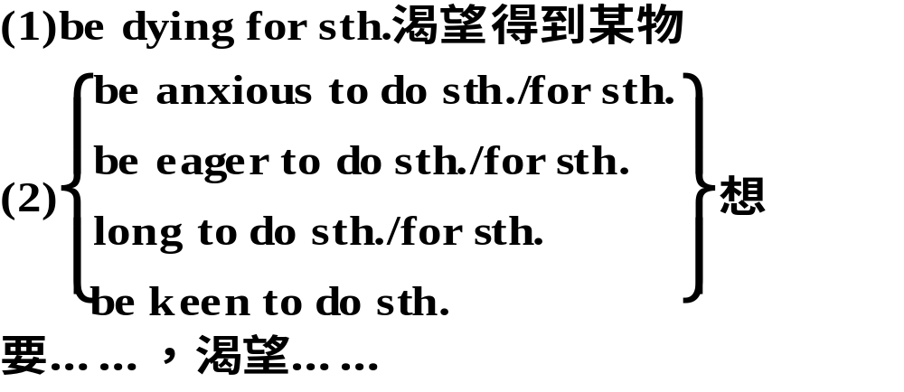
(be)dying to 极想；渴望
I know you’re dying to hear all about my life here，so I’ve included some photos which will help you picture the places I talk about.
我知道你急于了解我在这儿的生活情况，我在信中附有几张照片，能够帮助你想象出我所谈到的地方。

Slide 3
①I haven’t seen him for a few days. I’m dying to know what has happened to him.
我好几天没见到他，我很想知道他发生了什么事。
②She was_dying_for a holiday to relax herself.
她非常渴望一个假期来放松一下自己。
③Mike is_eager_to stay away from the busy city life for a while.迈克渴望离开繁忙的城市生活一段时间。
④(2011·高考山东卷阅读表达)Are you anxious and restless if you are separated from your mobile phone?
没有手机在你身边你会焦躁不安吗？

Slide 4
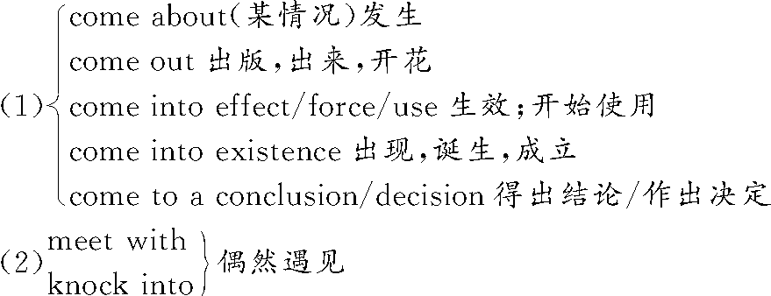
2. come across 偶然遇到或发现，碰见
The boys who had never come across anything like this before started jumping out of the windows.那些从未见过这种情况的男孩子们，(吓得)都往窗外跳去。

Slide 5
①(2011·天津)She came across an old friend of hers yesterday while she was shopping at the department store.昨天她在百货商店购物的时候偶遇一位老朋友。
②She came_across some old photographs in a drawer.
她在抽屉里偶然发现了一些旧照片。
③This situation should never have come about.
这种情况本来不应该发生。
④They met_with an accident on their way home.
他们在回家的路上出了车祸。

Slide 6
3. in need 在困难中；在危急中
Choose from this catalogue a really useful gift for some of the world’s poorest and bring hope for a better future to a community in need.
in need of需要
There is no need for sth.不需要某物
There is no need for sb.to do sth.
某人没有必要做某事

Slide 7
①A friend in need is a friend indeed.
患难朋友才是真朋友。
②We are collecting money for families in_need.
我们正在为有困难的家庭募捐。
③Deeds are better than words when people are in need of help.当人们需要帮助时，行动比话语更好。
④There_is_no_need_to_regret what has happened.
没必要为已经发生的事感到后悔。

Slide 8
1．An airport employee __________ the three kids alone in the terminal.
A．came across B．care about
C．look for D．focus upon
解析：选A。句意为：一位机场工作人员在候机厅里偶然发现了这3个没有大人陪伴的孩子。本题考查动词短语辨析。come across偶然发现，碰到；care about在意，关心；look for寻找；focus upon集中注意力于。

Slide 9
2．If we can______our present difficulties，then everything should be all right.
A．come across B．get over
C．come over D．get off
解析：选B。本题考查动词短语。come across偶然碰到/遇见；get over克服(困难)；come over过来，从远方来，顺便来访；get off意为“下车/来,动身，开始”。本题为“克服我们目前的困难”之意

Slide 10
3．Many Chinese universities provide scholarships for students _______financial aid.
A．in favour of B．in honour of
C．in face of D．in need of
解析：选D。很多中国大学为需要经济资助的大学生提供奖学金。in favour of 赞同，支持，有利于；in honour of 向……表示敬意；in face of 面临；in need of 需要。

Slide 11
not...but...意思是“不是……而是……”，连接两个表语。not...but...连接两个平行成分，当连接两个主语时，谓语动词的数按“就近一致”原则确定。
③Not you but he is to blame.
not only...but(also)，either...or...，neither...nor...连接两个主语时，谓语动词按“就近一致”原则确定。as well as连接主语时，谓语动词按“就前一致”原则确定。 Not he but you are wanted on the telephone.

Slide 12
2. We walked for two and a half hours to get there－first up a mountain to a ridge from where we had fantastic views and then down a steep path to the valley below.
关系副词where前一般不加介词，但from where是个例外
①There are many websites，from where you can find almost all the necessary information.
有许多网址，从那里你能够找到几乎所有必要的信息。

Slide 13
②China is the birthplace of kites，from_where kite flying spread to Japan, Korea and India.
中国是风筝的故乡，从那里放风筝传到了日本、朝鲜和印度。
③Alice stood at the window，from where she could watch her classmates playing football.
Alice站在窗户旁边，从那里她可以观看同学们踢足球。

Slide 14
2．The following are some popular websites____people can sell goods to each other.
A．where B．which
C．when D．whose
解析：选A。where引导定语从句，并在从句中作地点状语，意思是“在这些网站上”。

Slide 15
3．After supper，he usually stood near the window，___ he could see the tower，the tallest building in this city.
A．from which B．on which
C．on where D．from where
解析：选D。考查定语从句。晚饭后，他通常站在窗户旁，从那里他能看见塔，那是这座城市里最高的建筑。from是比较特殊的介词，后面可以接另外一个介词，比如from behind the door,接定语从句时就用from where，本句中from where＝from near the window。

