Slide 1
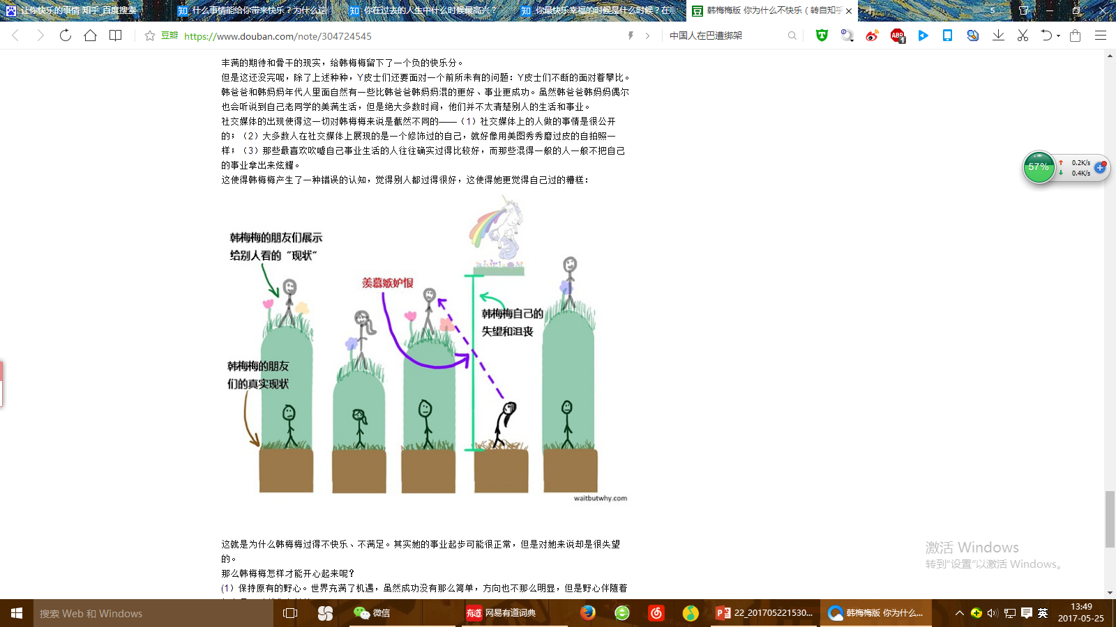
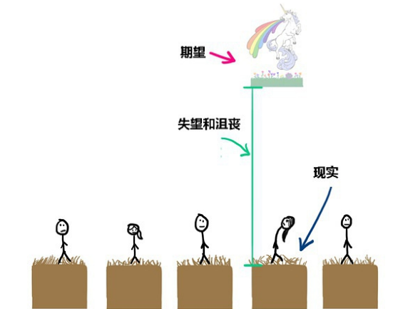
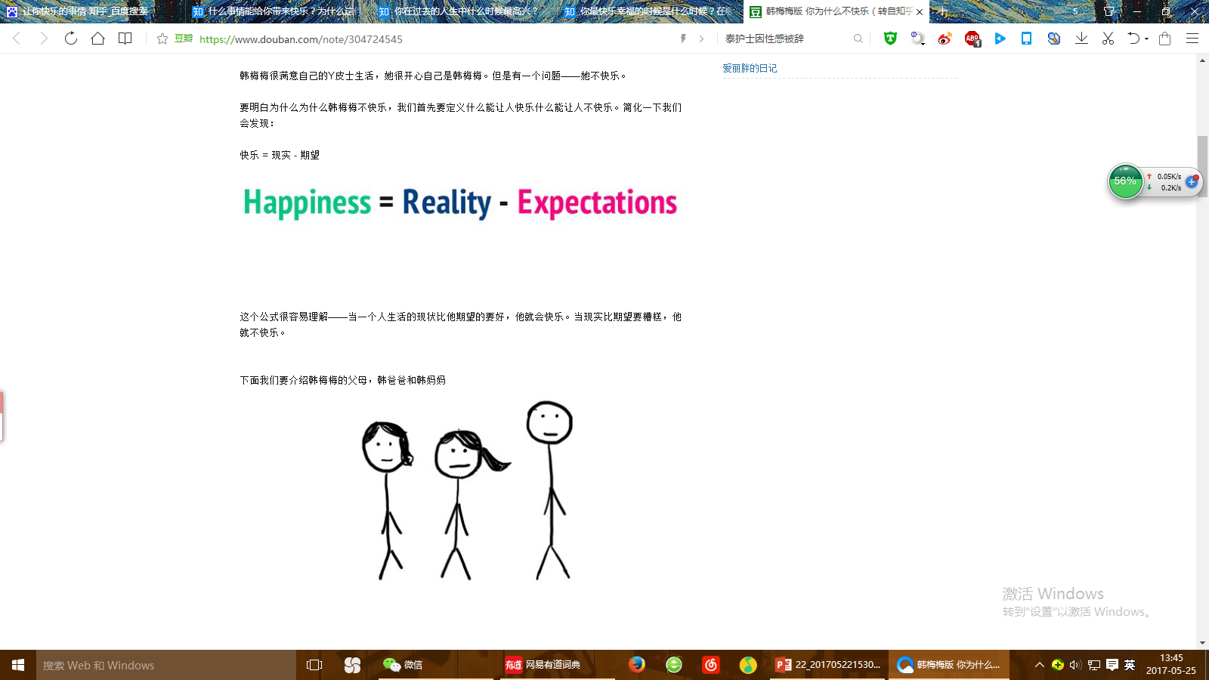
Please put the following words in the right order.
Reality, Happiness, Expectations,
_______ = _______ — _________

Slide 2
True or False
1. The author grew up in the US, and used to take a penny and hide it.
2. The author would hide the penny in the leaves of a tree.
3. The author drew lines in case other people might discover and steal the penny.
4. The author felt excited if her penny was taken by a passers-by.
5. The author would hide behind the tree to see who the first lucky passerby was.
T
F
F
T
F

Slide 3
6. The author would hide a penny some months later.
7. The author thought that there were in fact no generous people at all.
8. Many people would not be excited to find a penny in the street.
9. It is not poverty at all when a man is hungry and tired but he still won’t stoop to pick up a penny.
10. Because many of us don’t have a healthy poverty and simple life, we fail to live every day happily.
T
F
T
F
T

Slide 4
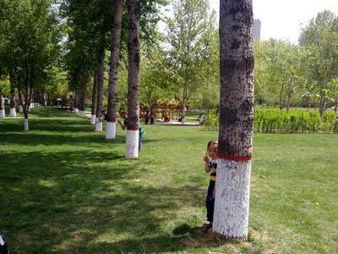
Read the passage and answer the following questions:
When the author was young, what was her habit?
Where would she hide the penny?
What would she do after hiding the penny?
How did she feel after she finished drawing and labeling?
Would the author stay about
and see who found the
penny? What would she do?

Slide 5
If you found a penny on the roadside, would you be happy?
What does penny mean in the last paragraph?
What is poverty indeed in the author’s opinion?
How can we buy a lifetime of days?

Slide 6
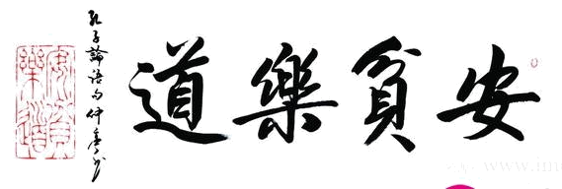
What is poverty indeed in the author’s opinion?
How can you buy a lifetime of days?
It is poverty indeed when a man is so hungry and tired that he won’t stoop to pick up a penny.
Cultivate simplicity and a healthy poverty, so that a penny will make your day.
Since the world is filled with pennies, you can have a lifetime of days.

Slide 7
What does the author mean at the end of the text?
The sentence means “My life has always been full of happiness, but I didn’t realize it until something happened or other people reminded me of that.”

Slide 8
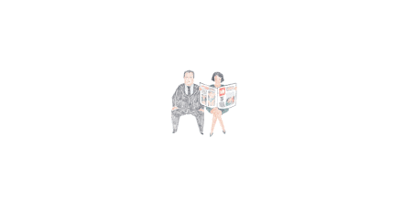
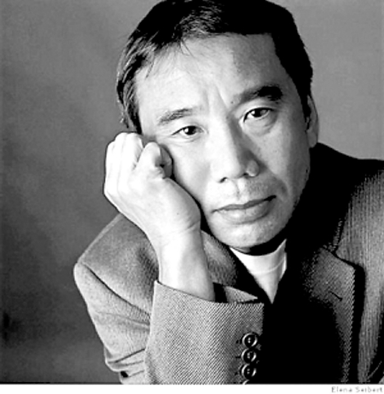
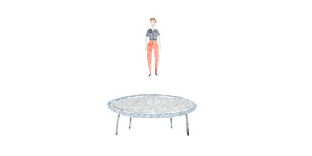
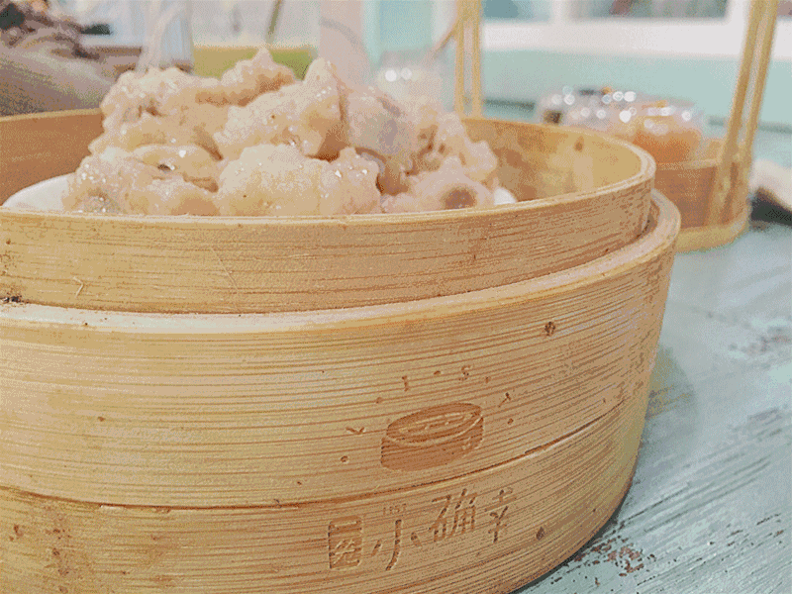

Slide 9

I like cancelled plans, and empty bookstores. I like rainy days and thunderstorms, and quiet coffee shops. I like messy beds and over-worn pajamas. Most of all, I like the small joys that a simple life brings.

Slide 10
penny
When I was young, I would hide a __ for someone else to find. For some reason, I always hid it in the ____ of a tree, or in a hole in the _______ .I would use a piece of chalk to label lines to lead passengers to discover the coin.
I felt very ______ during all this, because for the first lucky passer-by, it was a gift from the _______. But I would go straight home after this, and wouldn’t give the matter another ______, until some months
roots
sidewalk
excited
universe
thought

Slide 11
later, I would hide another penny.
The world is fairly full of pennies ____ away from a _______ hand. But many people don’t treasure these “free surprises”. So for many, it is important to cultivate a healthy ______ and _______. Only in this way can you feel the happiness of finding a penny on the road, and then you can buy a ______ of days. So it is all a matter of keeping my ____ open, since the world in full of beauty for us to enjoy.
cast
generous
poverty
simplicity
lifetime
eyes

Slide 12
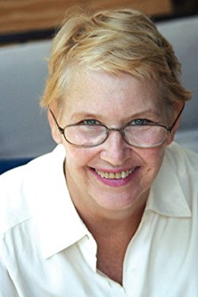
About the author
Annie Dillard (born April 30, 1945) is an American author, best known for her narrative(叙事的 ) prose (散文) in both fiction（小说） and non-fiction. She has published works of poetry, essays（散文，随笔）, prose, and literary criticism（文学评论）, as well as two novels and one memoir（回忆录）. Her 1974 work Pilgrim at Tinker Creek （《汀克溪的朝圣者》 ）won the 1975 Pulitzer Prize for General Nonfiction（一般非虚构类作品普利策奖）. Dillard taught for 21 years in the English department of Wesleyan University, in Middletown, Connecticut（康州卫斯理大学 ）.

