Slide 1
1．adjust________适应；调节
2．keep it________保持优秀成绩；继续干下去
3．fit________相适应；相融合
4．as far as one is________就……而言
5．be occupied________sth.忙着做……；忙于某事物
6．day in and day________日复一日
7．be abundant________在……丰富
8．______of the question不可能的→_____question没问题
9．settle________(迁入新居、更换工作后)安顿下来
答案1．to 2.up 3.in 4.concerned 5.with 6.out 7.in 8.out；out of 9.in/down

Slide 2
For some people, traveling abroad is the thing they enjoy most in life; for others, though, cultural differences make them feel______.
A．calm B．comfortable
C．excited D．uncomfortable
[解析]uncomfortable不舒服的，符合句意。calm平静的；excited兴奋的；comfortable舒服的。
[答案]D

Slide 3
—As you may have found, the Chinese language is _____ in idioms and proverbs.
—Yes, I often get________.
A．full; confusing B．abundant; confused
C．varied; confuse D．different; to be confused
[解析]be abundant in在……丰富；get confused迷惑。
[答案]B

Slide 4
(2012·沈阳) He said he would ________ me to Mr.Li as his assistant but he didn't.
A．comment B．suggest
C．command D．recommend
[解析]recommend推荐。suggest 建议，后不跟双宾语。comment 评论；command 命令。句意：他说他会向李先生推荐我当他的秘书，但他没有。
[答案]D

Slide 5
It's very wise of you to __ well-trained workers __ untrained ones in the assembly line. [答案]B
A．substitute; for B．substitute; with
C．replace; with D．instead; by
1.replace通常强调替换（用一个事物代替另一个），
比如你的身份证到期了，要换一张，用replace。
2 change 强调变化（依然是同一个事物，发生一些改变而已）， 随着时间流逝人会变的，people change as time pass by
3 substitute 代为做事的人或物，暂代，正主的位置没有变。
代课老师substitude teacher
4 exchange 交换，交流一物换一物 交换生 exchange student

Slide 6
Fully ________ in looking after three children at home, she no longer has time to enjoy the various activities in the club.
A．occupied B．contributed
C．hesitated D．devoted
[解析] [答案]A
be occupied in doing sth.忙于做某事。
devote yourself/ your time/energy/attention to (doing) sth.
日常英语中,人们说 put time/energy into something ,不说 devote time/energy to something 奉献 致力于 献身
contribute sth to/towards sth

Slide 7
In face of challenge for the moment, it's the most important to ___ a good state of health.
A．keep away B．keep up
C．keep on D．keep out
[解析]keep up 保持。keep away 远离；keep on 坚持；keep out 不让进入。
[答案]B

Slide 8
It's out of ______ question for such a little boy to solve such a complex problem.
A．/ B．the
C．a D．an
[解析]out of the question不可能的。
[答案]B

Slide 9
_______I'm concerned, they have no way of keeping away from the danger.
A．As long as B．As far as
C．Just as D．Even if
[解析]as far as one is concerned 就……而言。as long as 和……一样长，只要；just as 正如；even if 即使。句意：我认为他们无法远离危险。
[答案]B

Slide 10
(2012·江西) Forbes magazine has named President Hu as the world's most powerful person, a move that analysts say shows global ________of China's contribution to the world's economic recovery.
A．acknowledgement B．commitment
C．complement D．requirement
[解析]acknowledgement 承认，公认。commitment 承诺；complement 补充；requirement 要求。
[答案]A

Slide 11
—Was it in 1969 ____ the American astronaut succeeded ____ landing on the moon?
—Yes, that's right.
A．when; on B．that; on
C．which; in D．that; in
[解析]that引出强调句；succeed in doing sth.成功做成某事。
[答案]D
1. It was in the evening that i met him 强调句型
2. It was in the evening when i was walking in the street that i met him.
这也是强调句 只不过多了个when从句

Slide 12
(2012·湖北八校联考一)I am afraid we cannot include the item you suggest, as it does not ________ with the rest of the programme.
A．come down B．keep up
C．get on D．fit in
[解析]fit in with适应。句意：恐怕我们不能包括你提议的项目，因为它与节目的其余部分不一致。 come down 下来； keep up with 跟上；get on with 与……相处。
[答案]D

Slide 13
recommend sth./sb.推荐某物/人
recommend sb. sth.＝recommend sth. to sb.
向某人推荐某物
recommend doing sth.建议/劝告做某事
recommend sb. to do sth.劝告某人做某事
recommend sb.as推荐某人当……
recommend that sb.(should) do...建议某人做……
a letter of recommendation推荐信
follow one's recommendations听从某人的劝告

Slide 14
2．substitute n．代替者；代用品 vt.用……替代
There's no substitute for sensible eating and exercise if you want to keep fit.
想保持健康，没有比合理饮食和运动更好的做法了。
substitute A for B用A代替B
substitute sb. by/with...用……代替某人
substitute for sth. / sb. 代替；替换；取代
substitute sth. / sb.for...用某物/某人代替……
a substitute for... 代替……的人/物

Slide 15
3．acknowledge vt.承认；确认；答谢
I couldn't write what other people had said without acknowledging them.
我不能把别人的话写下来而不表示感谢。
It is now generally acknowledged that he was innocent.
现在大家普遍认为他是无辜的。
It is acknowledged that...……是大家公认的
acknowledge sb./sth.as/to be承认某人/事……
acknowledge that...承认……
acknowledge doing sth.承认做了某事
in acknowledge of...对……表示感谢

Slide 16
4．occupy vt. 占用；占领；占据
I have been so occupied with work that I haven't had time for social activities.
我一直忙于学习，以至于我没有时间去参加社会活动。
Soccer occupies most of my leisure time.
足球占去了我大部分时间。
be occupied with/in sth.从事、忙于……
be occupied in doing sth.忙于；专心于……
occupy oneself with sth./in doing sth.
忙于……；从事；专心于……

Slide 17
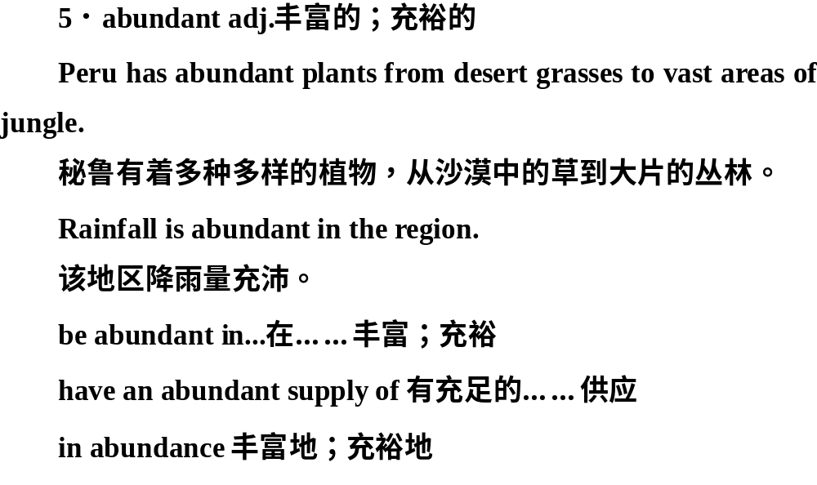

Slide 18
6．comfort n．舒适；安慰vt.安慰
They had enough money to live in comfort in their old age.
他们有足够的钱舒舒服服安度晚年。
If it's any comfort to you, I'm in the same situation.
如果这样对你有所安慰的话，我也得到了慰藉。
to live in comfort生活舒适
be comfort to sb.对某人来说是个安慰
comfort oneself with sth.用……来安慰自己

Slide 19
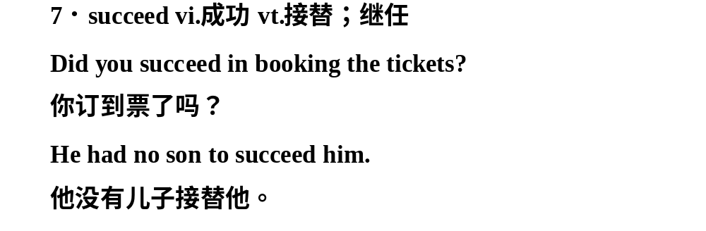
succeed in (doing) sth.在……方面成功
be successful in (doing) sth.在……方面成功
succeed in doing sth.＝manage to do sth.成功做成某事
succeed sb.接替某人
succeed to sth.继承某事
fail to do sth.没有做成

Slide 20
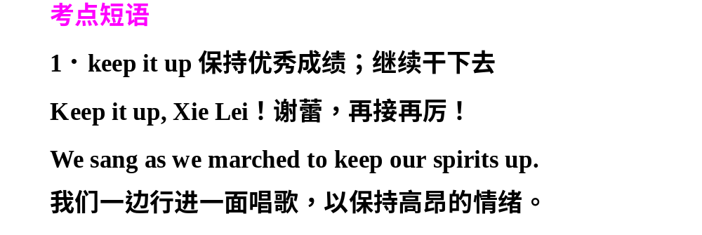
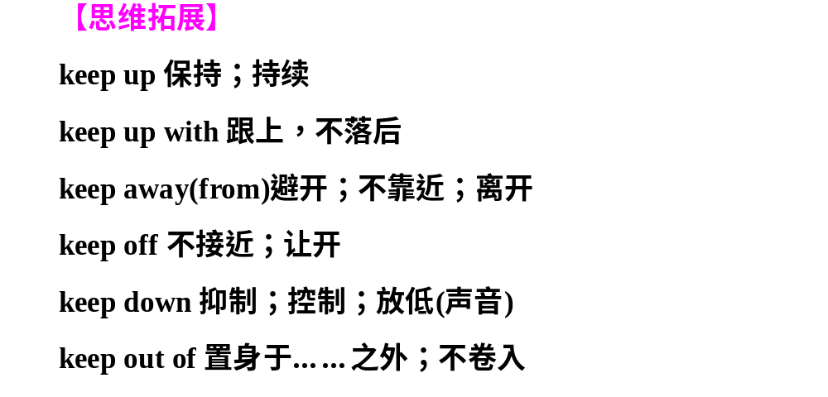

Slide 21
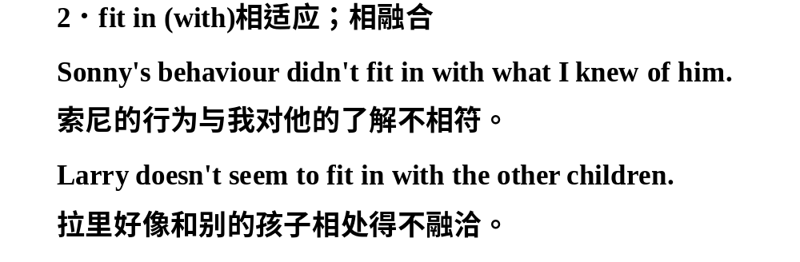
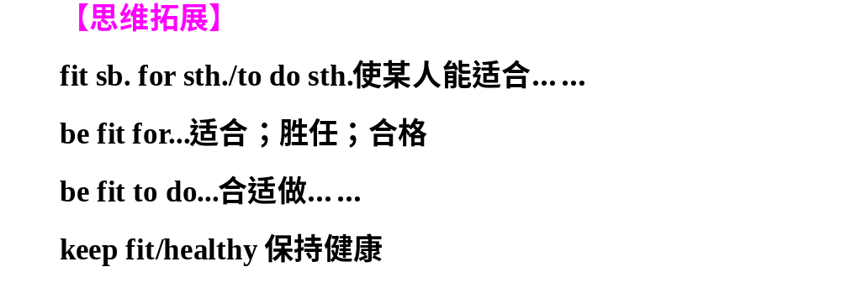

Slide 22
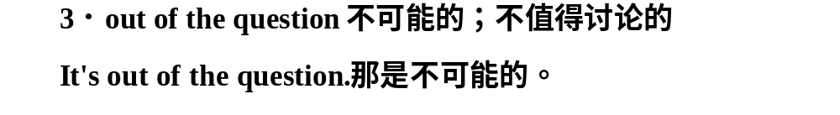
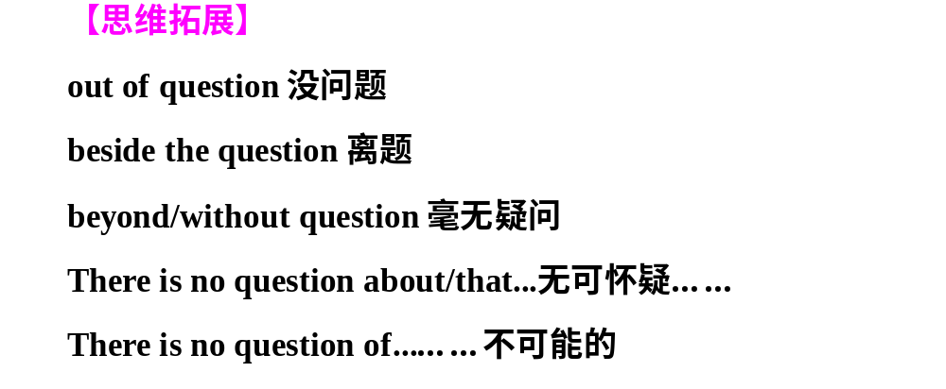

Slide 23
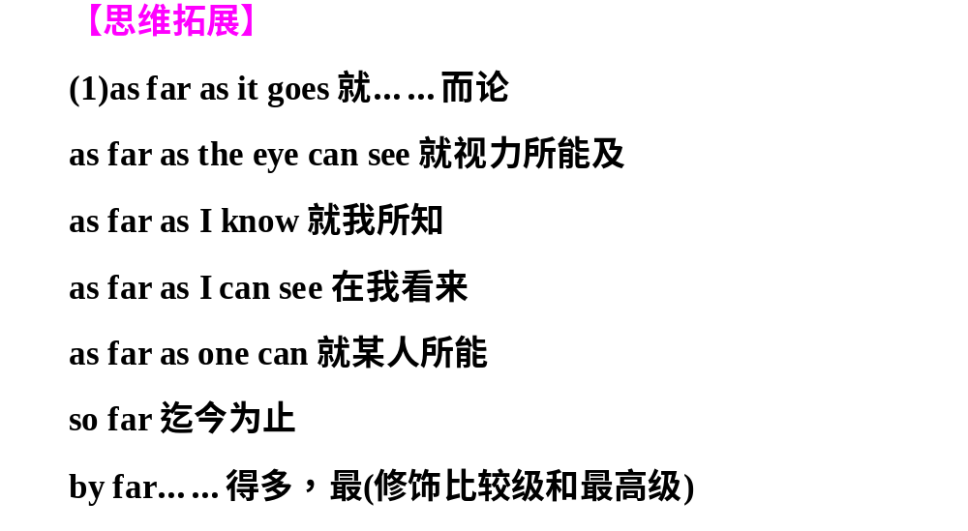
5．as far as one is concerned就……而言
As far as I'm concerned, the best colour is red.
就我来说，最好的颜色是红色。

Slide 24
(2)as follows如下
as for/to至于，关于
as though好像，仿佛
as long as只要，如果；既然，由于
as soon as一……就
as good as和……几乎一样

