Slide 1
means n. 手段；方法；工具；途径
All possible means have been tried.
Every possible means has been tried.
* means 单复数同形。
means, way, method, manner区别
He caught up with the other classmates by means of hard work.
means 方法、手段、工具，单复数同形，多与介词by 搭配。
way 方法，普通用语。可用于任何处理 事物的方式。多与介词in搭配。
2. Only in this way can we learn English well.
3. The teacher is trying teaching language points with a new method.
method 方法，理论，指合乎逻辑或系统的方法。多与介词with 搭配。
4. She answered my questions in a cool manner.
manner 单数形式: 方法,样式；举止,态度；较way庄重,多与介词in搭配。复数: 意为礼貌，礼仪；规矩,习俗。
5. It’s bad manners to talk with your mouth full.

Slide 2

单项选择：
1) We look forward to the day when the motor car has been replaced by some less dangerous ______ of transport.
A. means B. methods C. ways D. manners
2) The quickest means of travel ______ by plane.
A. was B. were C. is D. are
改错：
1) By no means we will give in to difficulties.
2) Only in this method can you get much benefit from it when reading.
will we
with

Slide 3
3. the /a majority (of) 大多数、大部分
n. 大多数 _________
adj. ________ _________
majority
反义
minority
major
反义
minor
The majority of students are hard-working.
The majority of the damage is easy to repair.
the majority of + n. 后可加可数名词复数,也可加不可数名词，谓语动词由后面的名词决定。
The / A majority speak（s) English.
The /A majority were / was in favour of the policy.
单做主语时，若强调整体，谓语动词用单数，
强调个体时，谓语动词用复数 。
占多数、过半数 be in (the /a) majority

Slide 4
1).Those who are for the proposal _______.
in the majority B. are the majority
C. are in the majority D. is in the majority
2).The number of students in our class ___63 and the majority of them ___ clever and work hard.
is; is B. are; are C. is ; are D. are; is
√
√

Slide 5
4. 开始/习惯新的生活、工作等, 谋生
谋生 ______________________
继续生活或生存 ___________________
过着……的生活 ___________________
After graduation, he went to Beijing, with the purpose of _____________there. However, he couldn’t find a job and had to _____________by begging. He said he was ___________________（过着悲惨的生活）but he would _______and never give up no matter what happened.
make a life
make /earn a/one’s living
live on
lead / live a (adj.) life
making a life
make a living
living a miserable life
live on

Slide 6
5. elect Vi. 选择，决定做某事；Vt. 选举，推选
1). elect to do … = choose/decide to do…选择，决定做某事
现在越来越多的人选择在家工作。
Nowadays more and more people elect to work at home.
2). elect sb. (to be/as)… 选举/推选某人为…
美国人隔4年选一次总统。奥巴马当选美国第44任总统。
Americans elect a President every four years and Obama was elected as the 44th president of America.
* adj. 候任的，当选而尚未就职的（用于名词后）
the president elect 候任总统
*n. election 选举/推选
presidential election
election results
stand/run for election
to win/lose an election

Slide 7
完成句子：
1) If this rain __________, the garden will be ruined.
2) This is my phone number. Let’s ________________.
3) The police asked the people to _________________ the scene of the accident.
4) We appeal to the government to ______________ the high prices of houses, about which many people are complaining.
5)The noises made by my neighbours when they play mahjong always ______ me ______ sleeping.
6) It’s of great benefit for you __________________ in English.
keeps up
keep in touch
keep off/keep away from
keep down
keep from
to keep a diary

Slide 8
6. keep up 坚持；维持；保持；沿袭（风俗、传统等）
keep 的相关短语
阻止/妨碍…做某事 跟上
记日记 (与…)保持联系
使离开, 避免接近，远离
使…不靠近/接触/远离…
抑制某事物的增长，使…保持在低水平
keep ... from
keep up with
keep a diary
keep in touch (with)
keep away (from)
keep off
keep down

Slide 9
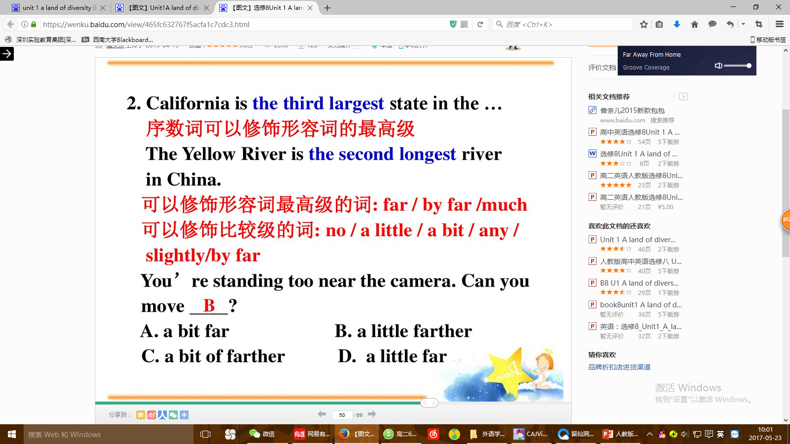

Slide 10
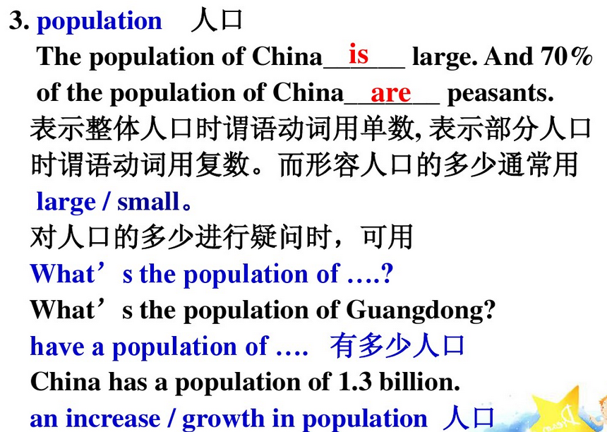

Slide 11
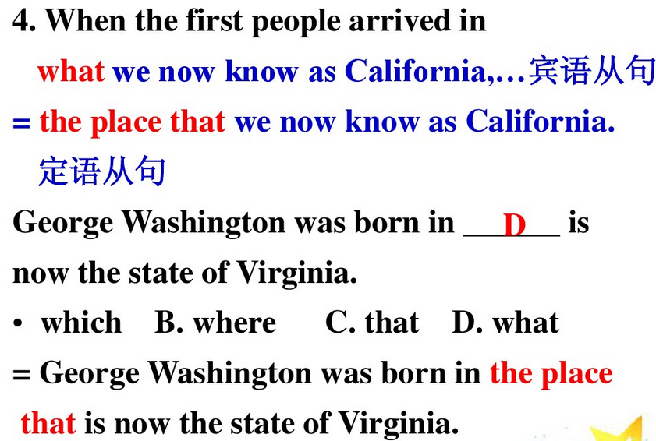

Slide 12

