Slide 1

3
MODULE
The Violence of Nature

Slide 2
INTRODUCTION
Have you ever experienced
a flood?
a hurricane?
a tornado?
a lightning?
a thunderstorm?...

Slide 3
Match the words with their definition
flood hurricane lightning thunderstorm tornado
1. a lot of water in a area which is usually dry _______
2. a very strong wind or storm __________
3. a lot of rain falling quickly, with loud noise and flashes of light _____________
4. the flashes of light which happens during a thunderstorm _______
5. a column of air that turns very quickly ___________
flood
hurricane
thunderstorm
lightning
tornado

Slide 4
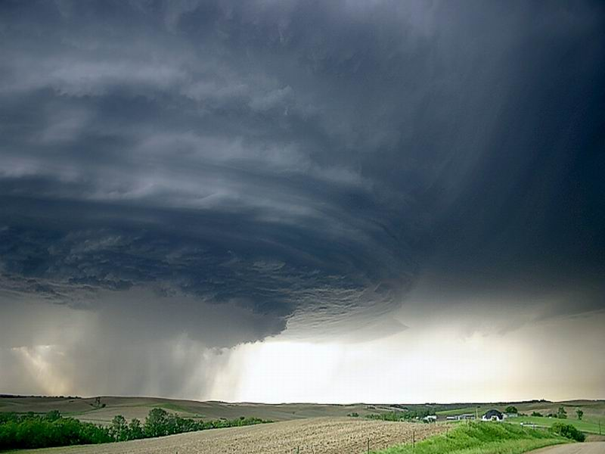
tornado

Slide 5
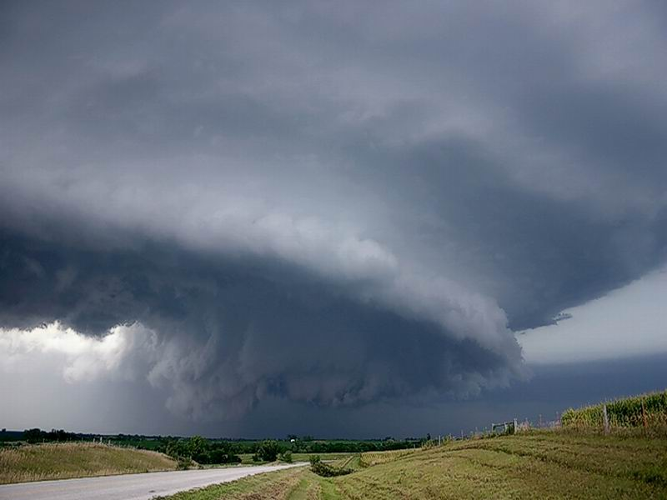
A rotating column of air from a
thunderstorm to the ground.
龙卷风：一种纵向的气旋，伴随有倒漏斗形的积雨云，涡流直径达几百码，以每小时八百公里）的速度移动，具有极大的毁坏性
What is a tornado?

Slide 6
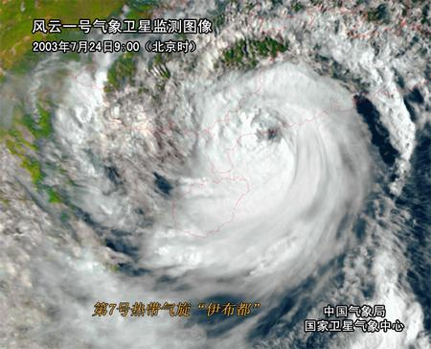
台风：A tropical cyclone occurring in the
western Pacific or Indian oceans.
发生在西太平洋或印度洋的热带暴风
typhoon

Slide 7
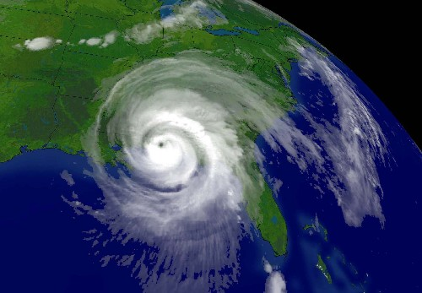
hurricane
A violent storm with extremely strong winds and heavy rain.
飓风：一种猛烈的热带风暴，形成于大西洋
或加勒比海赤道地区，从形成地向北、西北
或东北移动，常携有大量雨水

Slide 8
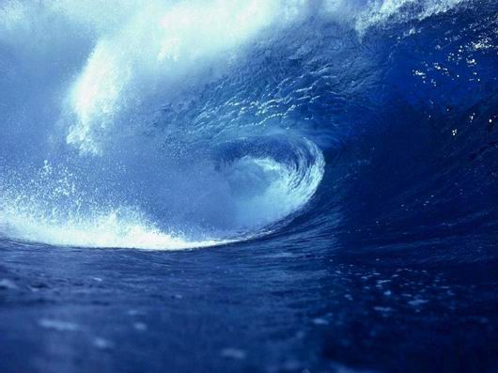
An earthquake originating under the sea floor. 海震/海啸：发自海底的地震
tidal wave / tsunami

Slide 9
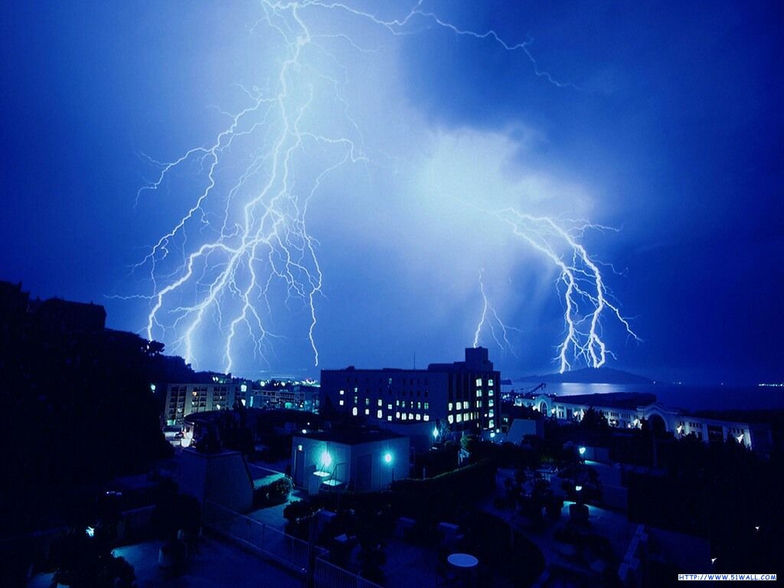
lightning
闪电：the bright flashes of light that you see in the sky during a storm.
天空中云层放电时所产生的闪光。

Slide 10
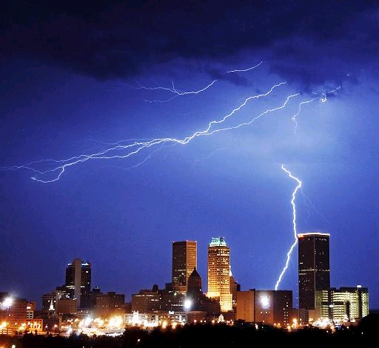
雷暴： a violent storm of thunder and lightning, often accompanied by rain and sometimes hail. 短暂且有时很猛烈的雷和闪电的风暴，通常伴有雨且有时下冰雹
thunderstorm

Slide 11
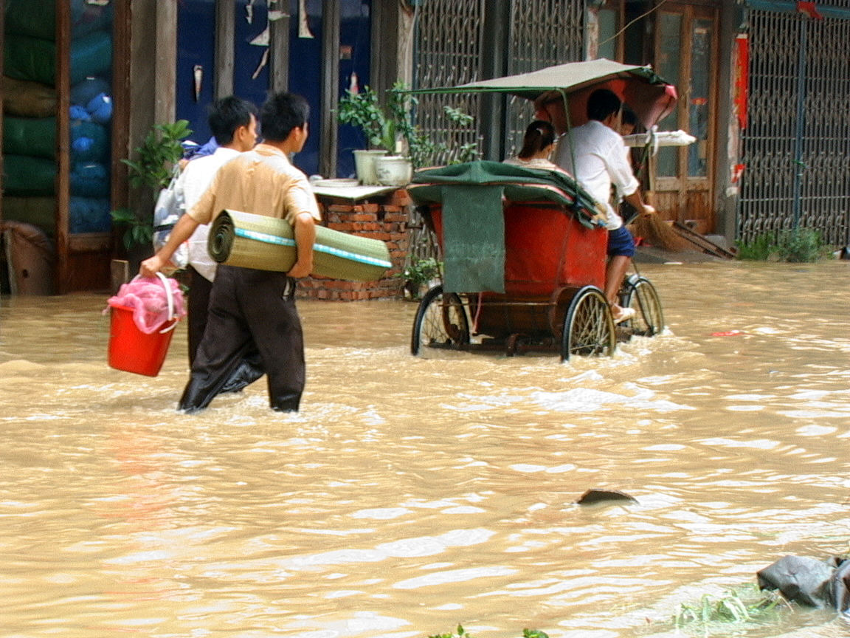
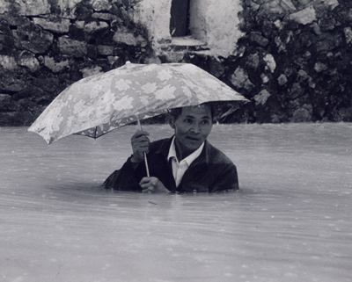
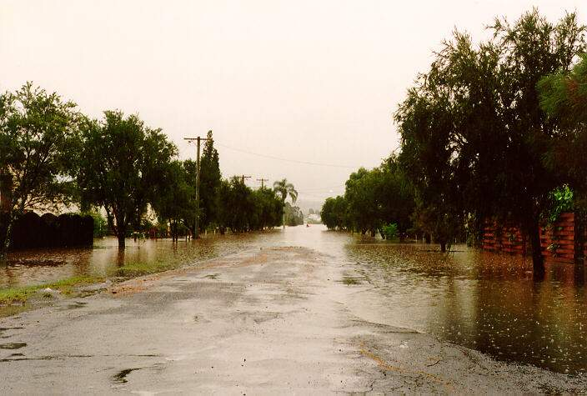
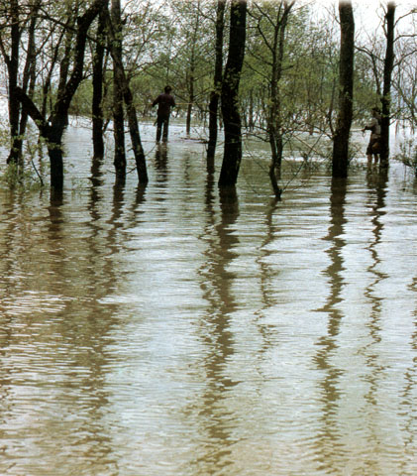
flood ：a large amount of water that covers an area which was dry before.正常情况下干燥为陆地地区的水泛滥

Slide 12

Disasters of Nature
flood
hurricane
lightning
thunderstorm
sandstorm
tornado
earthquake
typhoon
tidal wave
volcanic eruption
洪水
飓风
闪电
雷暴
沙尘暴
龙卷风
地震
台风
海啸
火山喷发

Slide 13
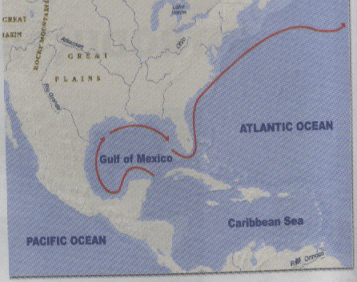
Read about the Gulf Steam and check the meaning of the words
1. What is a current ?
(a) A kind of electricity
(b) A movement of water
(c) A kind of wind
2. What kind of things flow ?
(a) Water (b) Time (c) Money
3. If two places are on the same latitude ,they are on the same line _____
(a) east/west
(b) north/south
★
★
★

Slide 14
Match the words with the definitions.
bury disaster feather fur occur tropical
1.You can see this on an animal _____
2.describe the hottest parts of the earth
_____
C
fur
C
tropical

Slide 15
3 a terrible event ______
4 you can see these on a bird ______
5 to place in the ground or tomb
______
6 to happen ______
C
disaster
C
feather
C
bury
C
occur

Slide 16
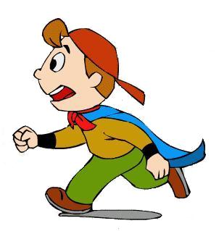
FAST-READING
Match the article with its main idea.

Slide 17
Charles Coghlan’s story in the worst hurricane disaster.
A rotating column of air and its power.
Hurricanes are strong tropical storms and introduce its power and the worst disaster by it.
Article one
Article two
Article three

Slide 18


CAREFUL-READING
Read the first part carefully and answer questions.

Slide 19
1. What is a tornado?
A tornado is a rotating column of air from a thunderstorm to the ground.
2. What can happen to furniture when a
house is destroyed by a tornado?
Furniture can be inside exactly where it was.
3. What can tornadoes do?
They can pick up…, put down…, take off..., destroy…, leave….

Slide 20


Read the second part

Slide 21
Hurricanes usually occur in the Pacific Ocean, the Caribbean Sea and the Gulf of Mexico.
There’re on average six Atlantic hurricanes each year and they usually affect the east coast of the US from Texas to Maine.
Hurricanes can cause huge waves, heavy rain and floods.
The worst hurricane of all time in the US destroyed 3,000 buildings.
F
Southern Atlantic Ocean, the Caribbean Sea and the Gulf of Mexico.
T
T
F
3,600

Slide 22
An extraordinary event
1.Who was Charles Coghlan?
He was a nineteenth-century Irish actor who went to live in Canada and died in Galveston.
2.What is the meaning of “Coghlan
traveled back to Canada after he had
been buried in Texas”?
His coffin was dropped in the sea by
a hurricane and it was carried to
Canada by the Gulf Stream.

Slide 23
READING
Listen to the tape and complete the passage.
Tornadoes can _________cars, trains and even houses and ____ them down in the next street. They can take the fur ____ the back of cat and feathers ____ a chicken. They can _______ houses. But leave the ________inside exactly where it was.
pick up
put
off
off
destroy
furniture

Slide 24
READING
Read the text and answer the questions.
1 How strong are tornado winds?
2 When was the worst hurricane?
3 Was the actor Charles killed in it?
4 How many tornadoes are there in US?

Slide 25

PRONUNCIATION
Listen and underline the words that the speaker stresses.

Slide 26

And now more information about the volcanic eruption on the island of Montserrat in the Caribbean Sea which took place at 3am on December 26th, one week age. We spoke to a local journalist and he told us that no one had been killed in the incident. According to the journalist, more than half the 11,000 residents had left the island.

Slide 27
EVERYDAY
ENGLISH
Choose the words to complete the sentences.
luckily unfortunately thankfully hopefully sadly fortunately
1 ________, we had plenty of warning.
2 ________, there were several villages in its path.
3___________, no one was killed.
Luckily
Sadly
Thankfully

Slide 28
EVERYDAY
ENGLISH
Choose the words to complete the sentences.
luckily unfortunately thankfully hopefully sadly fortunately
4 _________, it won’t be too long.
5 _____________, many houses caught fire .
6 __________, we put all the fires out quite quickly.
Hopefully
Unfortunately
Fortunately

Slide 29
Write a Composition
1976年7月28日深夜，人们正在睡觉。
随着一声巨响，成千上万的房屋倒塌，水电被切断，全城到处是大火和浓烟，几乎全城被毁，25万人丧生，许多人受伤，许多人无家可归。
全国各地的人民全力帮助唐山人民重建家园。
今日唐山比以前更美好。
题目：An earthquake in China
字数：100~120

Slide 30
A Earthquake in China
The Chinese people will never forget the 1976 earthquake in Tangshan. On the late night of July 28, 1976, people were fast sleep. With a terrible noise, houses and tall buildings fell down. Water and electricity were cut off. There were fires and smokes everywhere. The whole city was almost destroyed and 250,000 people were killed in the earthquake.

Slide 31

A large number of people were injured and many lost their homes. On hearing the news, people all over the country tired their best to help the people in Tangshan rebuild their homes. Tangshan has been made more beautiful than before.

