Slide 1



Slide 2

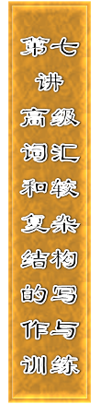







Slide 3


Slide 4
一、使用高级词汇
词汇量能反映一个人知识贮存量的多少，也是衡量英语水平的一个重要标准。考生要想取得高分，就要强化使用复杂、高级的词汇。常用方法如下：

Slide 5
1．多实少虚
  写作中多用specific words，少使用general words，多用蕴含感情色彩的词语，少用中性词。如good指人时可用以下形容词替换：kind, honest, generous, selfless, brave, warm­hearted, sympathetic, honorable, humorous, smart, gentle等；good指事物或事情时可用以下形容词

Slide 6
替换：great, fantastic, splendid, marvelous, excellent, wonderful, meaningful, enjoyable, nice等。以下句子中的形容词虽然都可以用good代替，但远不如原句出彩。
I hope everyone can have a time.
He is a teacher.
This is really a idea to go climbing Mount Hua this weekend.
wonderful
warm­hearted
nice

Slide 7
2．短语优先
  多使用词组、习语来代替一些单词，以增加文采。
  I can no longer the way he speaks to us.
  →I can no longer the way he speaks to us.
  He what I said in the class.
  →He what I said in the class.
bear
put up with
didn‘ tlisten to
turned a deaf ear to

Slide 8
3．弃旧取新
  写作中要恰当得体地使用高中学过的、较长的词汇。
  We all have the same chance.
  →We all possess the same chance (opportunity)．
  We have a_lot_of homework to do at the weekend.
  →We have endless homework to do at the weekend.

Slide 9
4．避免重复
  尽量避免过多地使用某一个单词，必要时选择使用其他恰当的同义词或词组来代替。
  I like reading while my brother likes watching football matches.
  →I like reading while my brother enjoys watching football matches.

Slide 10
We've built a new experiment building beside the old one and we've also built a library where the old playground used to be.
→We've built a new experiment building beside the old one and we've also set_up a library where the old playground used to be.

Slide 11
二、使用较复杂结构
1．在一篇文章中要适当地改变语法结构来增加文章表达方
  式的多样性。
(1)改变时态和语态
  The bell is ringing now.
  →There goes the bell!

Slide 12
(2)使用名词性从句
  It disappointed everybody that the player was badly injured in the first round.
  →The fact that the player was badly injured in the first round disappointed everybody.

Slide 13
(3)使用较高级的状语从句
  I won't believe what you say.
  →No matter what you say, I won't believe.

Slide 14
(4)使用定语从句
  The girl is spoken highly of.Her composition was well written.
  →The girl whose composition was well written is spoken highly of.
(5)使用虚拟语气
  You didn't take my advice, so you failed in the exam.
  →If you had taken my advice, you wouldn't have failed in the exam.

Slide 15
(6)使用倒装句
  Some valuable books and my credit cards are in it.
  →In it are some valuable books and my credit cards.

Slide 16
(7)使用强调句型
  He did not know what had happened until he had read the news in the newspaper.
  →It was not until he had read the news in the newspaper that he knew what had happened.

Slide 17
2．改变句子开头的方式。不要一味地采用“主语—谓语—
  宾语”的文法语序。可以适当地把一些成分(如状语)提前，放在句子的开头，这样使整个句子读起来跌宕起伏，增加书面表达的表现力。

Slide 18
We met at the school gate and went to the Hongxing Farm together early in the morning.
→Early in the morning we met at the school gate and went to the Hongxing Farm together.
The young man couldn't help crying when he heard the bad news.
→Hearing the bad news, the young man couldn't help crying.

Slide 19
3．通过整合的方式，把几个松散的句子用一定的连接方
  式连接起来，也可以对所学的英语句式加以简化，使写出来的句子更加准确、得体、简洁、灵活。
  We had a short rest. Then we began to play happily. We sang and danced. Some told stories. Some played chess.
  →After a short rest, we had great fun singing and dancing, telling jokes and playing chess.

Slide 21

Ⅰ.用更贴切的词或短语分别来代替画波浪线部分的词或短语
1．The boy realized the danger and began to run away.
  ________________________
  答案：was aware of

Slide 22
2．I have decided to study English better this term.
  ________________________
  答案：made up my mind

Slide 23
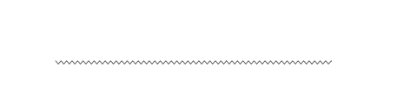
3．I don‘t know how to enlarge my vocabulary.
  ________________________
  答案：have no idea

Slide 24

4．We'll try our best to develop the traditional friendship
  between us.
  ________________________； ________________________
  答案：spare no efforts; promote

Slide 25

5．It is cold this winter. A drop of water will freeze in no
  time.
  ________________________
  答案：freezing

Slide 26
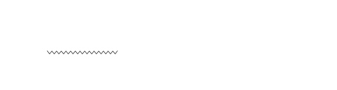
6．He is a nice student. He often makes us laugh and we
  have much fun with him.
  ________________________
  答案：humorous

Slide 27
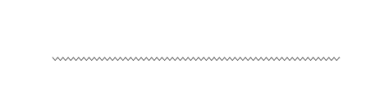
7．Surprisingly, the little girl knows so many things.
  ________________________
  答案：To our surprise

Slide 28
8．She decorated her bedroom well.
  ________________________
  答案：wonderfully

Slide 29

9．The house is on the second floor, with two bedrooms, a
  bathroom and a kitchen.
  ________________________
  答案：flat

Slide 30
10．Peter is good to others. He always gives away things to
  those in trouble.
  ________________________
  答案：generous

Slide 31
Ⅱ.使用较复杂结构修改下面三段话，使其简洁、连贯、紧凑
1．It's a flat of 25 square meters. There is a bedroom in the
  flat. There is a bathroom and a kitchen in it, too. In the bedroom, there is a bed; there is a sofa, a desk and a chair as well.
  __________________________________________________
  __________________________________________________
  __________________________________________________

Slide 32
答案：It's a flat of 25 square meters, with a bedroom, a bathroom and a kitchen. The bedroom is furnished with a bed, a sofa, a desk and a chair.

Slide 33
2．There is a new multimedia building on one side of the
  road. There used to be a playground on the other side. But there is a library now. There are all kinds of books, newspapers and magazines in the library. There is a new playground in the front of the school. There are a lot of trees in and around the school.
  _________________________________________________
  _________________________________________________
  _________________________________________________
  _________________________________________________

Slide 34
答案：On one side of the road there is a new multimedia building. On the other side, where the playground used to be, now stands another new building — our library, in which you can find all kinds of books, newspapers and magazines. A new playground is now in the front of the school. We have also planted a lot of trees in and around the school.

Slide 35
3．There are a large number of taxi drivers in Beijing.
  They serve passengers heart and soul. They play an important part in the traffic of Beijing. They make some money. They work from dawn till night. One day, I left my cellphone in the taxi I took. I got in touch with the driver. He drove to my home and gave it back to me. I was very excited.
  _______________________________________________
  _______________________________________________

Slide 36
答案：There are a large number of taxi drivers in Beijing, serving passengers heart and soul and playing an important part in the traffic of Beijing. In order to make some money to support their families, they work from dawn till night. One day, I got out of the taxi in a hurry with my cellphone left in the taxi I took. On hearing what had happened, the taxi driver drove to my home as fast as possible and gave the cellphone back to me. Seeing my cellphone again, I was too excited to say a word.

