Slide 1

Let’s appreciate a song
If I were a boy

Slide 2
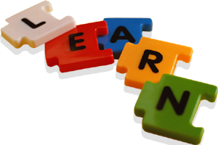
Module 6
Unit 3 Understanding each other
Grammar
Unreal conditionals with "if "

Slide 3
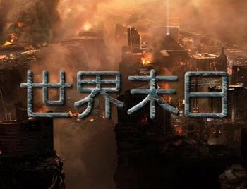
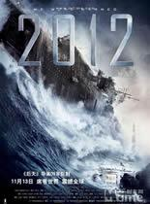
If it were the end of the world today,
who would you stay with and
what would you do?
If it were the end of the world today, I would…

Slide 4
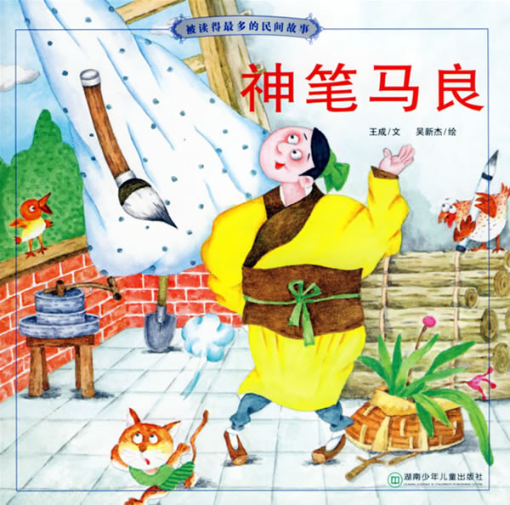
If I had a magic brush, I could paint the earth green and the sky blue.
If I had a magic brush, I would/could draw…

Slide 5
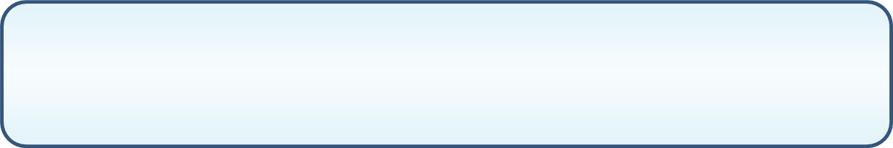
Find the rule
1
Opposite to the present truth
If it were the end of the world today,I would stay with my family members to enjoy the last moment.
If I had a magic brush, I could paint the earth green.
did/were
would/could/
might/should
If sb.________ sth, sb. _________do sth.

Slide 6
If sb. did/were sth, sb. would/could/might/should do sth.
如果你在文莱，你不应该饮酒。
要是我有机会克隆人类的话，我会克隆死去的小悦悦.
Fill in the blanks:
were
shouldn’t
If you in Brunei, you drink alcohol.
had the chance
If I of cloning human beings,
I the dead Yueyue.
would clone
If I had had the chance of cloning human
beings, I would have cloned Yueyue before
she died.

Slide 7
Find the rule
2
Opposite to the past truth
If I had had the chance of cloning human beings, I would have cloned Yueyue before she died.
had done
If sb.________ sth, sb. would/should/
could/might_________ sth.
have done

Slide 8
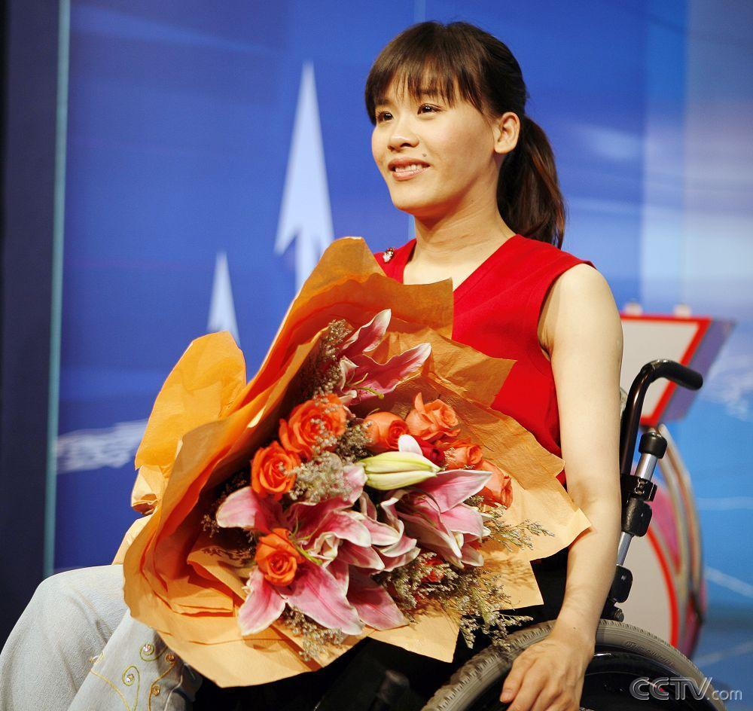
If sb. had done sth, sb. would/should/could/might have done
如果1998年桑兰不参加Goodwill Games的体操锦标赛( gymnastics tournament)的话，就不会发生那个改变她一生的事故。
If Sanglan hadn’t competed in the gymnastics tournament at the Goodwill Games, the accident that changed her life wouldn’t have happened.
Sanglan

Slide 9
如果她没有吃减肥药的话，她的肝脏
不可能衰竭。
If she hadn’t taken weight-loss pills, her liver
couldn’t have failed .

Slide 10
1
Opposite to the present truth
2
Opposite to the past truth
3
Opposite to the future truth

Slide 11
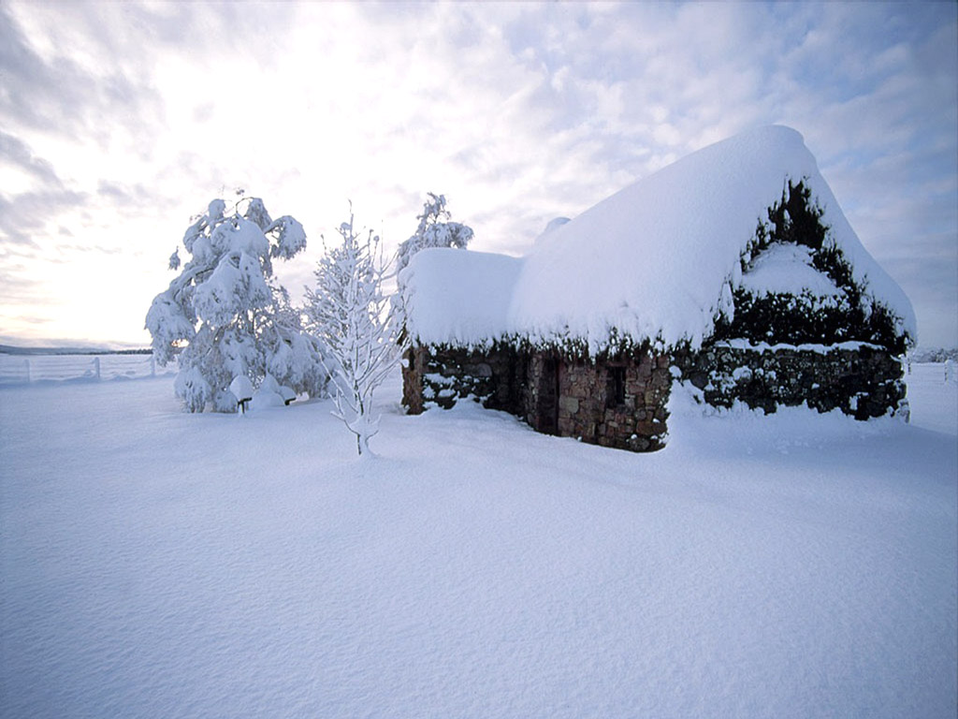
If it were to snow/
snowed/should snow
tomorrow ,
...
如果明天下雪，…。

Slide 12
Find the rule
3
Opposite to the future truth
If it were to snow/snowed/should snow, I could stay here for another day.
If it were to snow/snowed/should snow, our PE might be cancelled
If sb.______________________ sth, sb. would / could / might/should do …
did / were to do / should do

Slide 13
Unreal conditionals with “if”
did/ should do/
were to do
did/were
would/could/should/
might have done
would/could/should/
might do
would/could/should/
might do
had done
Opposite to…
If sb….,
sb. …
Present
(现在)
Past
(过去)
Future
(将来)

Slide 14
Tips
Would, could and might are often interchangeable, but with some difference in meaning.
would → intention; plan
could → ability; possibility
might → probability
2) In written English or in formal situation,
we usually use were in If-clauses in place
of was. However, in everyday conversation,
was is often used.

Slide 15
Is there anything special?
Were you in Brunei, you shouldn’t drink alchol.
Had Sanglan not competed in the gymnastics tournament at the Goodwill Games, the accident that changed her life wouldn’t have happened.
Should it snow tomorrow, I could stay here for another day.
We can also put should, were and had at the beginning of
an unreal conditional sentence. In this case, if is not
needed any more.

Slide 16
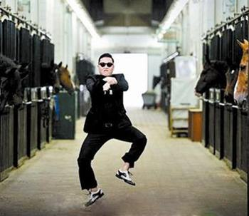
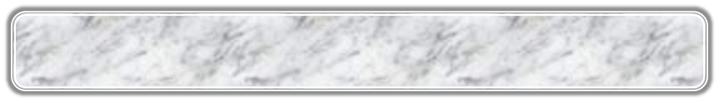

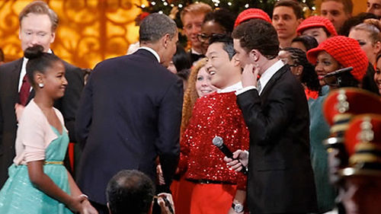
如果PSY <Gangnam Style >
没有上传网络，….
If Gangnam style hadn’t been uploaded to the Internet ,…
Psy couldn’t have performed it for Obama .
Psy couldn’t be popular all over the world now.
adverbial clause of mixed
condition（错综条件句）

Slide 17
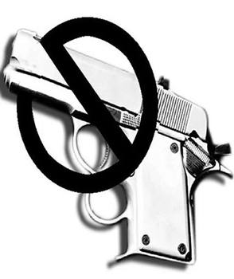
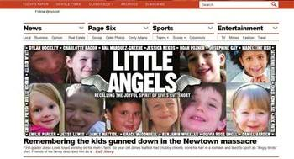
12月14日，亚当·兰扎在美国康涅狄格州新城桑迪胡克
小学制造了令全世界都“心碎”的血腥枪击案。
如果美国对枪支有严格的控制，….
If America had had a stricter control over the gun ,…
these lovely kids couldn’t have died .
these lovely kids might be alive now.

Slide 18
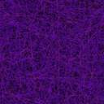

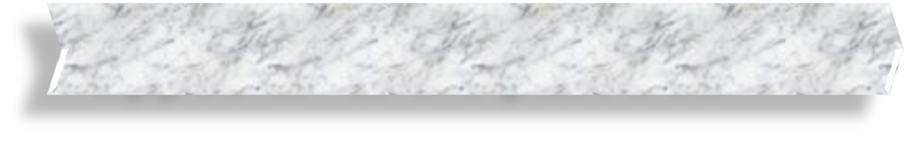
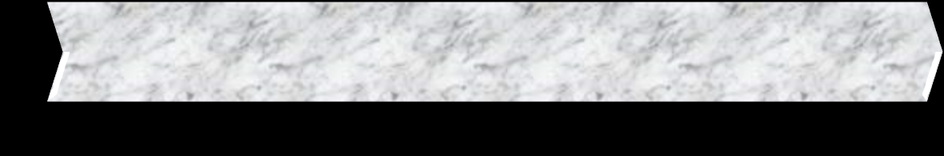

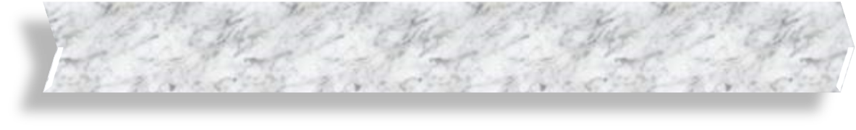

Group Work
Opposite to the past truth
Opposite to the present truth
2
3
Opposite to the future truth
Topic

Slide 19

Appreciate a prose:

Slide 20
Three Days to See
Sometimes I have thought it would be an excellent rule to live each day as if we should die tomorrow. Such an attitude would emphasize sharply the values of life.
我有时想，如果把每天都当作生命的最后一天来过，也许是一条非常好的生活准则。
Notes:
Step2. Presentation

Slide 21
Three Days to See
I have often thought it would be a blessing if each human being were stricken blind and deaf for a few days at some time during his early adult life. Darkness would make him more appreciative of sight; silence would teach him the joys of sound.
我时常想，如果让每个人在成年不久的某个时候瞎几天，聋几天，那将会是一种福气，黑暗让人更加珍惜光明，寂寞会让人明白声音的欢乐。
Notes:
Step2. Presentation

Slide 22
If I were the president of a university I should establish a compulsory course in "How to Use Your Eyes". The professor would try to show his pupils how they could add joy to their lives by really seeing what passes unnoticed before them. He would try to awake their dormant and sluggish faculties.
如果我是一所大学的校长，我将设一门必修课“怎样使用你的眼睛”。教授应当启发他的学生，如果他们能真正看清那些在他们面前不被注意而滑过的事物的话，那么他们的生活就会增加丰富多彩的乐趣。他应当努力唤醒他身上那些处于睡眠状态的、懒散的官能。

Slide 23




Homework

Slide 25

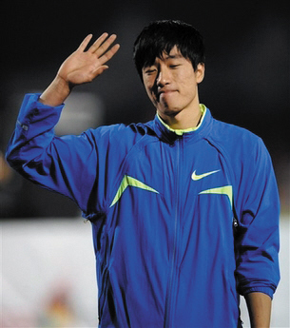
Opposite to the past truth
在2008年北京奥运会上，刘翔由于右脚伤痛 ，遗憾地退出了比赛。
Please use the unreal conditionals to imagine an opposite situation.

Slide 26
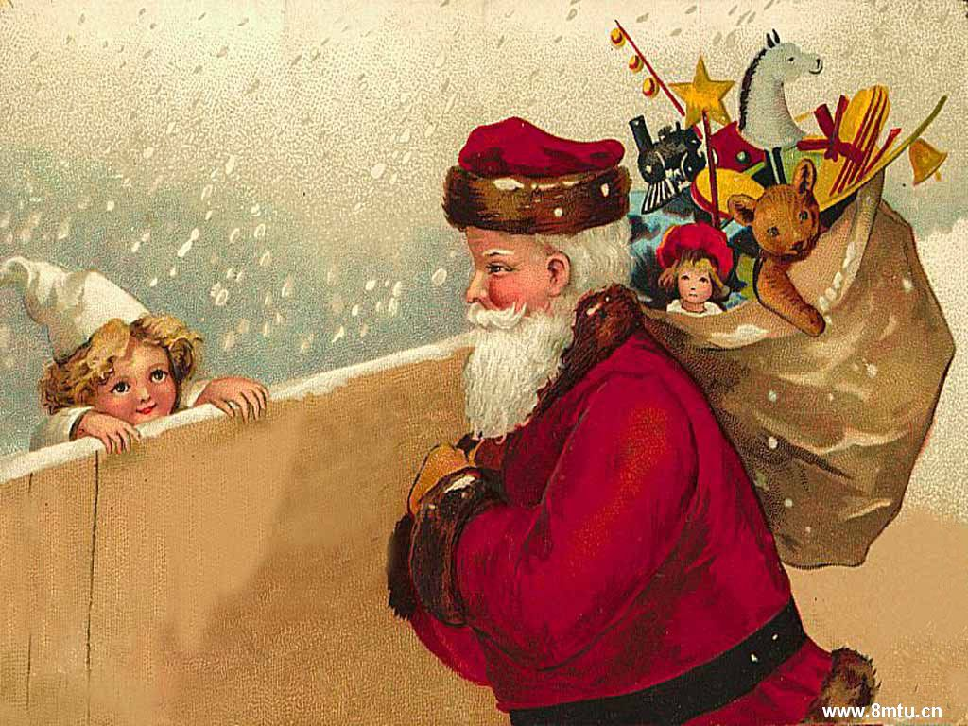
Christmas is coming.
What might/would/could you do if you were Santa Claus ?
Opposite to the present truth

Slide 27
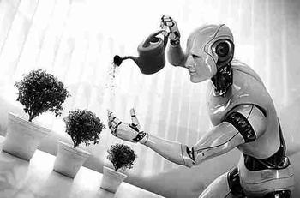
Opposite to the future truth
If you were to live in 2l50, what would the life be like then?

Slide 28
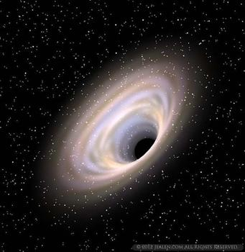
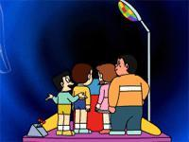
Topic:
If I had a time travel(穿越), I would ……

