Slide 1

英语课标教学课件
选修6

Slide 2
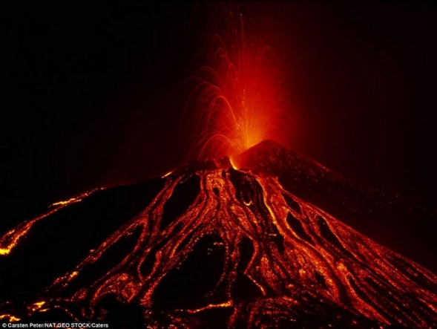
The power of nature
Language points

Slide 3
1. appoint v. 任命; 委派
They appointed him chairman.
他们任命他为主席。
He appointed Williams as his deputy in the city of York.
他任命威廉斯作为他在约克市的代理人。
I have an appointment on Wednesday.
我星期三有个约会。
appointment n. 约会; 预约

Slide 4


Translate the following sentences.
1.我们今年已经任用了3名新教师。
We've appointed three new teachers this year.
2. He's just been appointed (as) director of the publishing division.
他刚刚被任命为出版科科长。

Slide 5
2. burn to the ground 全部烧毁
He has no place to live because his
house has been burnt to the ground.
他无处栖身因为他的房子被烧掉了。
burn away 烧掉
The wood had burnt away to nothing.
木头已烧成灰烬。

Slide 6
burn off 烧掉
He was badly injured in the accident,
and his hair was burnt off.
他在事故中严重受伤，头发也被烧掉了。
burn out 烧坏
The engine had burnt out.
引擎给烧坏了。

Slide 7
Translate the following sentences.
1.这幢建筑10年前被烧毁了。
The building was burned to the ground ten years ago.
2. Running is an excellent way to burn off excess calories.
跑步是消耗多余卡路里的好方法。

Slide 8
3. make one’s way 前往
She hesitated, and made her way
to the gate.
她犹豫了一下，朝大门走去。
She hastily left the room, and made her
way to her bed.
她迅速离开房间，朝她床边走去。

Slide 9
make one’s way 还表示“有出息”
If you want to make your way in the world, you must learn to work hard
while you are still young.
你若想要有出息，趁年轻的时候要学
会发奋。

Slide 10
make way (for) 让路; 让位
All the traffic has to make way for a fire engine.
所有的车辆都得给救火车让道。
I shall make way for a younger man.
我将把职位让给更年轻的人。

Slide 11
Translate the following sentences.
1.天晚了，我们应该马上回家。
It's getting late - we should make our way home soon.
2. Tropical forest is felled to make way for grassland.
热带森林被砍伐，来给草地腾出地方。

Slide 12
Tips for teacher
Let the word fly 板块是帮助学生学习一些一词多义、熟词生义的词汇。通过此环节，学生可以对一些常见词的用法、意思有一个全面的了解。在翻译过程中体会词汇使用的丰富多彩。

Slide 13




Let the word fly
Age does not protect you from love.
But love, to some extent, protects you from age.
~~~- Anais Nin
年龄不会阻止你获得爱情，但爱情在一定程度上使你永远年轻。
protect

Slide 14
试着翻译下面的英文，注意单词protect
的用法。
Protecting wild animals is very important
to us.
When I am in danger, my parents always
do their best to protect me.
对我们来说，保护野生动物是很重要的。
当我遇到危险时，父母总是尽力保护我。
protect及物动词，保卫，保护。后面跟名词或代词作宾语。

Slide 15
The umbrella can protect us from the rain.
We should protect our country against the attack.
伞能保护我们不被雨淋。
我们应该保护我们的国家不被侵犯。
protect … from (against) sth.
保护……不受侵害。且对于较小的事通常
用from，而对于较大的事常用against。

Slide 16
根据所给中文完成句子。
他穿了雨衣以防被雨淋。
He wore a raincoat to _______ himself
______ the rain.
2. 动物是怎样保护自己的？
How do animals _______ __________?
3. 他们挤在一起，免受风吹。
They huddled together to _______
themselves ______ the wind.
protect
from
protect
themselves
protect
from

Slide 17

现学现用
Work in pairs, one of you makes up
sentences with protect in English,
the other makes up sentences in Chinese,
then you exchange and translate them.

Slide 18

课文重难点精析
I was about to go back to sleep when suddenly my bedroom became as bright as day.
我刚要再睡，突然我的卧室亮如白昼。
be about to do sth. … when …
表示“正要做某事，这时……”
Mary was about to go home when the telephone rang.

Slide 19
Translate the following sentences.
1.她正在吃午饭，这时一位老朋友来看她。
She was having lunch when an old friend came to see her.
2. 他正要离开，这时有人敲门。
He was on the point of leaving when someone knocked at the door.

Slide 20




Slide 21

Quiz I: Multiple choice.
After the earthquake, the first thing the local government did was to provide ______ for the homeless families. (2010湖北)
A. occupation B. furniture
C. equipment D. accommodation

Slide 22
Quiz II: Fill in the blanks.
1. Much of the land ________ (at the side
of) the river is below sea level.
2. We're linked to the on-line ________
(数据库) at our head office.
3. We shall need to ________ (judge) how
the new material stands up to wear and
tear.
alongside
database
evaluate

Slide 23
4. I _______ (挥手) to/at him from the
window but he didn't see me.
5. ‘You're wrong,’ she said with ________
(complete) certainty.
6. Corn is grown a lot in this area - the
soil seems to ____ (be right for) it very
well.
7. A number of po______ buyers have
expressed interest in the company.
waved
absolute
suit
potential

Slide 24
Quiz III : Translation.
1. 他最重要的要求是：他想要回家乡。
The most important thing about
____________________________ his demand is that he wants to return to his hometown.
2. 大家让让路。
get out of the way
Please _________________.
3. 整座城市都被烧光了。
burned to the ground
The whole city was _______________
____________.

Slide 25
4. 我永远也忘不了我第一次看见湄公
河的情景。
I shall never forget my first sight of
_______________________________ the Mekong River.
5. 这么多的问题，在这样短的时间内
得到解决，确实不容易。
It was not easy to
_______________ solve so many problems in such a short time.
6. 我们向火车站走去。
made our way to
We _______________ the railway station.

