Slide 1


Using Language

Slide 2

Words preview
topic
mix
mixture
bush
maple
frost
confirm
n. 话题
vt.&vi. 混合；调配
n. 混合（物）；混合状态
n. 灌木（丛）；矮树（丛）
n. 枫；枫树
n. 霜；霜冻
vt. 证实；证明；批准

Slide 3
Words preview
wealthy
distance
mist
misty
schoolmate
booth
downtown
adj. 富有的
n. 距离；远方
n. 薄雾
adj. 有薄雾的；模糊的
n. 同学；校友
n. 公用电话间；售货亭
adj. 市区的
adv. 在市区；往市区

Slide 4
Words preview
approximately
dawn
buffet
broad
nearby
tradition
adv. 接近；大约
n. 黎明；拂晓；破晓
n. 自助餐；饮食柜台
adj. 宽阔的；广泛的
adv. 在附近
adj. 附近的；临近的
n. 传统；风俗

Slide 5
Words preview
terrify
terrified
pleased
impress
impressive
vt. 使恐怖；恐吓
adj. 恐惧的；受恐吓的
adj. 欣喜的；愉快的
vt. 使印象深刻；使铭记
adj. 给人深刻印象的；
感人的

Slide 6
Expressions preview
in the distance
在远处

Slide 7

Listening

Slide 8

Before you listen, read the
incomplete sentences in Exercise
2 on page 37 and guess what the
topic of the listening text is.

Slide 9
Listen to the tape and complete these
sentences with the correct information.
1 Canada encourages people to keep
2 Canada is a mixture of
3 If you live in the province of Quebec,
their own customs.
many cultures and races.
you are expected to speak French.

Slide 10
4 Native Indians and the Inuit are trying to
5 More than languages are used in radio and TV programmers.
6 You may find areas where
live near each other.
7 The families
are usually all mixed up.
keep their languages alive.
80
people from
the same culture
who lived in Canada for
a long time

Slide 11

Listening text
WHAT IS A CAHADIAN?
I am a Canadian and very proud of my country. However, people sometimes don’t know what being Canadian really means. People who come to Canada are encouraged to be proud of their own culture and keep their own and keep their own customs.

Slide 12
Except for the Native Indians, everybody else who lives here came from another country or their ancestors did. Canada is a mixture of many cultures and races. It is what we call a multicultural country.
We have two official languages, French and English. Even though we encourage people to keep their own customs, we expect

Slide 13
everyone to learn French or English
in order to live in Canada. If you live in the province of Quebec, you are expected to speak French. However, the Native Indians and the Inuit of Canada are still trying to keep their languages alive. You can hear some of their languages in the names of rivers and lakes as well as cities. “Canada” means

Slide 14
“village”. Toronto and Ottawa are also Native Indian names. There are radio and television programmes, newspapers and magazines in over 80 different languages across Canada, and the Toronto city government offers help to people in 70 languages.

Slide 15
Many of our big cities have areas where people from the same culture live near each other－there might be a Chinatown, a Little Italy, a Korea Town and so on. However, People whose families have lived in Canada for a long time are usually all mixed up. My own family is a mixture of English, Native Indian and French.

Slide 16
My neighbour’s family is Chinese, German and African!
When I say that I am proud to be a Canadian, maybe you can help me decide what a Canadian is.

Slide 17
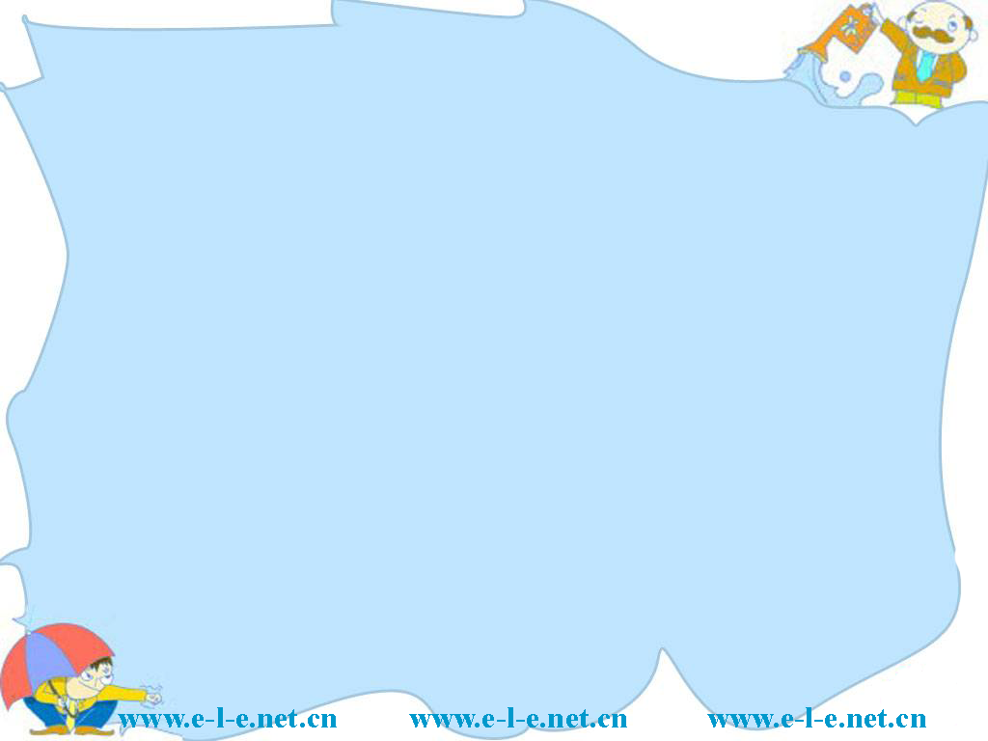
Reading
“THE TRUE NORTH” FROM TORONTO TO MONTREAL

Slide 18

Answer the following questions
after reading the passage.
1 What can sometimes be seen from the CN Tower in Toronto?
2 Why is there good Cantonese food in Toronto?
3 Which direction is the train going from Toronto?
4 What three things show that Montreal
is a French city?

Slide 19
Suggested answer:
1 Sometimes the misty cloud that rises from Niagara Falls can be seen from the CN Tower.
2 There is good Cantonese food in Toronto because most of the Chinese people there came from South China, especially Hong Kong.

Slide 20
3 The train is going east from Toronto.
4 Good coffee, good bread and good music show that Montreal is a French city. Also the signs and ads are in French.

Slide 21
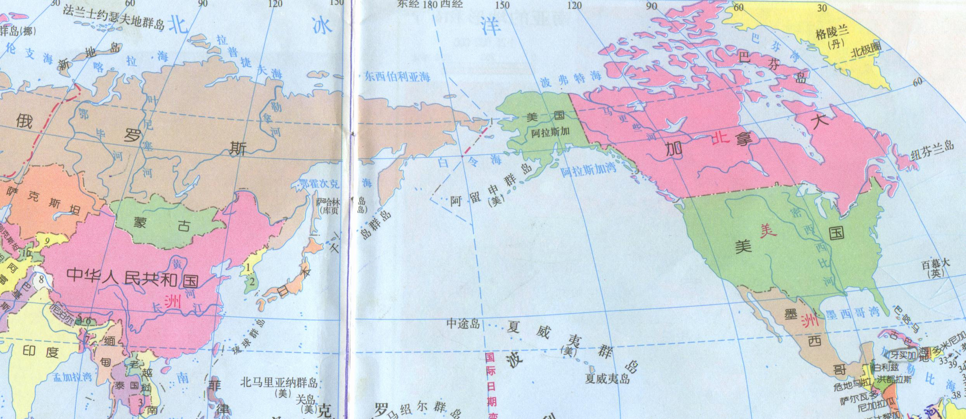
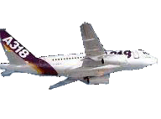
Draw the traveling route of the
two girls.

Slide 22
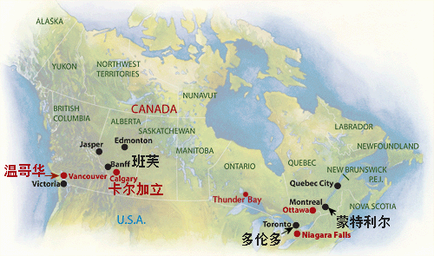
Vancouver
Calgary
Thunder Bay
Toronto

Slide 23
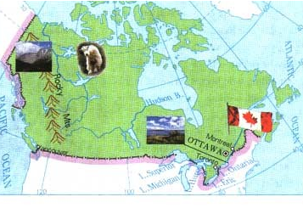
Rocky Mountains
.
.
.
Calgary
.
.
Thunder Bay
Vancouver
Toronto
Lake Superior

Slide 24

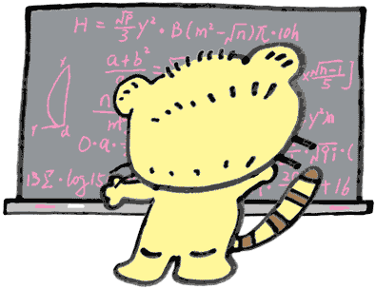
Discussion
Do you think these sentences are
true or false？
1、“The True North” is the train which
goes across Canada.
2、Li Daiyu and her cousin Liu Qian are
crossing South America.
T
F

Slide 25

Writing

Slide 26

Write a short report about the two or three most impressive things during the trip across Canada. Be sure that your report has:
1 title
2 a short paragraph to introduce your
report’s topic
3 a paragraph for each impressive thing
you are presenting
4 a short conclusion

Slide 27

Language points
1 The next morning the bushes and maple trees outside their windows were red, gold and orange, and there was frost on the ground, confirming that fall had arrived in Canada.
bush n. 灌木（丛）；矮树（丛）
maple n. 枫；枫树
frost n. 霜；霜冻

Slide 28
confirm vt. 证实；证明；批准
The news confirmed my resolution.
这消息加强了我的决心。
He looked around to confirm that he
was alone.
他四处张望，要确定周围没人。
confirmation: n. 确认
Your news was really confirmation for
my beliefs.
你带来的消息证实了我的信念。

Slide 29
2 In the distance, they could see the misty cloud that rose from the great Niagara Falls, which is on the south side of the lake.
distance n. 距离；远方
My house is four miles distance from the
sea.
我家离海四英里。
We can see the mountain from the
distance.
我们从远处就可以看到那座山。

Slide 30
in the distance 在远处
We can see a windmill in the distance.
我们可以望见远处有架风车。
A lighthouse was flashing in the distance.
灯塔在远处发出闪烁的光。

Slide 31
3 I’m a student at the university nearby.
nearby
a. 附近
He roped his horse on a nearby tree.
他把马拴到附近的一棵树上。
ad. 在附近
It happened that there was a telephone
booth nearby.
碰巧在附近有个公用电话亭。

Slide 32
4 Most of us speak both English and French, but the city has French culture and traditions.
tradition: n. 传统, 风俗
We shall carry forward the revolutionary
tradition.
我们应该发扬革命传统。
The old man told us a story passed on by
oral tradition.
老人给我们讲述了一个口头流传的故事。

Slide 33

Homework
1、Retell the text using
100 words.
2、Read the text aloud
after class.

Slide 34

Thank you.

