Slide 1

Writing

Slide 2


Write a report for Li Daiyu or Liu Qian.
Sample:
Li Daiyu’s report
What we saw in Canada
My cousin and I traveled across Canada by train from west to east. We saw many things from the train on the way across,

Slide 3
and in the cities of Toronto and Montreal. Some of the most important and interesting things that we saw are included in this report.
We passed through the Rocky Mountains on the train, and saw wild scenery, a grizzly bear and some mountain goats.

Slide 4
Canada is a wheat-growing area. The city of Thunder Bay is a port in the center of Canada. Ocean ships can come all the way to the top of the Great Lakes.
In Toronto, we went up the CN Tower and saw the mist from

Slide 5
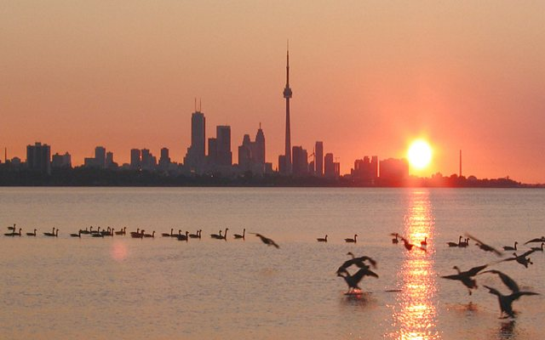

Slide 6
Niagara Falls. We visited the covered stadium, which is the home of the famous basketball team. We saw Chinatown and had dinner at the Pink Pearl restaurant.
When we arrived in Montreal the next day, we saw many signs and ads in French. Then we went to Old

Slide 7
Montreal and sat in a typical café beside the St Lawrence River. We spent the afternoon in shops and visiting the artists in their workplace.
There is so much things to see and do in Canada on one trip. We saw only a few things, but we think we would like to go back for another visit.

Slide 8
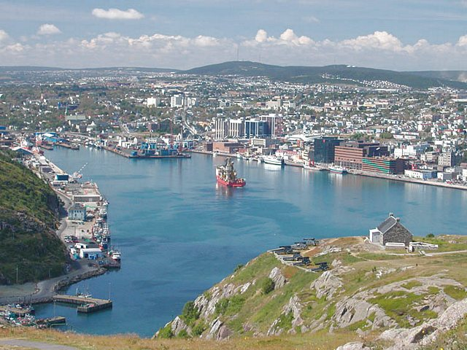

Slide 9
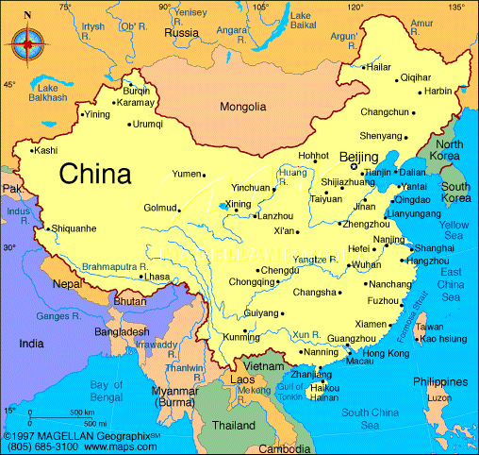
Writing Task on Page75

Slide 10


Sample Tour Plan
Day one: Arrive in Yichang, the city of the Three Gorges Dam project.
Check into the hotel in the morning and have lunch. In the afternoon go out to see the sights around Yiling Square. In the evening, watch the dancing out on the square, among the fountains and lights.

Slide 11
Day two: Take the two-day boat tour up the Changjiang River to see the Three Gorges Dam. See the beautiful scenery along the way.
Day three: Arrive back from the boat tour in the evening. Walk down to the night market and enjoy eating some of Yichang’s special food sold by the street vendors.

Slide 12

Homework
1. Write a passage. Introduce our hometown to the visitors. In what direction is it of the capital of our province? What can a visitor see and hear in our hometown?
2. Finish summing up on Page 40 after class.

Slide 13

Thank you.

